Slide 1

The Clinical Pharmacogenetics Implementation Consortium: Incorporating Pharmacogenetics into Clinical Practice and the EHR

Slide 2
Learning Objectives
After completing this activity, the learner should be able to…
Describe barriers to clinical implementation of pharmacogenetics.
Describe CPIC and the underlying assumptions of CPIC guidelines.
Explain the CPIC guideline development process.
Illustrate how CPIC guidelines can be used by clinicians to make specific prescribing decisions for patient care when genetic information is available.
Illustrate how CPIC guidelines can be used to aid the clinical implementation of pharmacogenomics into the electronic health record with clinical decision support.

Slide 3

PGRN Vision and Mission
The mission of the Pharmacogenomics Research Network (PGRN) is to catalyze and lead research in precision medicine for the discovery and translation of genomic variation influencing therapeutic and adverse drug effects.

Slide 4
Survey: Challenges to implementing pharmacogenetics in the clinic
What do you think is the most challenging aspect of the implementation of pharmacogenetics into the clinic?
Translation of genetic information into clinical action
Test cost, test reimbursement or other economic issues
Availability of high quality genotyping test (CLIA approved)
Electronic medical record use, such as the application of CDS
Clinician and patient resistance and/or ethical concerns
Clin Pharmacol Ther. 2011 Mar;89(3):464-7.

Slide 5
Survey: top 3 Challenges to implementing pharmacogenetics in the clinic
95% of respondents selected: “process required to translate genetic information into clinical actions”
Next 2 responses
Genotype test interpretation (e.g. using genotype information to impute phenotype)
Providing recommendations for selecting the drug/gene pairs to implement
Clin Pharmacol Ther. 2011 Mar;89(3):464-7.

Slide 6
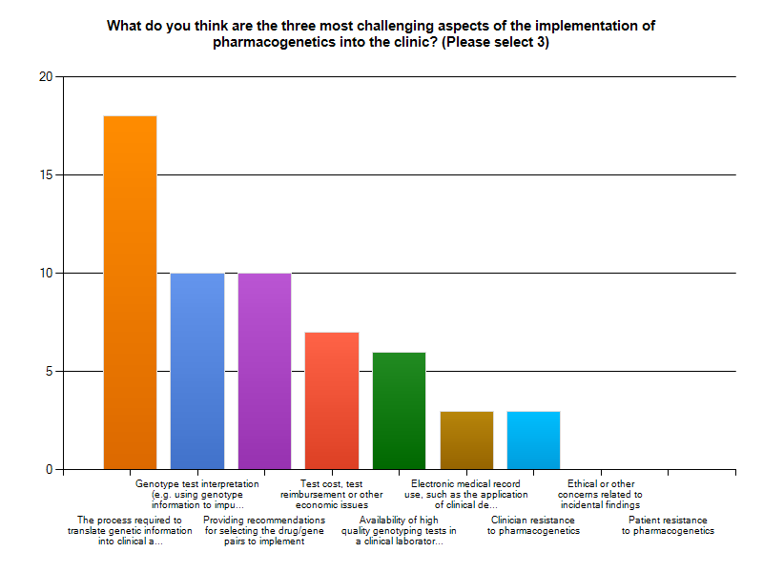
Clin Pharmacol Ther. 2011 Mar;89(3):464-7.

Slide 7
Key Points about a CPIC guideline
Based on assumption that the test results are in hand and NOT to discuss the merits of doing the test
Standardized formats
Grading of evidence and of recommendations
Peer reviewed
Freely available
Updated
Authorship with COI policy
Closely follow IOM practices

Slide 8
CPIC guidelines are designed to help clinicians understand HOW available genetic test results should be used to optimize drug therapy.
Not WHETHER tests should be ordered.
Key Assumption:
Clinical high-throughput and pre-emptive genotyping will become more widespread.
Clinicians will be faced with having patients’ genotypes available even if they did not order test with drug in mind.

Slide 9
As of March 2017:
206 Members
Clinicians and scientists
141 institutions
23 countries
10 Observers (NIH and FDA)
CPIC Informatics
>25 members from 22 organizations
Notes:
89 in 2013
42 institutions

Slide 10
2011
TPMT – thiopurines
Updated March 2013
Update underway-including NUDT15
CYP2C19 – clopidogrel
Updated Sept 2013
CYP2C9, VKORC1 – warfarin
ACCEPTED
2012
CYP2D6 – codeine
Updated Apr 2014
HLA-B – abacavir
Updated Feb 2014
SLCO1B1 – simvastatin
Updated Oct 2014
2013
HLA-B – allopurinol
Updated July 2015
CYP2D6, CYP2C19 – TCAs
Updated December 2016
HLA-B – carbamazepine
Update in progress
DPYD -- 5FU / capecitabine
Update in progress
2014
IL28B -- PEG interferon α
CFTR -- Ivacaftor
G6PD -- Rasburicase
CYP2C9, HLA-B -- Phenytoin
2015
CYP3A5 – tacrolimus
CYP2D6, CYP2C19– SSRIs
UGT1A1 – atazanavir
2016
CYP2C19 – voriconazole
CYP2D6 – ondansetron
Guidelines in progress
CYP2D6 – tamoxifen
RYR1– inhaled anesthetics
CYP2B6--efavirenz
Notes:
Kelly to update this slide closer to the meeting

Slide 11
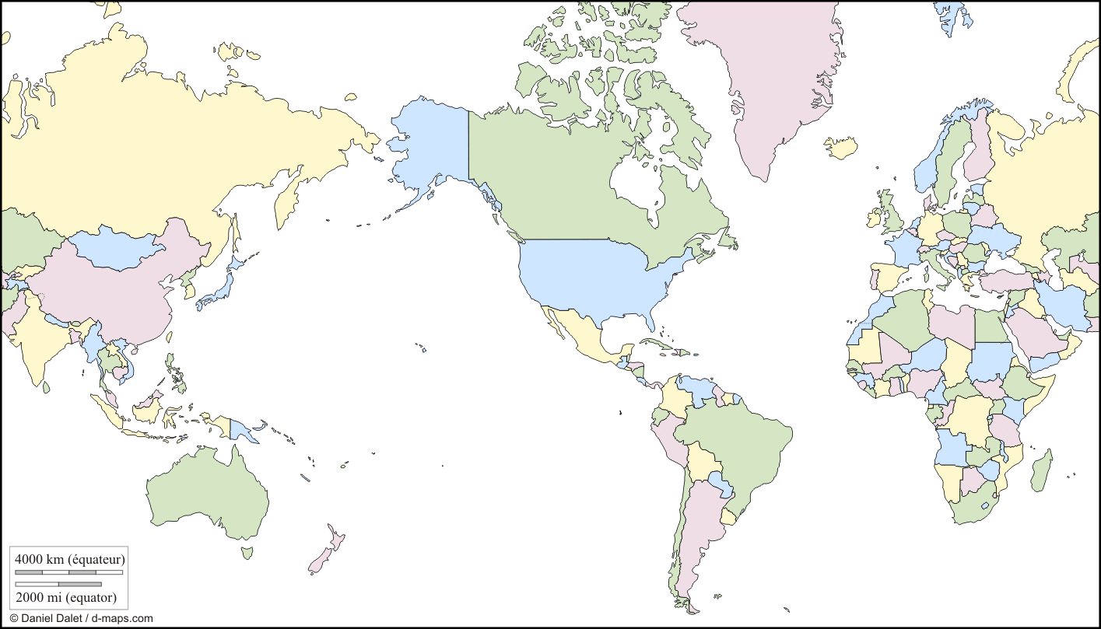
2017 >200 members
Academic, Hospital, Health Care Systems
Industry

Slide 12
CPIC guideline genes (n=16) and drugs, March 2017
TPMT
MP, TG, azathioprine
CYP2D6
Codeine, tramadol, hydrocodone, oxycodone, TCAs, tamoxifen (in progress), SSRIs, ondansetron, tropisetron
CYP2C19
TCAs, clopidogrel, voriconazole, SSRIs
VKORC1
Warfarin
CYP2C9
Warfarin, phenytoin
CYP4F2
Warfarin
HLA-B
Allopurinol, CBZ, abacavir, phenytoin
CFTR
Ivacaftor
DPYD
5FU, capecitabine, tegafur
G6PD
Rasburicase
UGT1A1
Atazanavir
SLCO1B1
Simvastatin
IFNL3 (IL28B)
Interferon
CYP3A5
Tacrolimus
CYP2B6
Efavirinz (in progress)
RYR1
Inhaled anesthetics (in progress)
https://cpicpgx.org/guidelines/

Slide 13
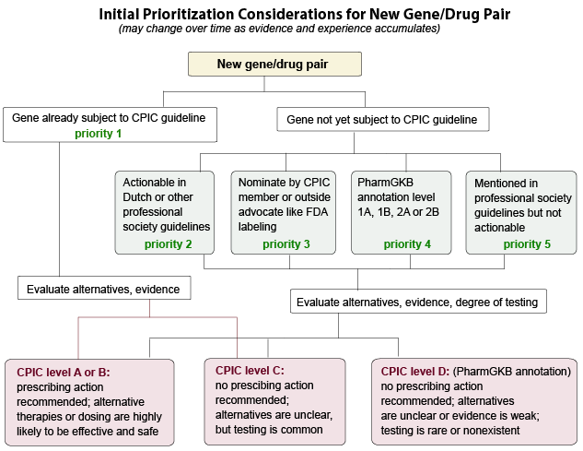
Initial Prioritization Considerations for New Gene/Drug Groups
New genes/drugs

Slide 14
Level Definitions for CPIC Genes/Drugs
CPIC Level | Clinical Context | Level of evidence | Strength of Recommendation
A | Genetic information should be used to change prescribing of affected drug | Preponderance of evidence is high or moderate in favor of changing prescribing | At least one moderate or strong action (change in prescribing) recommended.
B | Genetic information could be used to change prescribing of the affected drug because alternative therapies/dosing are extremely likely to be as effective and as safe as non-genetically based dosing | Preponderance of evidence is weak with little conflicting data | At least one optional action (change in prescribing) is recommended.
C | There are published studies at varying levels of evidence, some with mechanistic rationale, but no prescribing actions are recommended because (a) dosing based on genetics convincingly makes no difference or (b) alternatives are unclear, possibly less effective, more toxic, or otherwise impractical. Most important for genes that are subject of other CPIC guidelines or genes that are commonly included in clinical or DTC tests. | Evidence levels can vary | No prescribing actions are recommended.
D | There are few published studies, clinical actions are unclear, little mechanistic basis, mostly weak evidence, or substantial conflicting data. If the genes are not widely tested for clinically, evaluations are not needed. | Evidence levels can vary | No prescribing actions are recommended.

Slide 15
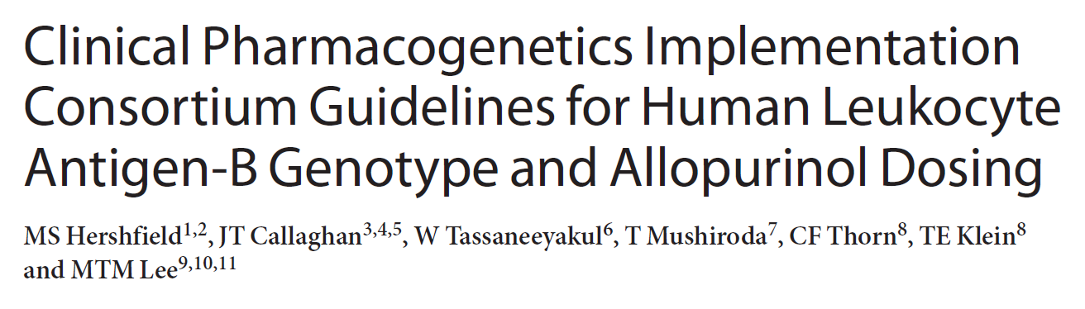
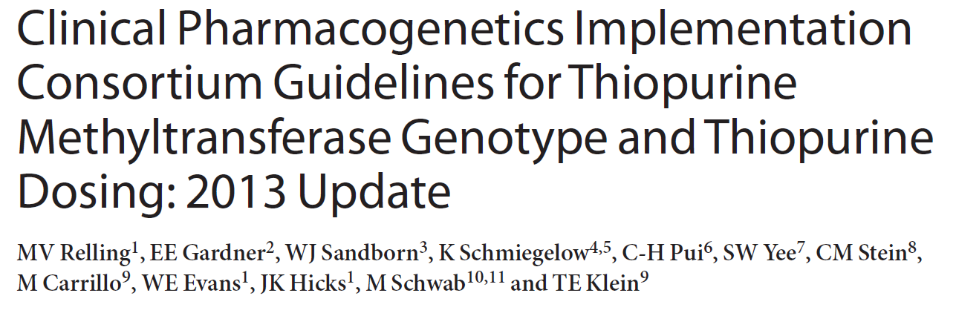
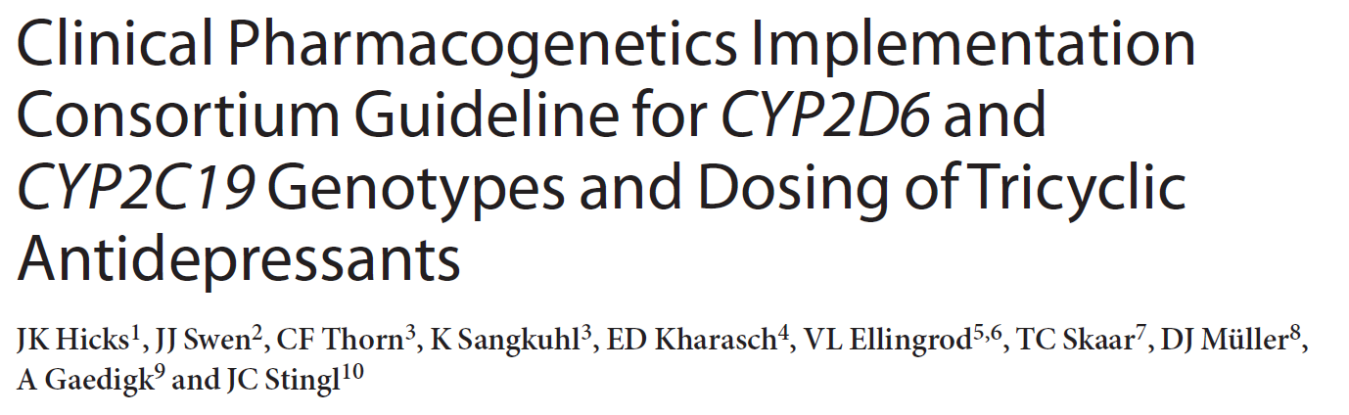
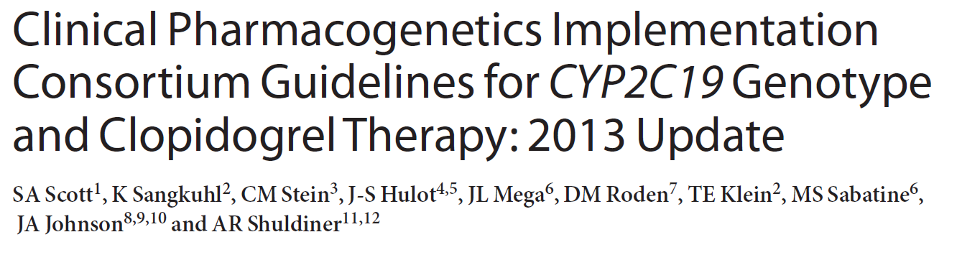
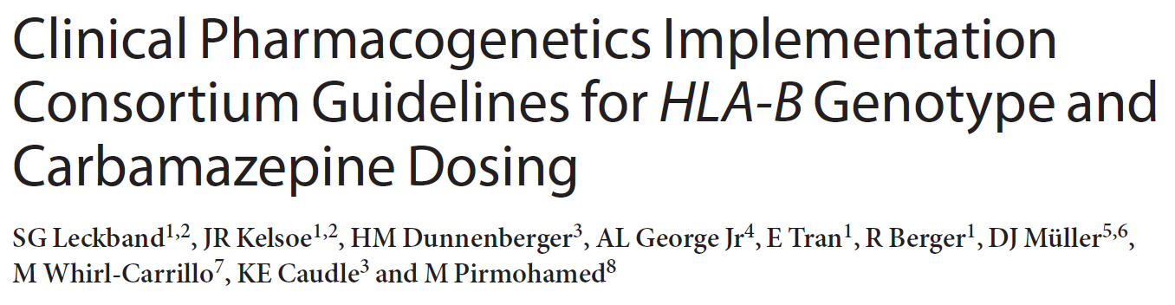
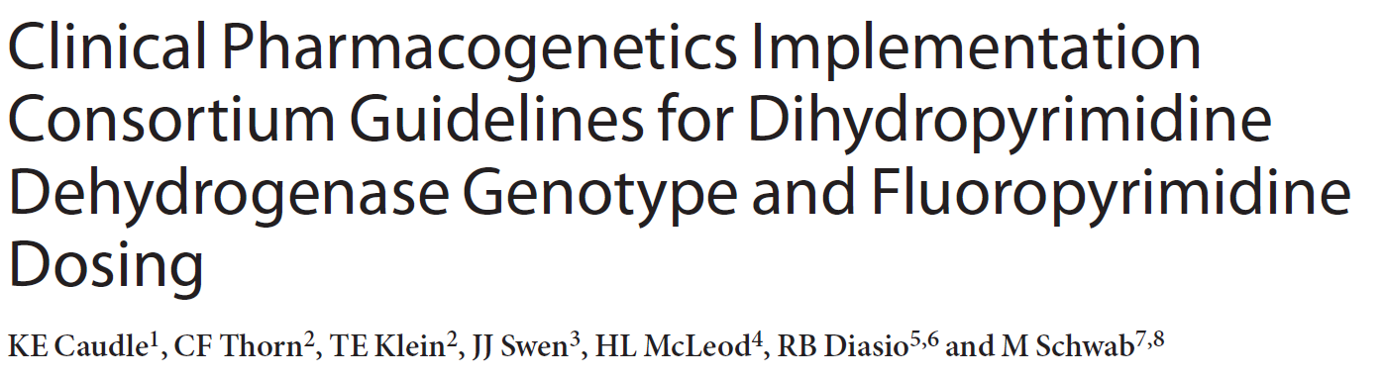
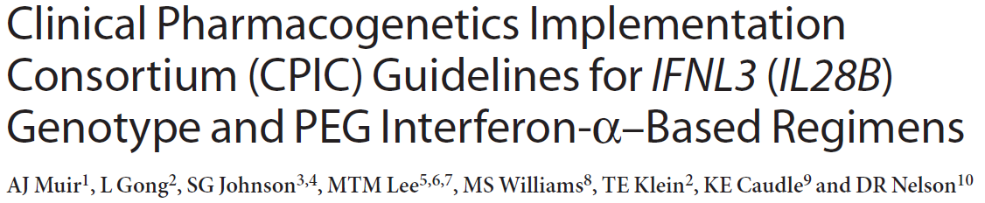
Clin Pharmacol Ther. 2013 Feb;93(2):153-8
Clin Pharmacol Ther. 2013 Apr;93(4):324-5.
Clin Pharmacol Ther. 2013 May;93(5):402-8.
Clin Pharmacol Ther. 2013 Sep;94(3):317-23
Clin Pharmacol Ther. 2013 Sep;94(3):324-8.
Clin Pharmacol Ther. 2013 Aug 29. Epub
Clin Pharmacol Ther. 2014 Feb;95(2):141-6.

Slide 16
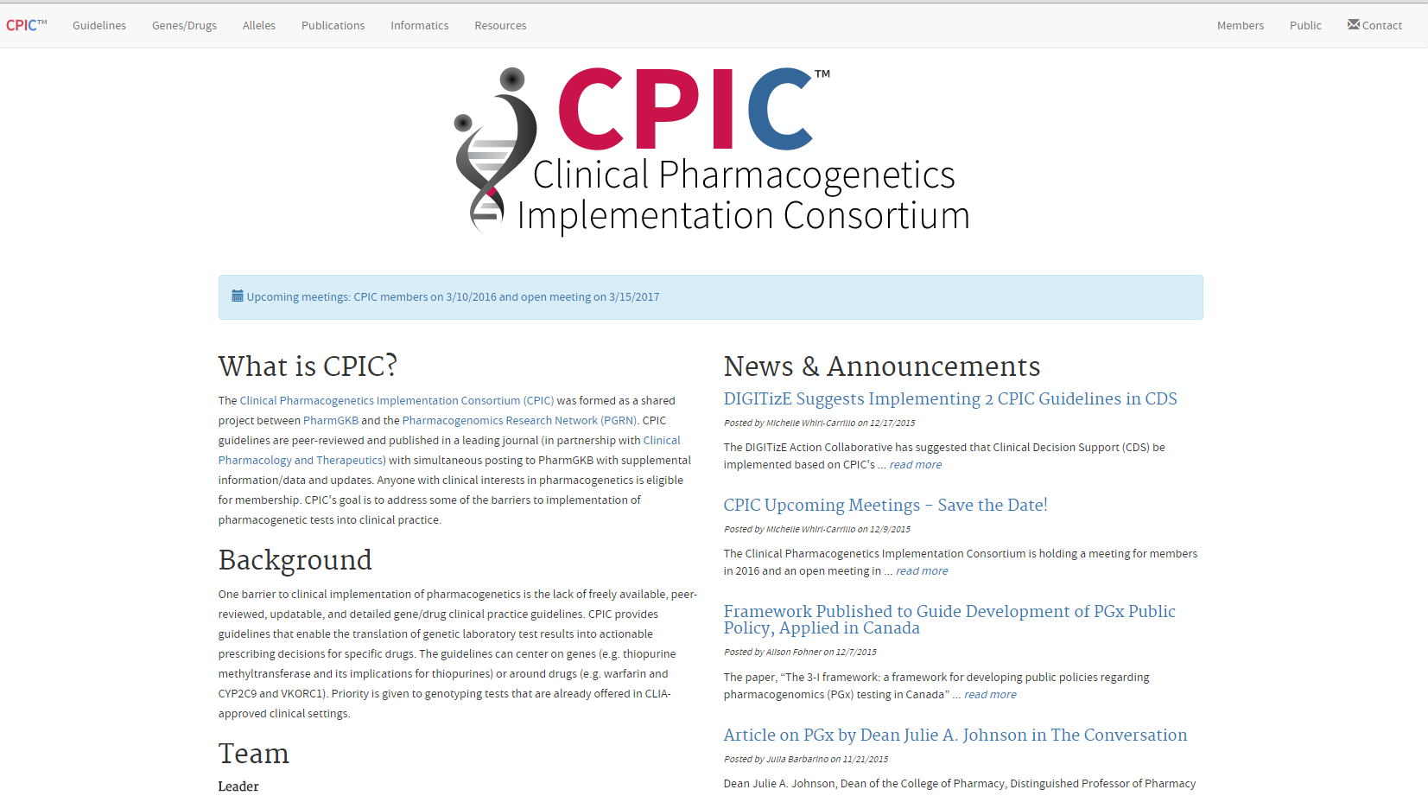
CPIC website: www.cpicpgx.org
CPIC guidelines and list of CPIC genes/drugs
CPIC announcements
CPIC information

Slide 17
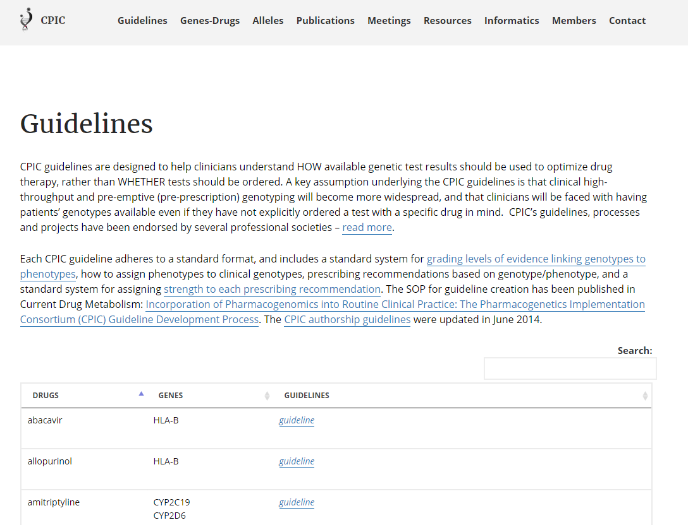
Link to guideline page

Slide 18
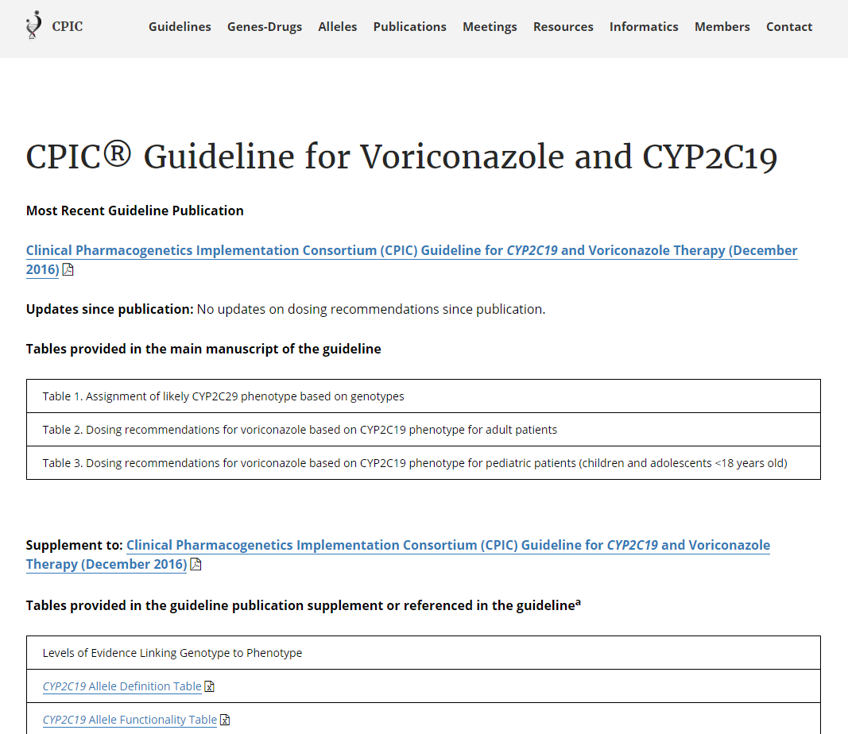

Slide 19
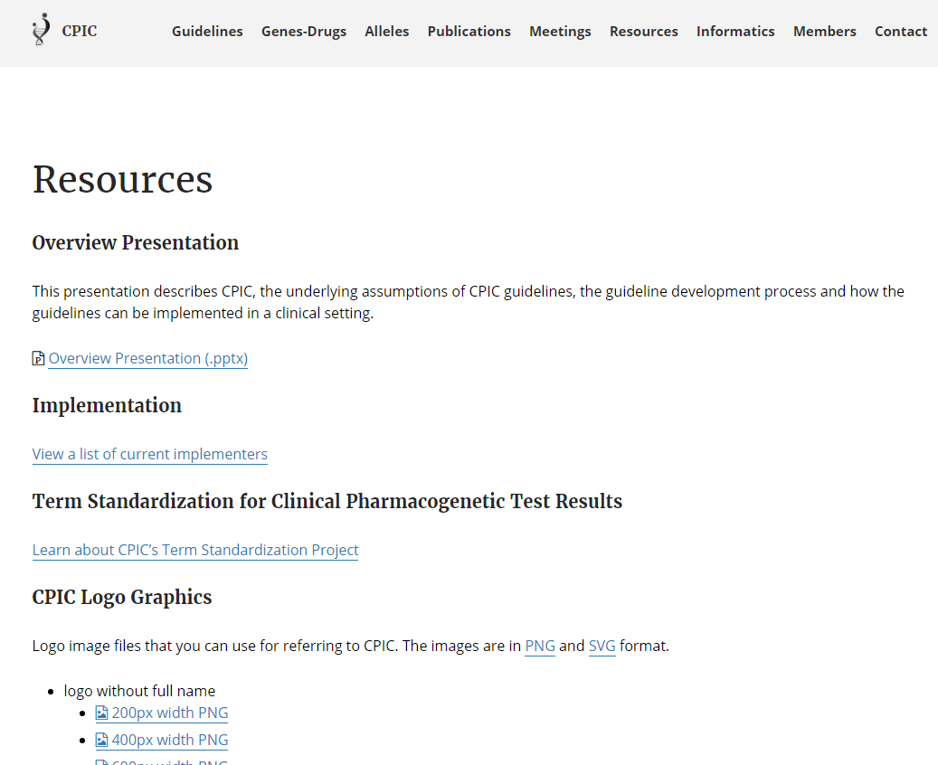
CPIC slides
CPIC projects
CPIC logo

Slide 20
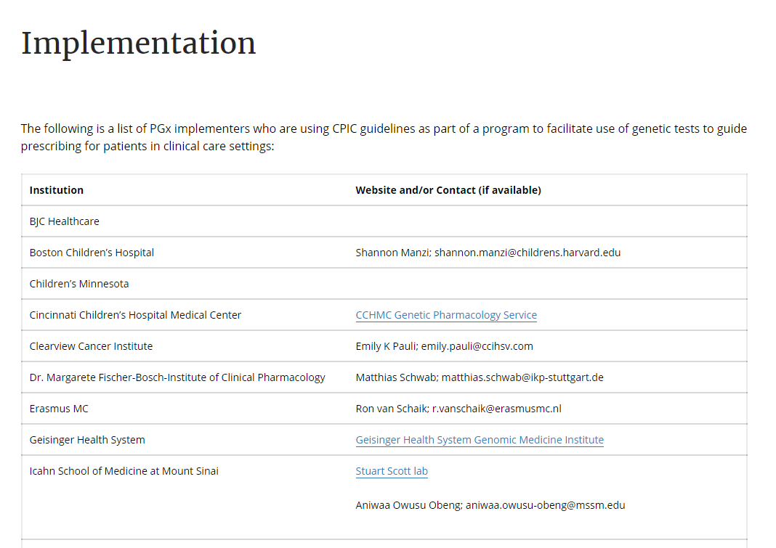
https://cpicpgx.org/implementation/

Slide 21
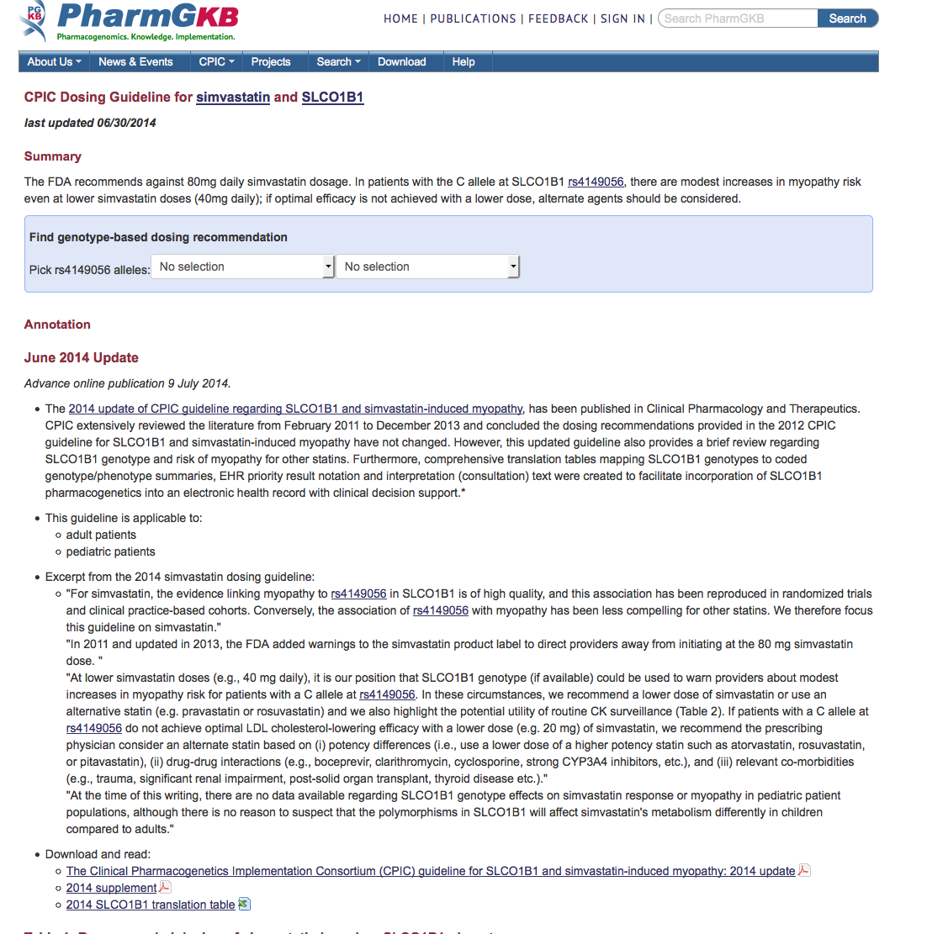
CPIC guidelines are posted on PharmGKB (www.pharmgkb.org)

Slide 22
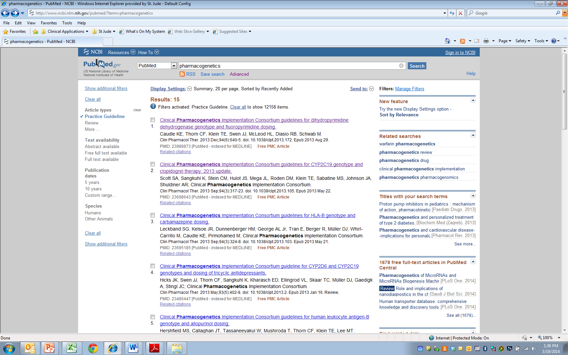
CPIC guidelines linked to “Practice Guideline” filter on PubMed

Slide 23
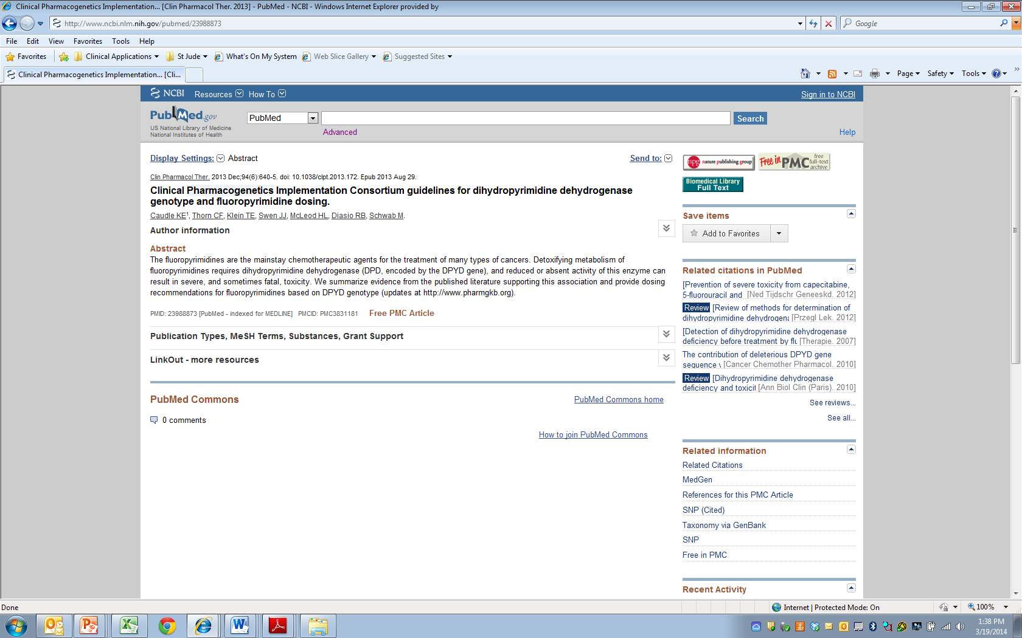

Slide 24
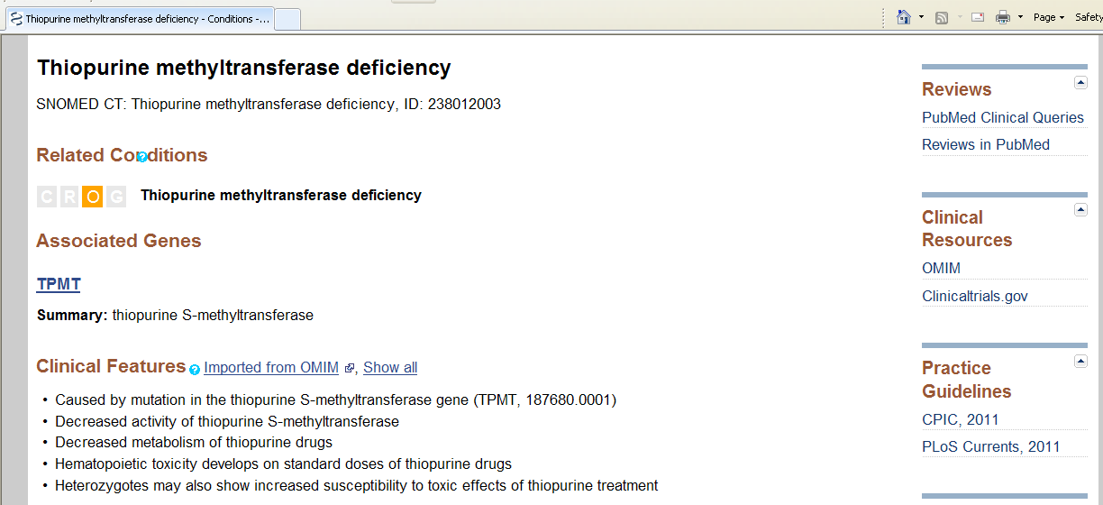
CPIC is cited in NIH’s Genetic Test Registry (GTR) for clinical pharmacogenetic tests

Slide 25
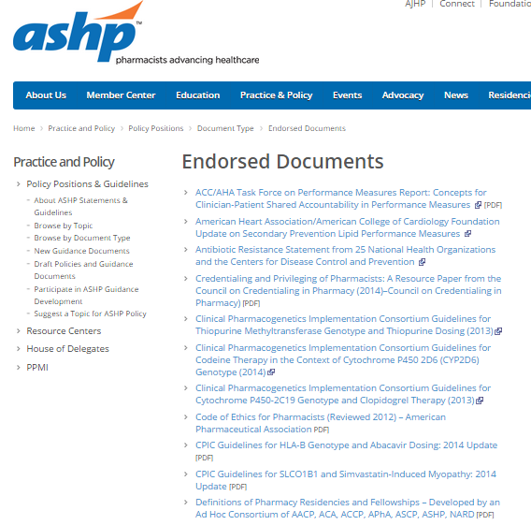
ASHP is endorsing CPIC guidelines

Slide 26
External interactions with other groups
Endorsement by professional societies
ASCPT, ASHP
Continue interactions with www.guidelines.gov, NIH’s GTR, PubMed, FDA, NHGRI’s Genomic Medicine Working Group, IOM’s Genomic Medicine Roundtable, DIGITiZE, PGRN, AMIA, and eMERGE
Grow interactions with ClinGen/ClinVar

Slide 27
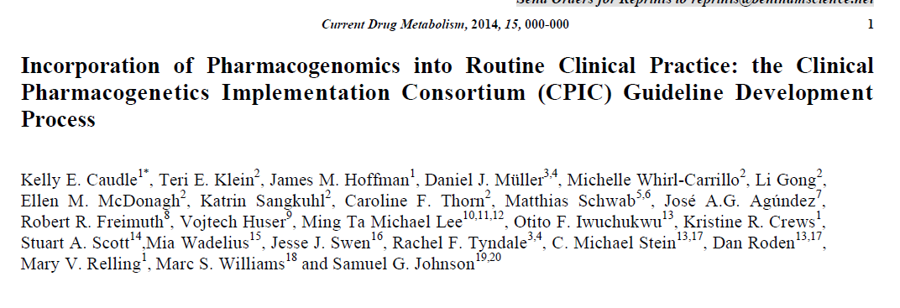
Purpose:
To describe the development process of the CPIC guidelines
To compare our process to the Institute of Medicine’s Standards for Developing Trustworthy Clinical Practice Guidelines

Slide 28


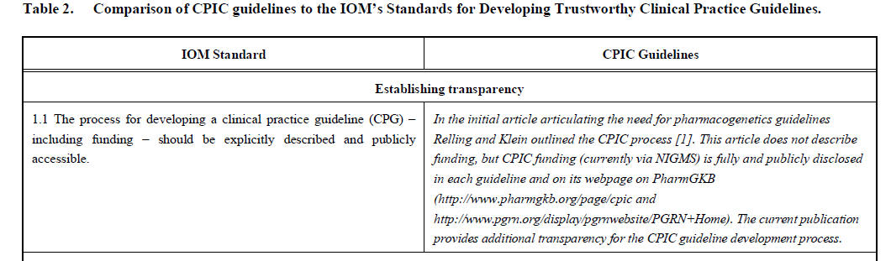
Caudle et al, Current Drug Metab 2014

Slide 29
Uniform Elements of CPIC Guidelines (Main)
Introduction
Focused Literature Review
Gene:
Background
Genetic Test Interpretation
Table 1. Assignment of likely _____ [gene] phenotypes based on genotypes
Available Genetic Test Options
Incidental findings
Other considerations

Slide 30
Uniform Elements of CPIC Guidelines (Main)
Drug (s):
Background
linking genetic variability to variability in drug-related phenotypes
Dosage Recommendations
Table 2. Recommended Dosing of ____ [drug/s] by ____ [gene] phenotype
Strength of recommendations grading system
Recommendations for Incidental Findings
Other considerations
Potential Benefits and Risks for the Patient
Caveats: Appropriate Use and/or Potential Misuse of Genetic Tests

Slide 31
Uniform Elements of CPIC Guidelines (Supplement)
Literature Review details
Genetic Test Interpretation
Available Genetic Test Options
Supplemental Table . Genotypes that constitute the * alleles for ______
Supplemental Table . Association between allelic variants and _____ [gene function]
Supplemental Table . Frequencies of alleles in major race/ethnic groups
Supplemental Table . Evidence linking genotype with phenotype
Levels of Evidence grading system
Resources to facilitate incorporation of pharmacogenetics into an electronic health record with clinical decision support (CDS) (workflow diagrams and example CDS alerts and consults)

Slide 32
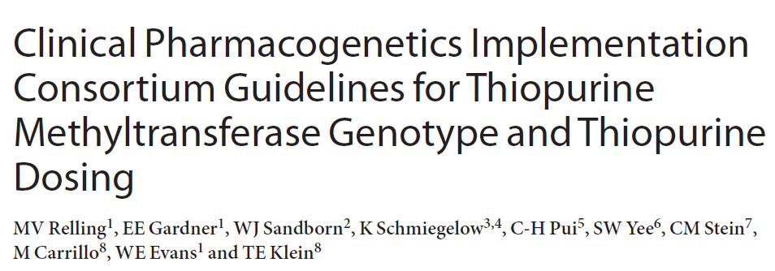
Clin Pharmacol Ther. 2011 89:387-91

Slide 33
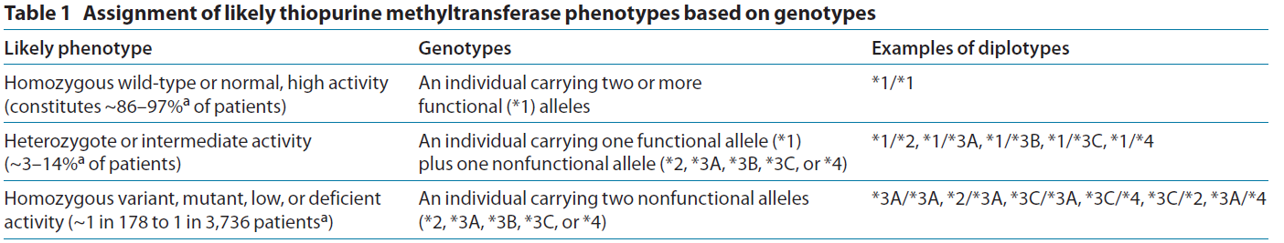
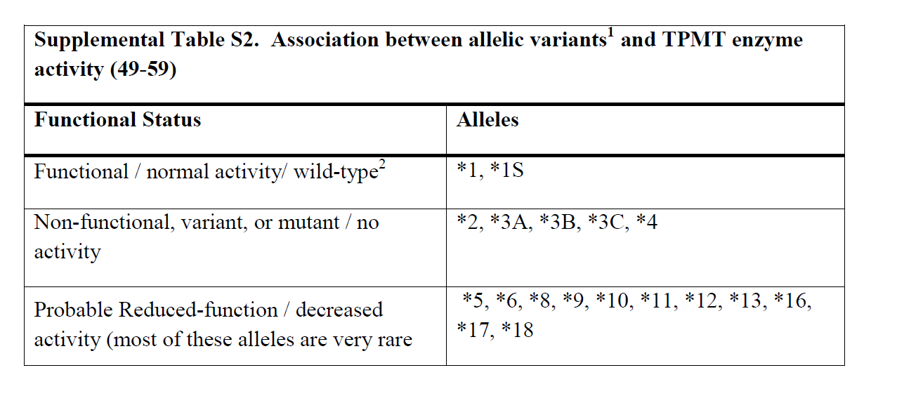
Linking genotype to phenotype
Clin Pharmacol Ther. 2011 Mar;89(3):387-91.

Slide 34
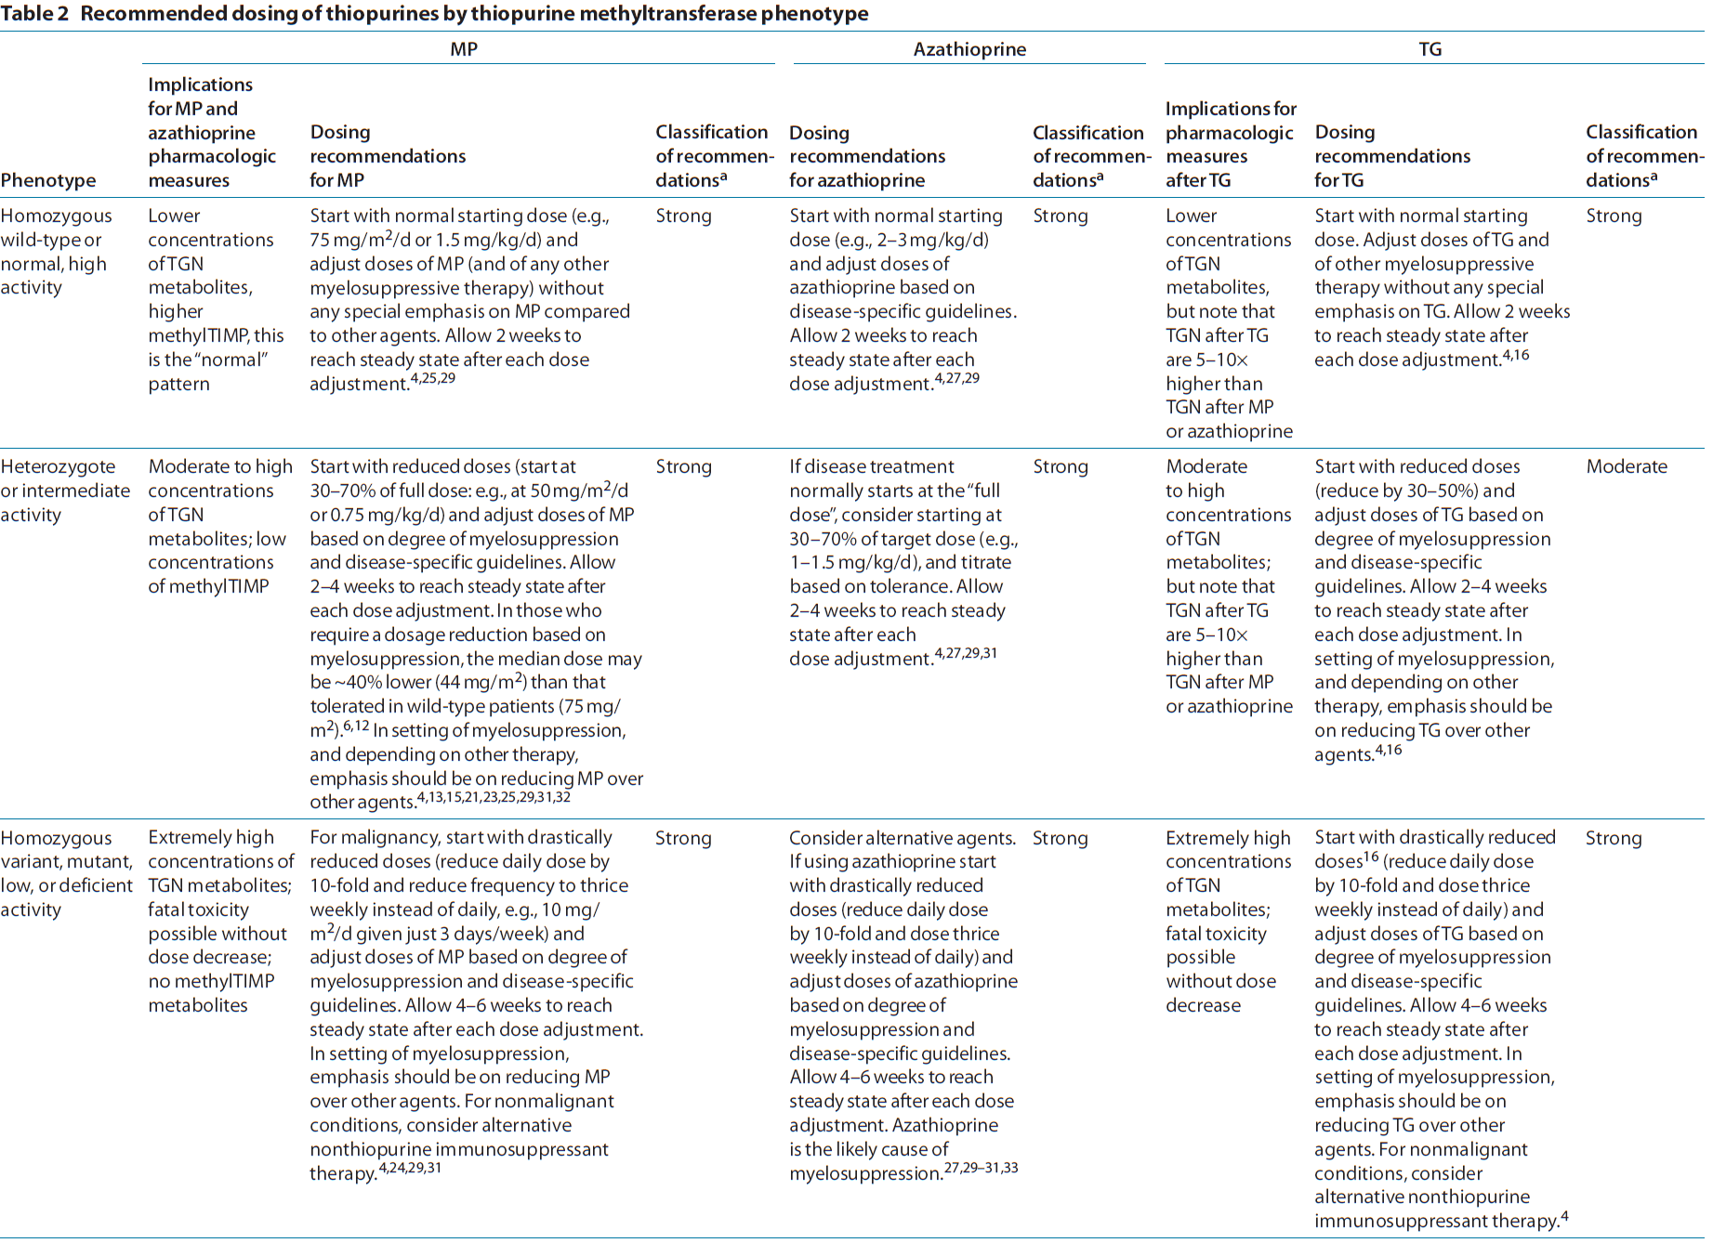

Slide 35
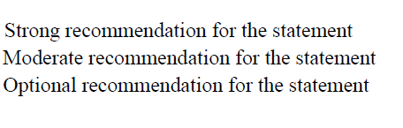

Dosing recommendations: strength based on evidence

Slide 36
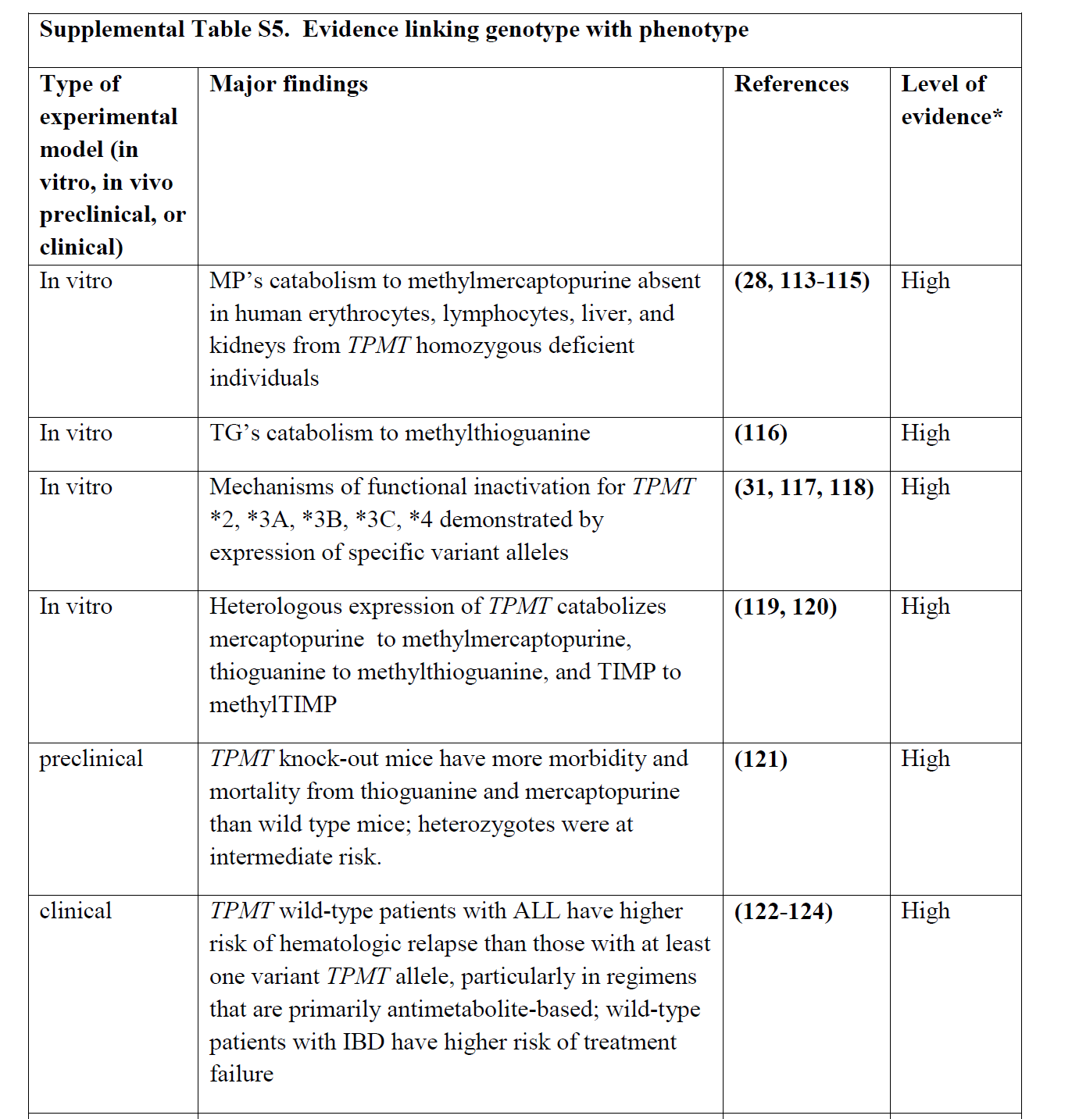
High: Evidence includes consistent results from well-designed, well-conducted studies.
Moderate: Evidence is sufficient to determine effects, but the strength of the evidence is limited by the number, quality, or consistency of the individual studies; generalizability to routine practice; or indirect nature of the evidence.
Weak: Evidence is insufficient to assess the effects on health outcomes because of limited number or power of studies, important flaws in their design or conduct, gaps in the chain of evidence, or lack of information

Slide 37
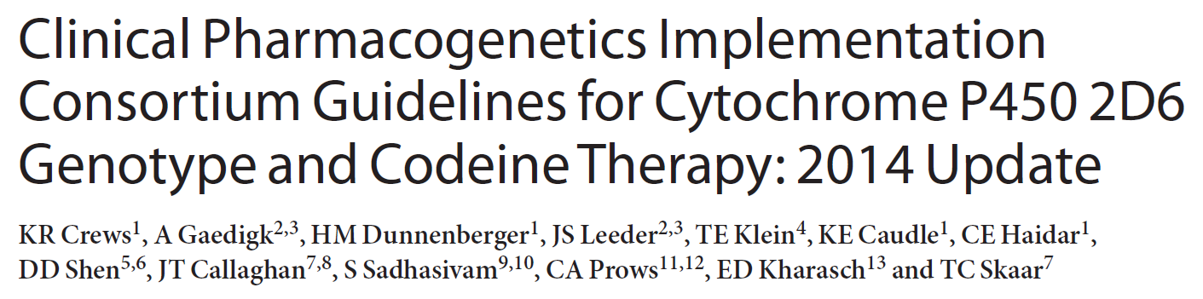
Clin Pharmacol Ther. 2014 Apr;95(4):376-82

Slide 38
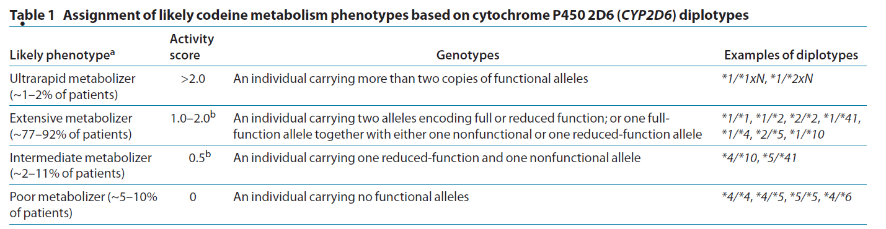
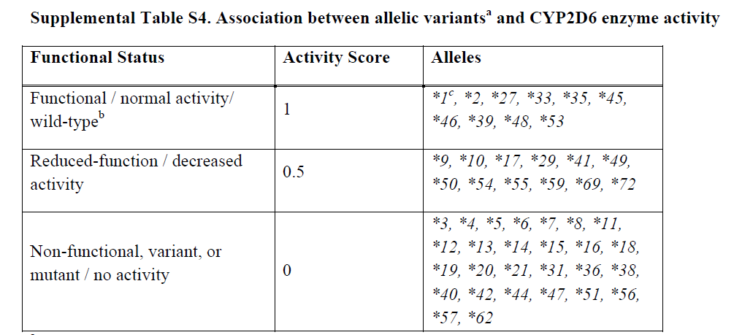
Clin Pharmacol Ther. 2014 Apr;95(4):376-82

Slide 39
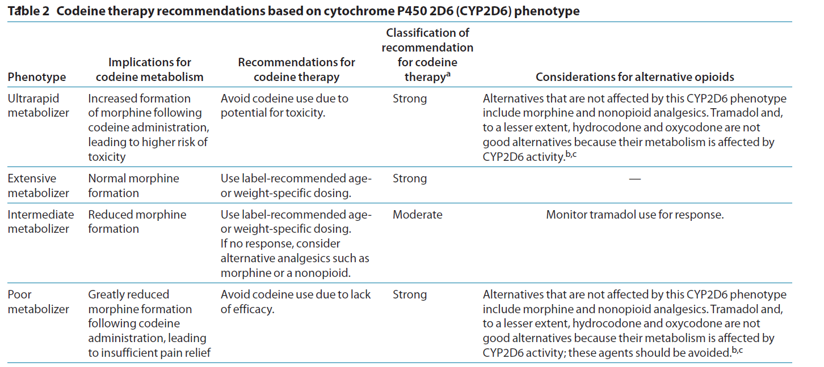

Slide 40
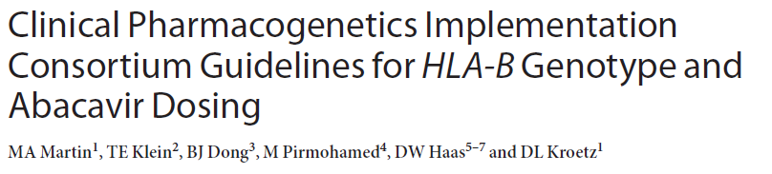
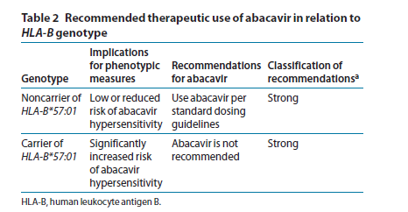
Clin Pharmacol Ther. 2012 Apr;91(4):734-8.

Slide 41
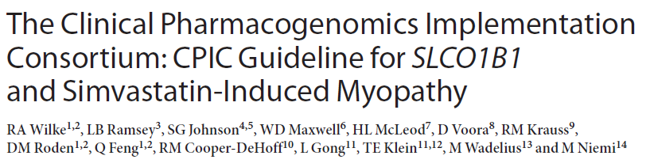
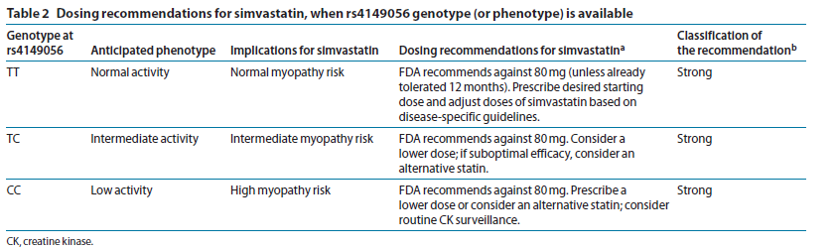
Clin Pharmacol Ther. 2012 Jul;92(1):112-7.

Slide 42
CPIC Guidelines Updates
CPIC guidelines are evaluated on an ongoing basis and updated regularly
No change: Update with date reviewed documented on pharmgkb.org.
Update to publications:
New publication with re-publishing main dosing tables
Changes as needed to supplemental material and website.
Update to pharmgkb.org website: as needed, without waiting for updated publication

Slide 43

How can CPIC accelerate the clinical implementation of pharmacogenetics into EHRs with CDS?
Publish and maintain authoritative translation tables
Genotype/Diplotype
Phenotype
Recommendation

Slide 44
CPIC Informatics Working Group
Growing interest in informatics aspects of CPIC guidelines and clinical implementation of pharmacogenetics
Working group is a forum for discussion and collaboration focused on informatics issues
Goal
To support the adoption of the CPIC guidelines by identifying, and resolving where possible, potential technical barriers to the implementation of the guidelines within a clinical electronic environment.

Slide 45
CPIC Informatics Working Group: Initial Focus
Create comprehensive translation tables from genotype to phenotype to clinical recommendation for CPIC guidelines
Define structure and process to efficiently develop and maintain in the most useful format(s)
Publish as part of CPIC guidelines and post on PharmGKB
Genotype/Diplotype
Phenotype
Recommendation

Slide 46
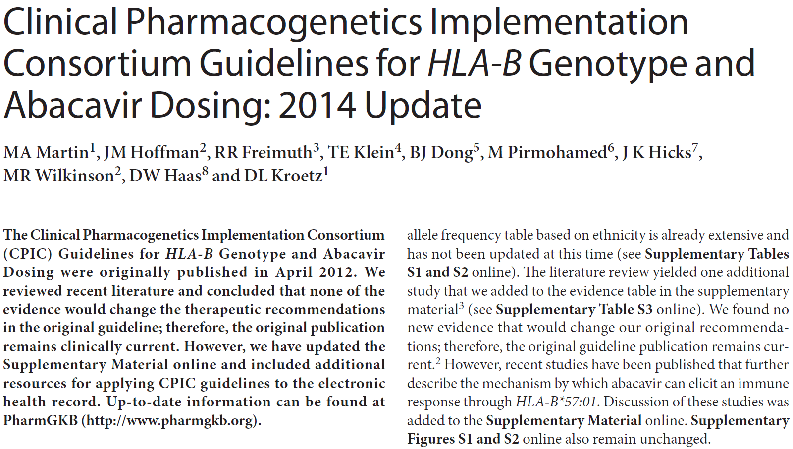
Informatics section added to supplement for HLA-B Genotype and Abacavir Dosing: 2014 Update
Tables with drug and gene codes
Figures that describe workflow
Incorporation of genetic test
CDS when abacavir ordered
Translation table
Sample CDS text
Clin Pharmacol Ther. 2014 Feb 21

Slide 47
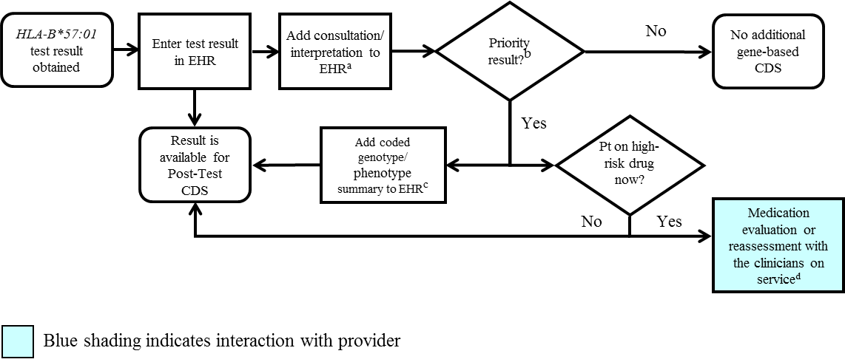
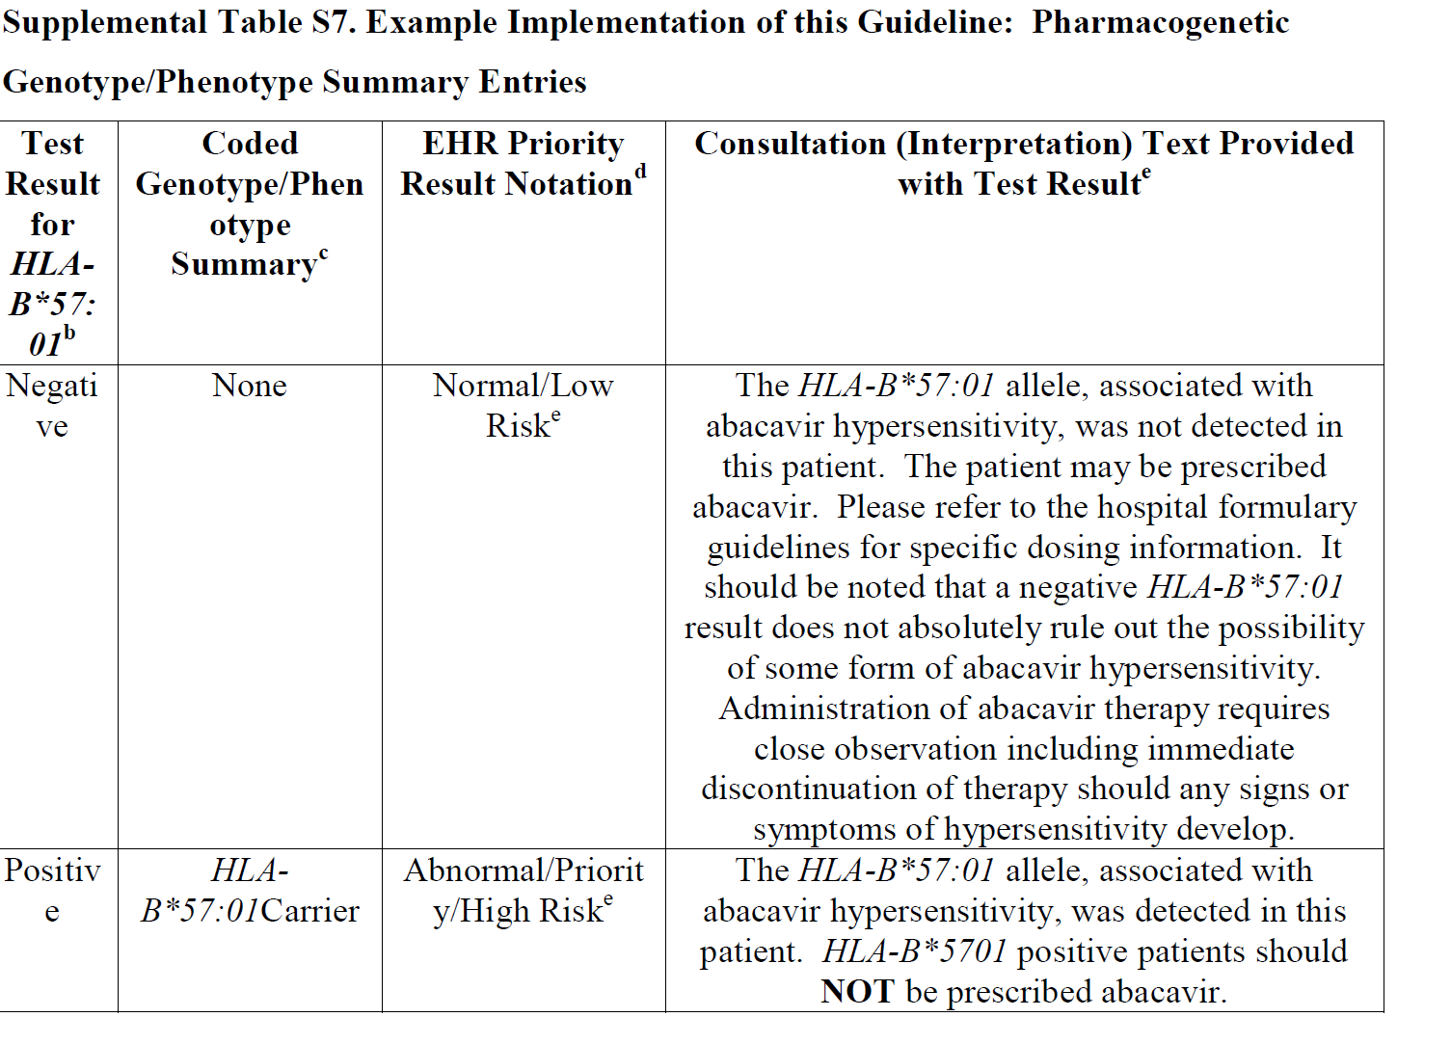
HLA-B*57:01 Pharmacogenetic Test Result: Clinical Implementation Workflow for EHR
Notes:
Supplemental Figure S3. HLA-B*57:01 Pharmacogenetic Test Result: Clinical Implementation Workflow for EHR
ªSee Supplementary Table S7 for diplotype/phenotype specific example
^{b}"Priority result" is defined as a genetic test result that necessitates a change in drug, drug dose, or drug monitoring now or potentially in the future.
^{c}Documentation in the EHR is institution specific. Optimally, the phenotype and/or genotype are available in the EHR to permanently inform prescribing decisions. See Supplementary Table S7 for genotype/phenotype-specific summaries.
^{d}See supplement section “Other Considerations” for discussion regarding use of abacavir in HLA-B*57:01 positive patient.

Slide 48
HLA-B*57:01 Pharmacogenetic Test Result: Clinical Implementation Workflow for EHR
Notes:
Supplemental Figure S3. HLA-B*57:01 Pharmacogenetic Test Result: Clinical Implementation Workflow for EHR
ªSee Supplementary Table S7 for diplotype/phenotype specific example
^{b}"Priority result" is defined as a genetic test result that necessitates a change in drug, drug dose, or drug monitoring now or potentially in the future.
^{c}Documentation in the EHR is institution specific. Optimally, the phenotype and/or genotype are available in the EHR to permanently inform prescribing decisions. See Supplementary Table S7 for genotype/phenotype-specific summaries.
^{d}See supplement section “Other Considerations” for discussion regarding use of abacavir in HLA-B*57:01 positive patient.

Slide 49
SLCO1B1 Genotype and Simvastatin: Point of Care
Clinical Decision Support
Simvastatin order initiated
SLCO1B1 genetic test results on file?
Yes
Priority result?^{c}
No
No post-test alert required; continue with drug order
No
Yes
1
2
CDS Pre-test Alert Messageª
(additional action may be considered)^{b}
CDS Post-test alert^{d} or notify prescriber with recommendation
Note: Circled numerals refer to Supplementary Table 12
Supplemental Figure S3. SLCO1B1 Genotype and Simvastatin: Point of Care Clinical Decision Support
ªSee Supplementary Table S12 for diplotype/phenotype specific pre-test alert example.
^{b}Additional actions may include ordering a pharmacogenetic test, preventing the clinician from ordering the medication or allowing the clinician to cancel out of the alert.
^{c}Priority result defined as a genetic test result that results in a change in drug, drug dose, or drug monitoring.
^{d}See Supplementary Table S12 for diplotype/phenotype specific post-test alert example.

Slide 50
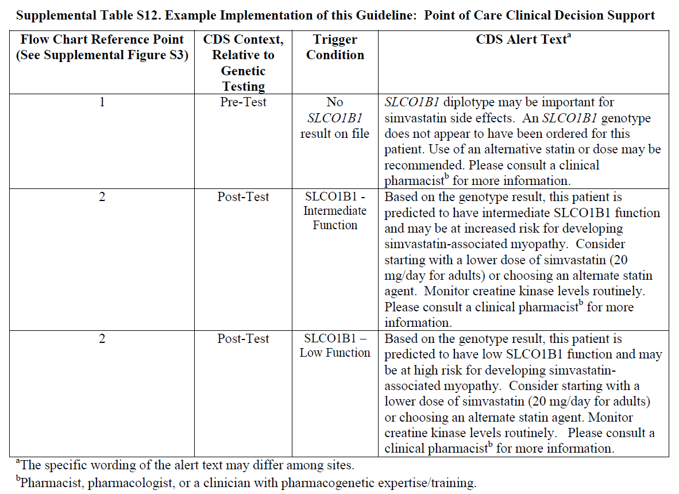

Slide 51
Translation Tables
Table for abacavir is simple:
Test Result for HLA-B*57:01^{b} | Examples of Diplotypes^{c} | Interpreted Phenotype^{d}
Negative | X/X | Low Risk of abacavir hypersensitivity
Positive | X/57:01 or 57:01/57:01 | High Risk of abacavir hypersensitivity
SLCO1B1/Simvastatin – Many more diplotypes
Diplotypes of known functional significance
CPIC Supplement Table
All possible diplotype combinations
Post to PharmGKB

Slide 52

Summary
CPIC guidelines help clinicians understand HOW available genetic test results should be used to optimize drug therapy.
Not WHETHER tests should be ordered.
17 guidelines produced in a standard format
Published in Clinical Pharmacology and Therapeutics
Freely available on
Publication on CPIC guideline process
New CPIC resources now available to support the adoption of pharmacogenetics into the EHR with CDS

Slide 53
Acknowledgements
CPIC Steering Committee
Mary Relling
Julie Johnson
Teri Klein
Dan Roden
Rachel Tyndale
Kelly Caudle, CPIC Coordinator
PGRN
PharmGKB
Russ Altman
Teri Klein
Michelle Whirl-Carrillo
PharmGKB curators
CPIC members/observers
CPIC informatics working group
James Hoffman
Michelle Whirl-Carrillo
Bob Freimuth

