Slide 1
CPIC Term Standardization for
Clinical Pharmacogenetic Test Results: Alleles and Phenotypes
Brief Overview of Project and Results
October 2015

Slide 2
Background
The terms used to describe pharmacogenetic allele function and clinical phenotype are not standardized
Implications
  Often confusing for clinicians and patients
  Precludes interoperability between EHR systems and portability of patient results over a patient’s lifetime

Slide 3
CPIC Phenotype Term
Standardization Project
Purpose:
To standardize phenotype terms in the CPIC guidelines and harmonize terms with external groups (e.g., ClinGen, IOM, etc.)
  Allele functional status terms (i.e. allele descriptive-Table 1 in guideline)
    Low, absent, high, intermediate
  Phenotype (i.e. diplotype descriptive-Table 2 in guideline)
    UM, EM, IM, PM

Slide 4
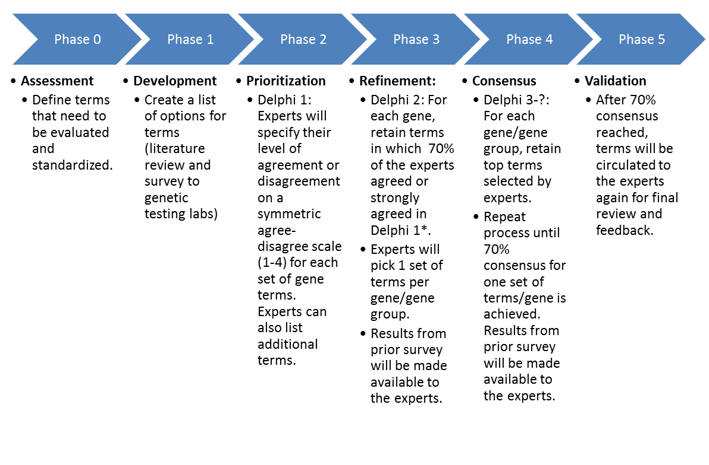
A modified Delphi Process was used to develop consensus
Five total rounds
Thank You CPIC Members!!!!

Slide 5
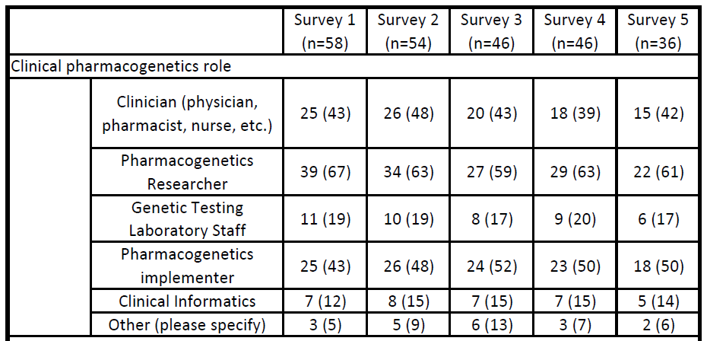
Results: Clinical Pharmacogenetics role of expert panel members

Slide 6
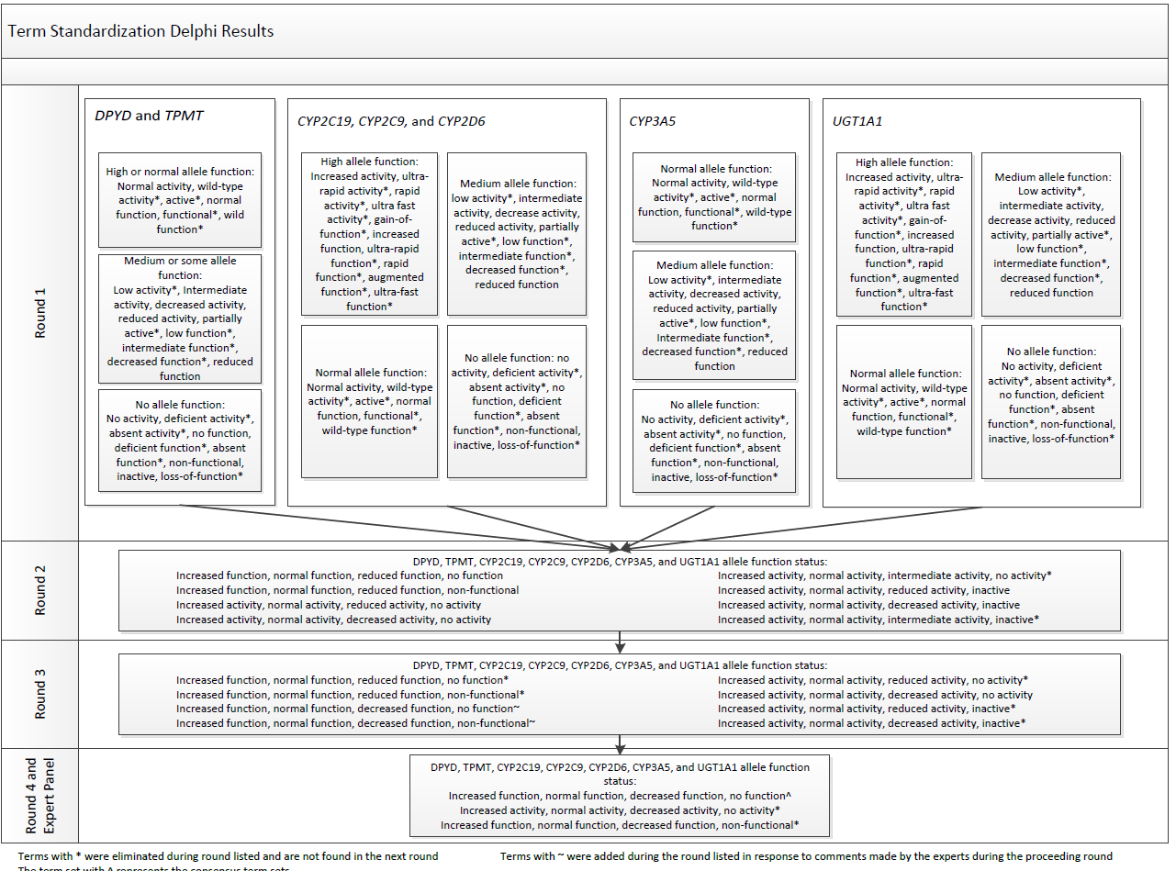

Slide 7
Consensus on final terms
Consensus defined as 70% agreement
  Allele functional status and carrier status achieved greater than 70% consensus after survey 4 (n=48)
  Drug metabolizing enzymes required survey 5 with conference call
By the end of the delphi process, consensus was reached with 90% of experts agreeing to the final terms (n=36)

Slide 8
Final Terms and Definitions

Slide 9
Term/Gene Category | Final Term* | Functional Definition | Genetic Definition | Example diplotypes/alleles
Allele Functional Status-all genes | Increased Function | Function greater than normal function | N/A | CYP2C19*17
 | Normal Function | Fully functional/wild-type | N/A | CYP2C19*1
 | Decreased Function | Function less than normal function | N/A | CYP2C19*9
 | No Function | Non-functional | N/A | CYP2C19*2
 | Unknown Function | No literature describing function or the allele is novel | N/A | CYP2C19*29
 | Uncertain Function | Literature supporting function is conflicting or weak | N/A | CYP2C19*12
Phenotype-Drug Metabolizing Enzymes (CYP2C19, CYP2D6, CYP3A5, CYP2C9, TPMT, DPYD, UGT1A1) | Ultra-rapid Metabolizer | Increased enzyme activity compared to rapid metabolizers. | Two increased function alleles, or more than 2 normal function alleles | CYP2C19*17/*17 CYP2D6*1/*1XN
 | Rapid Metabolizer | Increased enzyme activity compared to normal metabolizers but less than ultra-rapid metabolizers. | Combinations of normal function and increased function alleles | CYP2C19*1/*17
 | Normal Metabolizer | Fully functional enzyme activity | Combinations of normal function and decreased function alleles | CYP2C19*1/*1
 | Intermediate Metabolizer | Decreased enzyme activity (activity between normal and poor metabolizer) | Combinations of normal function, decreased function, and/or no function alleles | CYP2C19*1/*2
 | Poor Metabolizer | Little to no enzyme activity | Combination of no function alleles and/or decreased function alleles | CYP2C19*2/*2
Phenotype-Transporters (SLCO1B1) | Increased Function | Increased transporter function compared to normal function. | One or more increased function alleles | SLCO1B1*1/*14
 | Normal Function | Fully functional transporter function | Combinations of normal function and/or decreased function alleles | SLCO1B1*1/*1
 | Decreased Function | Decreased transporter function (function between normal and poor function) | Combinations of normal function, decreased function, and/or no function alleles | SLCO1B1*1/*5
 | Poor Function | Little to no transporter function | Combination of no function alleles and/or decreased function alleles | SLCO1B1*5/*5
Phenotype-Carrier status (HLA-B) | Positive | Detection of high-risk allele | Carrier of high-risk allele | HLA-B*15:02
 | Negative | High risk-allele not detected | Not a carrier of high-risk allele
*All terms should begin with the gene name (e.g., CYP2D6 Poor metabolizer, TPMT Normal metabolizer, SLCO1B1 Decreased Function)

Slide 10
Next Steps
Use final terms in CPIC Guidelines
Dissemination
  Abstract submitted to American Medical Informatics Association (AMIA) Translational Bioinformatics Meeting
  Manuscript in preparation
  ClinGen
  IOM DIGITizE

Slide 11
Next Steps
CPIC Informatics Working Group organizing submission of terms to Laboratory Observations Identifiers Names and Codes (LOINC)
  LOINC seen as central ontology for these terms
  LOINC leadership interested
Formal endorsement by relevant professional societies

