Slide 1

Prioritization of Genes and Drugs for CPIC Guideline Development
Roseann S. Gammal, PharmD, BCPS
Pharmacogenomics Clinical Specialist

Slide 2
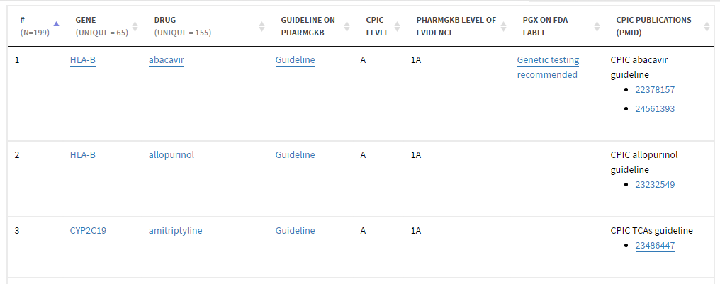
CPIC genes and drugs
https://cpicpgx.org/genes-drugs/

Slide 3
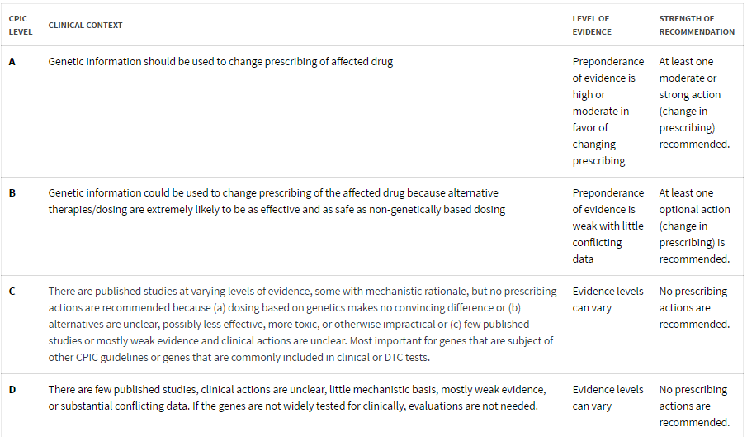
CPIC level definitions
https://cpicpgx.org/prioritization/#cpicLevels

Slide 4
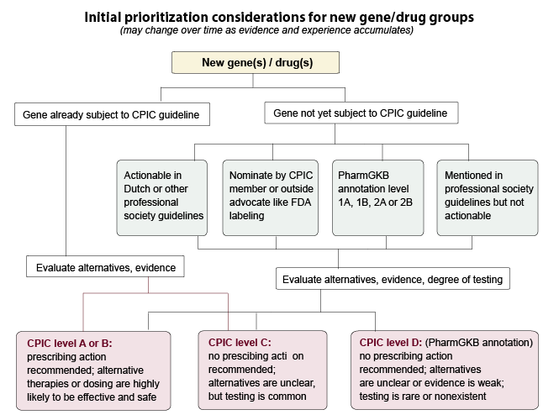
Algorithm for CPIC gene/drug prioritization
https://cpicpgx.org/prioritization/#flowchart

Slide 5
1. New gene/drug brought up for consideration
For example,
ABCB1/antidepressants
Is this gene the subject of a current CPIC guideline?
No

Slide 6
1. New gene/drug brought up for consideration
ABCB1/antidepressants
antidepressant
P-GP
blood
BBB
Brain extra-cellular fluid
ADP
ATP
Notes:
The gene ABCB1 (also known as MDR1) codes for the efflux pump P-glycoprotein (P-gp), which plays a key role in regulating the transfer of molecules across the blood-brain barrier. P-gp protects the brain by selectively extruding exogenous compounds from the brain back into the bloodstream. Many antidepressants are substrates of P-gp. P-gp functionality is postulated to impact the concentration of active drug at the site of action (CNS), therefore contributing to inter-individual differences in antidepressant efficacy and toxicity. Patients who carry SNPs associated with reduced P-gp function may have better chance of remission with antidepressants that are P-gp substrates and may also be at higher risk for side effects.

Slide 7
2. Have other groups already explored this gene?
ABCB1/antidepressants
Actionable in Dutch or other professional society guidelines?
No
Nominated by CPIC member or outside advocate like FDA labeling?
Yes -
CPIC member
What is the PharmGKB annotation level?
Level 3
(low evidence)
Mentioned in professional society guidelines but not actionable?
No

Slide 8
3. Evaluate alternatives
ABCB1/antidepressants
Selective Serotonin Reuptake Inhibitors (SSRIs)
Citalopram, escitalopram, fluoxetine, fluvoxamine, paroxetine, sertraline
Serotonin-Norepinephrine Reuptake Inhibitors (SNRIs)
Duloxetine, desvenlafaxine, venlafaxine
Tricyclic Antidepressants (TCAs)
Amitriptyline, clomipramine, nortriptyline, imipramine
Other agents
Buproprion, mirtazapine, trazodone
Notes:
Important to consider alternative agents
Many agents available to treat depression, including many first-line agents
Not an all-inclusive list

Slide 9
4. Evaluate the evidence
PubMed Keywords:
(ABCB1 or MDR1) and antidepressants
29 original articles, 3 meta-analyses

Slide 10
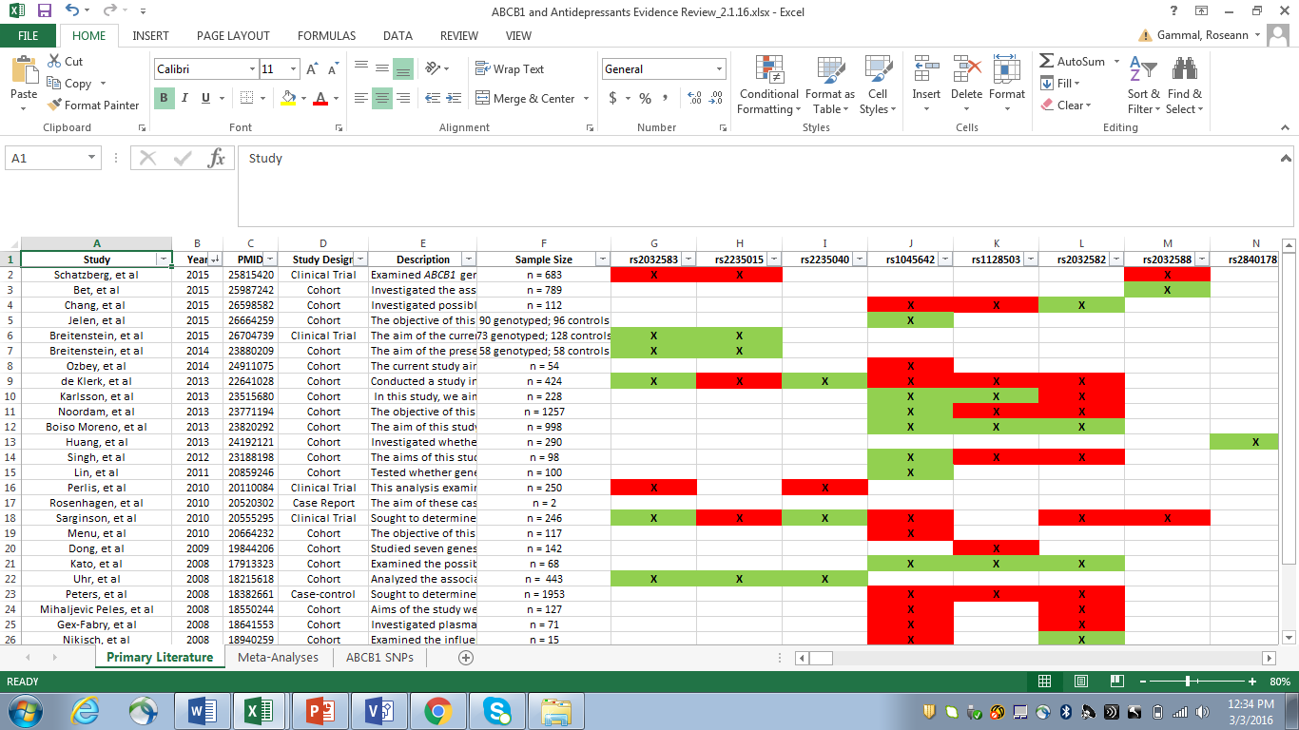
4. Evaluate the evidence
Notes:
Type of study, SNPs tested, antidepressants used, how clinical endpoints were defined, results/statistics, applicability to practice
Color-coded so easy to see at a glance which studies had positive vs. negative results
Goal – get a general idea as to the amount and quality of literature, as well as clinical utility

Slide 11
4. Evaluate the evidence
ABCB1 SNP | Association Found | No Association Found
rs2032583 | 5 | 2
rs2235015 | 3 | 3
rs2235040 | 3 | 1
rs1045642 | 9 | 10
rs1128503 | 3 | 6
rs2032582 | 4 | 9
Need further analysis: study quality, antidepressants included, clinical endpoints – efficacy vs. safety, etc.
Notes:
High level overview – data are mixed
Some studies grouped many types of antidepressants together, others looked at one or two specific agents

Slide 12
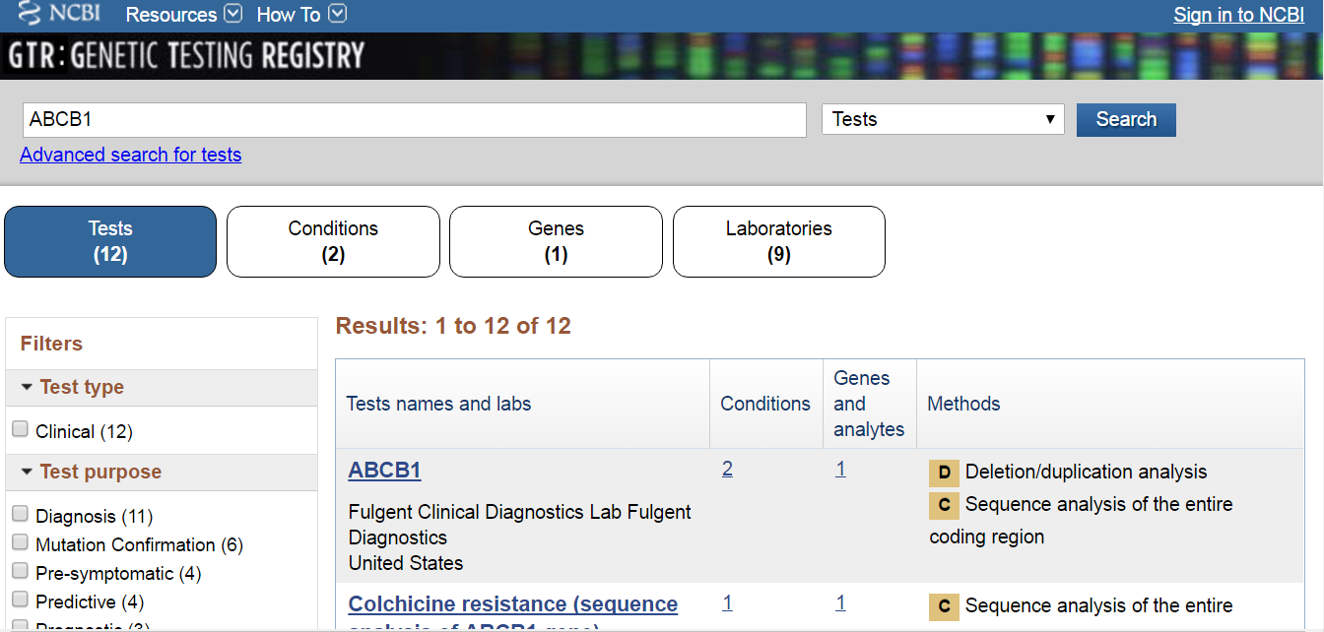
5. Evaluate the degree of testing
Notes:
If the gene isn’t widely tested, no CPIC guideline or low priority to become CPIC guideline
GTR may not have all available tests listed
Assurex - no, Kailos - yes, ARUP – no

Slide 13
6. Assign CPIC level to gene/drug pair
Actionable
At least one change in prescribing is recommended
Not Actionable
No prescribing actions are recommended
CPIC Level
A
B
C
D

Slide 14
CPIC levels A and B are actionable
Genetic information should be used to change prescribing of affected drug.
A
Genetic information could be used to change prescribing of the affected drug because alternative therapies/dosing are extremely likely to be as effective and as safe as non-genetically based dosing.
B
Notes:
All gene/drug pairs currently published in CPIC guideline is level A?

Slide 15
CPIC levels C and D are not actionable
There are published studies at varying levels of evidence, some with mechanistic rationale, but no prescribing actions are recommended because (a) dosing based on genetics makes no convincing difference or (b) alternatives are unclear, possibly less effective, more toxic, or otherwise impractical or (c) few published studies or mostly weak evidence and clinical actions are unclear. Clinical testing is common.
C
D
There are few published studies, clinical actions are unclear, little mechanistic basis, mostly weak evidence, or substantial conflicting data. Clinical testing is rare.

Slide 16


Next steps for ABCB1/antidepressants
Needs further investigation
Closer look at evidence by experts
Notes:
Other genes/drugs higher priority at this point, but will likely be considered for a future CPIC guideline
Currently rated as B/C, but until a thorough evaluation of literature by experts is conducted (e.g., for guideline development), the CPIC level is often provisional

Slide 17
Prioritization of Genes and Drugs for CPIC Guideline Development
Roseann S. Gammal, PharmD, BCPS
Pharmacogenomics Clinical Specialist

