Slide 1





Slide 2
Agenda June 29, 2016
1. FDA/CPIC interactions (follow-up from last SAB meeting)
2. CPIC Table revisions: allele definition table, allele and diplotype frequency tables, diplotype “translation” implementation table
3. CPIC guideline implementers/resource page
4. CPIC calls: attendance, presentations from implementers
5. Engaging 3rd party payers
6. Term standardization manuscript in press
7. Requests to translate guidelines into foreign languages

Slide 3
FDA/CPIC
Michael A. Pacanowski, Pharm.D., M.P.H. Associate Director for Genomics and Targeted Therapy Office of Clinical Pharmacology, Office of Translational Sciences Center for Drug Evaluation and Research
E. David Litwack
Personalized Medicine Staff
OIR/CDRH/FDA
Review of variant databases

Slide 4
CPIC guideline tables
Allele function assignment with citations
Implementation tables
Possible diplotypes
Interpretation notes
Pre- and post-test alerts
Allelle definition table
Frequency tables
Allele frequency by “race” group
Diplotype frequency by “race”
Phenotype frequency by “race”
References
Change log

Slide 5
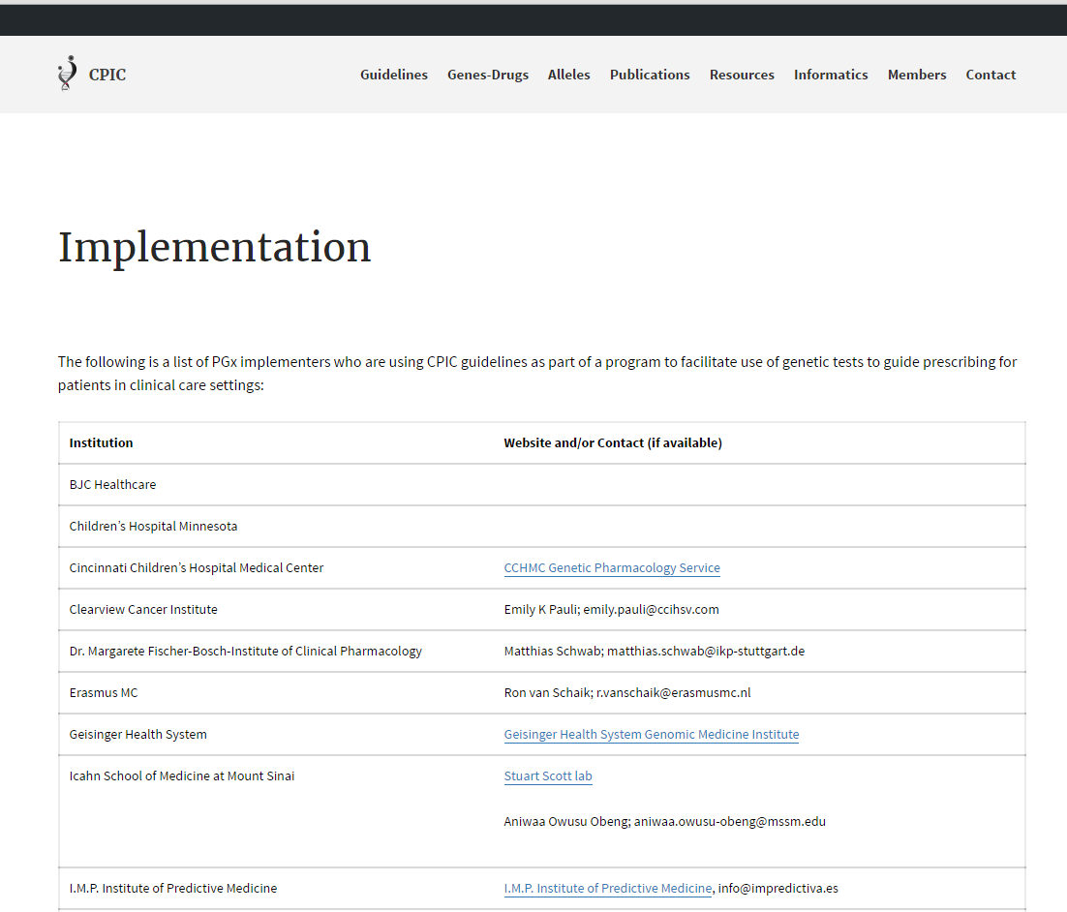
CPIC resources page: implementers

Slide 6
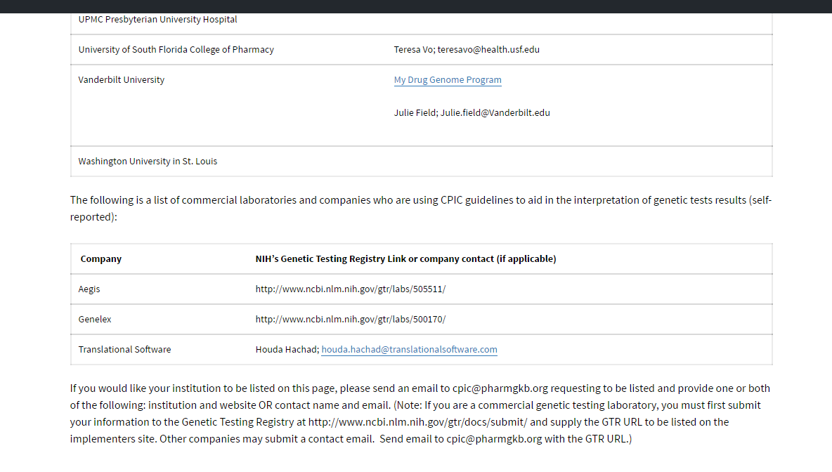

Slide 8
CPIC Conference Call Implementation Presentations
Cleveland Clinic
Northshore Hospital, Chicago
Mt. Sinai
Center for Addiction and Mental Health, Toronto
University of Florida Health
St. Jude Children’s Research Hospital
Vanderbilt University Medical Center

Slide 9
Engaging 3rd party payers

Slide 10
STANDARDIZING TERMS FOR CLINICAL PHARMACOGENETIC TEST RESULTS: CONSENUS TERMS FROM THE CLINICAL PHARMACOGENETICS IMPLEMENTATION CONSORTIUM (CPIC)
Authors: Kelly E. Caudle, Pharm.D., Ph.D.1, Henry M. Dunnenberger, Pharm.D.2, Robert R. Freimuth, Ph.D. 3, Josh F. Peterson, M.D. 4, Jonathan D. Burlison, Ph.D.1, Michelle Whirl-Carrillo, Ph.D. 5, Stuart A. Scott, Ph.D. 6, Heidi L. Rehm, Ph.D. 7, Marc S. Williams, M.D. 8, Teri E. Klein, Ph.D. 5, Mary V. Relling, Pharm.D.1, James M. Hoffman, Pharm.D. M.S.1
Genetics in Medicine July 2016

Slide 11
Final Terms-Allele function
Term/Gene Category | Final Term* | Functional Definition | Example diplotypes/alleles
Allele Functional Status-all genes | Increased Function | Function greater than normal function | CYP2C19*17
 | Normal Function | Fully functional/wild-type | CYP2C19*1
 | Decreased Function | Function less than normal function | CYP2C19*9
 | No Function | Non-functional | CYP2C19*2
 | Unknown Function | No literature describing function or the allele is novel | CYP2C19*29
 | Uncertain Function | Literature supporting function is conflicting or weak | CYP2C19*12

Slide 12
Final Terms-Phenotype
Term/Gene Category | Final Term* | Functional Definition | Example diplotypes/alleles | Term/Gene Category
Phenotype-Drug Metabolizing Enzymes (CYP2C19, CYP2D6, CYP3A5, CYP2C9, TPMT, DPYD, UGT1A1) | Ultra-rapid Metabolizer | Increased enzyme activity compared to rapid metabolizers. | Two increased function alleles, or more than 2 normal function alleles | CYP2C19*17/*17 CYP2D6*1/*1XN
 | Rapid Metabolizer | Increased enzyme activity compared to normal metabolizers but less than ultra-rapid metabolizers. | Combinations of normal function and increased function alleles | CYP2C19*1/*17
 | Normal Metabolizer | Fully functional enzyme activity | Combinations of normal function and decreased function alleles | CYP2C19*1/*1
 | Intermediate Metabolizer | Decreased enzyme activity (activity between normal and poor metabolizer) | Combinations of normal function, decreased function, and/or no function alleles | CYP2C19*1/*2
 | Poor Metabolizer | Little to no enzyme activity | Combination of no function alleles and/or decreased function alleles | CYP2C19*2/*2
Phenotype-Transporters (SLCO1B1) | Increased Function | Increased transporter function compared to normal function. | One or more increased function alleles | SLCO1B1*1/*14
 | Normal Function | Fully functional transporter function | Combinations of normal function and/or decreased function alleles | SLCO1B1*1/*1
 | Decreased Function | Decreased transporter function (function between normal and poor function) | Combinations of normal function, decreased function, and/or no function alleles | SLCO1B1*1/*5
 | Poor Function | Little to no transporter function | Combination of no function alleles and/or decreased function alleles | SLCO1B1*5/*5
Phenotype-High risk genotype status (HLA-B) | Positive | Detection of high-risk allele | Homozygous or heterozygous for high-risk allele | HLA-B*15:02
 | Negative | High risk-allele not detected | No copies of high-risk allele

Slide 13
Next Steps
Endorsed by Association of Molecular Pathology
Used in IOM’s DiGITIZE Action Collaborative implementation guides
LOINC-Terms accepted December 2015
Using in CPIC guidelines

Slide 14
CPIC guidelines in Foreign Languages

Slide 15
Pharmacogenes for ACMG list
TPMT

Slide 16
Acknowledgements
CPIC Steering Committee
Mary Relling
Julie Johnson
Teri Klein
Dan Roden
Rachel Tyndale
PGRN
PharmGKB
Teri Klein
Russ Altman
Michelle Whirl-Carrillo
PharmGKB curators
CPIC members/observers
CPIC informatics working group
James Hoffman
Michelle Whirl-Carrillo
Bob Freimuth

Slide 18
CPIC issues to discuss
How best to assess usage of CPIC guidelines?
How to improve interactions with external groups?
How to prioritize given limited resources?
Plan for sustainability over time
How to interact with SAB?
Timeline: grant renewal application likely due summer of 2017

Slide 19
Guidelines.gov
Number of CPIC guideline page views reported by guidelines.gov (through July 2015)
Title | Date Posted | Page Views
Clinical Pharmacogenetics Implementation Consortium guidelines for HLA-B genotype and abacavir dosing. | 7/26/2013 | 10159
Clinical Pharmacogenetics Implementation Consortium guidelines for human leukocyte antigen-B genotype and allopurinol dosing. | 7/26/2013 | 10253
Clinical Pharmacogenetics Implementation Consortium guideline for CYP2D6 and CYP2C19 genotypes and dosing of tricyclic antidepressants. | 7/26/2013 | 14623
Clinical Pharmacogenetics Implementation Consortium guidelines for thiopurine methyltransferase genotype and thiopurine dosing. | 7/26/2013 | 10171
Clinical Pharmacogenetics Implementation Consortium guidelines for CYP2C19 genotype and clopidogrel therapy: 2013 update. | 2/14/2014 | 7648
Clinical Pharmacogenetics Implementation Consortium guidelines for HLA-B genotype and carbamazepine dosing. | 2/14/2014 | 6961
Clinical Pharmacogenetics Implementation Consortium guidelines for cytochrome P450 2D6 genotype and codeine therapy: 2014 update. | 8/29/2014 | 12543
Clinical Pharmacogenetics Implementation Consortium guidelines for dihydropyrimidine dehydrogenase genotype and fluoropyrimidine dosing. | 8/29/2014 | 1842
Clinical Pharmacogenetics Implementation Consortium (CPIC) guidelines for IFNL3 (IL28B) genotype and PEG interferon-α–based regimens. | 8/29/2014 | 2054
Clinical Pharmacogenetics Implementation Consortium (CPIC) guidelines for ivacaftor therapy in the context of CFTR genotype. | 12/5/2014 | 1738
The Clinical Pharmacogenetics Implementation Consortium guideline for SLCO1B1 and simvastatin-induced myopathy: 2014 update. | 3/13/2015 | 11874
Clinical Pharmacogenetics Implementation Consortium (CPIC) guidelines for rasburicase therapy in the context of G6PD deficiency genotype. | 3/13/2015 | 1223

Slide 20
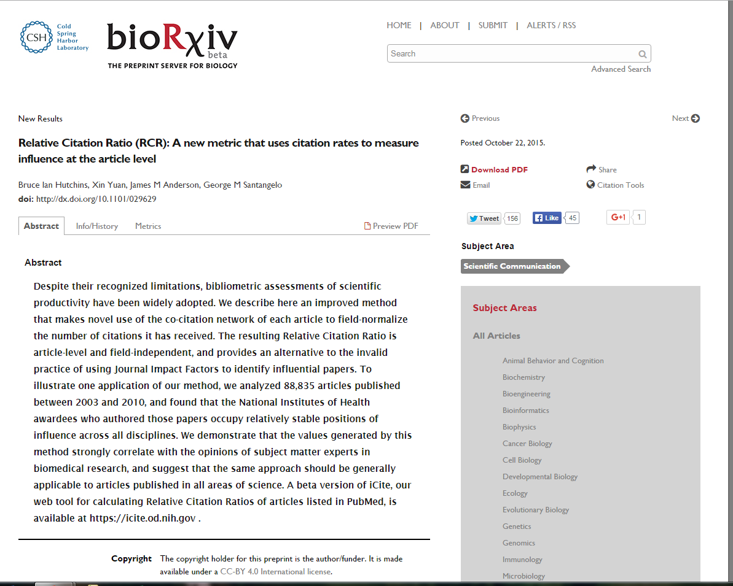

Slide 21
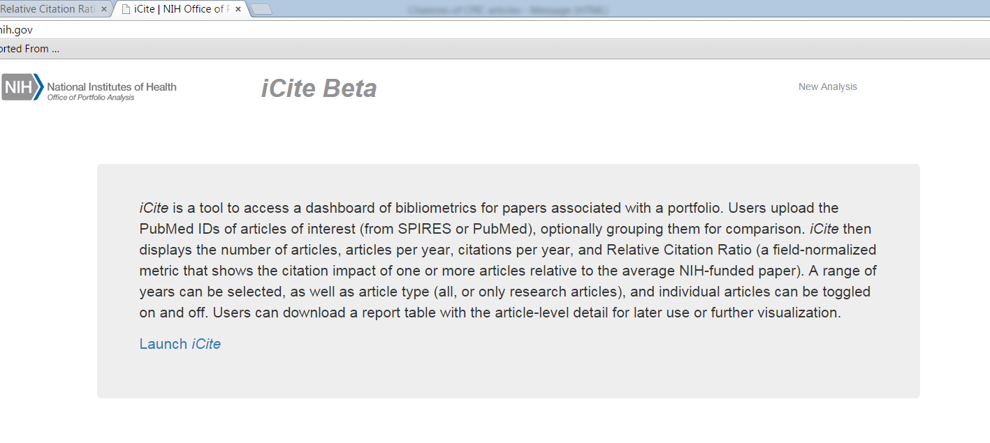
cites/year of each paper, normalized to the citations per year received by NIH-funded papers in the same field and year. A paper with an RCR of 1.0 has received the same number of cites/year as the average NIH-funded paper in its field, while a paper with an RCR of 2.0 has received twice as many cites/year as the average NIH-funded paper in its field. (Average high-impact Nature article ~ 4).

Slide 22
Year | Title | Authors | RCR
2013 | Clinical Pharmacogenetics Implementation Consortium guidelines for dihydropyrimidine dehydrogenase genotype and fluoropyrimidine dosing. | Caudle, K E; Thorn, C F; Klein, T E; Swen, J J; McLeod, H L; Diasio, R B; Schwab, M | 4.44
2013 | Clinical Pharmacogenetics Implementation Consortium guidelines for CYP2C19 genotype and clopidogrel therapy: 2013 update. | Scott, S A; Sangkuhl, K; Stein, C M; Hulot, J-S; Mega, J L; Roden, D M; Klein, T E; Sabatine, M S; Johnson, J A; Shuldiner, A R; | 8.97
2013 | Clinical Pharmacogenetics Implementation Consortium guidelines for HLA-B genotype and carbamazepine dosing. | Leckband, S G; Kelsoe, J R; Dunnenberger, H M; George, A L; Tran, E; Berger, R; Müller, D J; Whirl-Carrillo, M; Caudle, K E; Pirmohamed, M; | 4.92
2013 | Clinical Pharmacogenetics Implementation Consortium guideline for CYP2D6 and CYP2C19 genotypes and dosing of tricyclic antidepressants. | Hicks, J K; Swen, J J; Thorn, C F; Sangkuhl, K; Kharasch, E D; Ellingrod, V L; Skaar, T C; Müller, D J; Gaedigk, A; Stingl, J C; | 10.66
2013 | Clinical pharmacogenetics implementation consortium guidelines for thiopurine methyltransferase genotype and thiopurine dosing: 2013 update. | Relling, M V; Gardner, E E; Sandborn, W J; Schmiegelow, K; Pui, C-H; Yee, S W; Stein, C M; Carrillo, M; Evans, W E; Hicks, J K; Schwab, M; Klein, T E | 9.59
2013 | Clinical Pharmacogenetics Implementation Consortium guidelines for human leukocyte antigen-B genotype and allopurinol dosing. | Hershfield, M S; Callaghan, J T; Tassaneeyakul, W; Mushiroda, T; Thorn, C F; Klein, T E; Lee, M T M | 6.19
2012 | The clinical pharmacogenomics implementation consortium: CPIC guideline for SLCO1B1 and simvastatin-induced myopathy. | Wilke, R A; Ramsey, L B; Johnson, S G; Maxwell, W D; McLeod, H L; Voora, D; Krauss, R M; Roden, D M; Feng, Q; Cooper-Dehoff, R M; Gong, L; Klein, T E; Wadelius, M; Niemi, M; | 7.69
2012 | Clinical pharmacogenetics implementation consortium guidelines for HLA-B genotype and abacavir dosing. | Martin, M A; Klein, T E; Dong, B J; Pirmohamed, M; Haas, D W; Kroetz, D L; | 4.52
2012 | Clinical Pharmacogenetics Implementation Consortium (CPIC) guidelines for codeine therapy in the context of cytochrome P450 2D6 (CYP2D6) genotype. | Crews, K R; Gaedigk, A; Dunnenberger, H M; Klein, T E; Shen, D D; Callaghan, J T; Kharasch, E D; Skaar, T C; | 13.47
2011 | Clinical Pharmacogenetics Implementation Consortium Guidelines for CYP2C9 and VKORC1 genotypes and warfarin dosing. | Johnson, J A; Gong, L; Whirl-Carrillo, M; Gage, B F; Scott, S A; Stein, C M; Anderson, J L; Kimmel, S E; Lee, M T M; Pirmohamed, M; Wadelius, M; Klein, T E; Altman, R B; | 9.68
2011 | Clinical Pharmacogenetics Implementation Consortium guidelines for cytochrome P450-2C19 (CYP2C19) genotype and clopidogrel therapy. | Scott, S A; Sangkuhl, K; Gardner, E E; Stein, C M; Hulot, J-S; Johnson, J A; Roden, D M; Klein, T E; Shuldiner, A R; | 8.86
2011 | Clinical Pharmacogenetics Implementation Consortium guidelines for thiopurine methyltransferase genotype and thiopurine dosing. | Relling, M V; Gardner, E E; Sandborn, W J; Schmiegelow, K; Pui, C-H; Yee, S W; Stein, C M; Carrillo, M; Evans, W E; Klein, T E; | 11.04
2011 | CPIC: Clinical Pharmacogenetics Implementation Consortium of the Pharmacogenomics Research Network. | Relling, M V; Klein, T E | 9.61

Slide 23
CPIC meetings
CPIC luncheon meeting—open to CPIC members
Thursday March 10th, 2016 Noon-1:30 PM
Hilton Bayfront Hotel, San Diego, CA
Email: kelly.caudle@stjude.org to attend
CPIC Meeting (a specialty meeting of the PGRN)
Wednesday March 15th, 2017
Marriott Wardman Park Hotel, Washington DC
Further details pending.

Slide 24
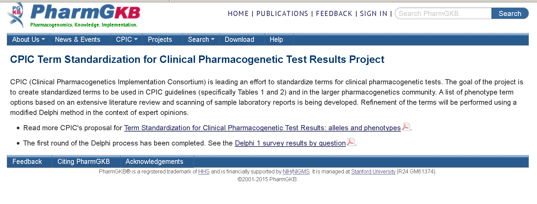
To standardize phenotype terms in the CPIC guidelines and harmonize terms with external groups (e.g., ClinGen, IOM, etc.) to facilitate use in Electronic Health Records
Allele functional status terms (Table 1 in guideline)
Low, absent, high, intermediate
Phenotype (i.e. from diplotypes; Table 2 in guideline)
UM, EM, IM, PM

Slide 25
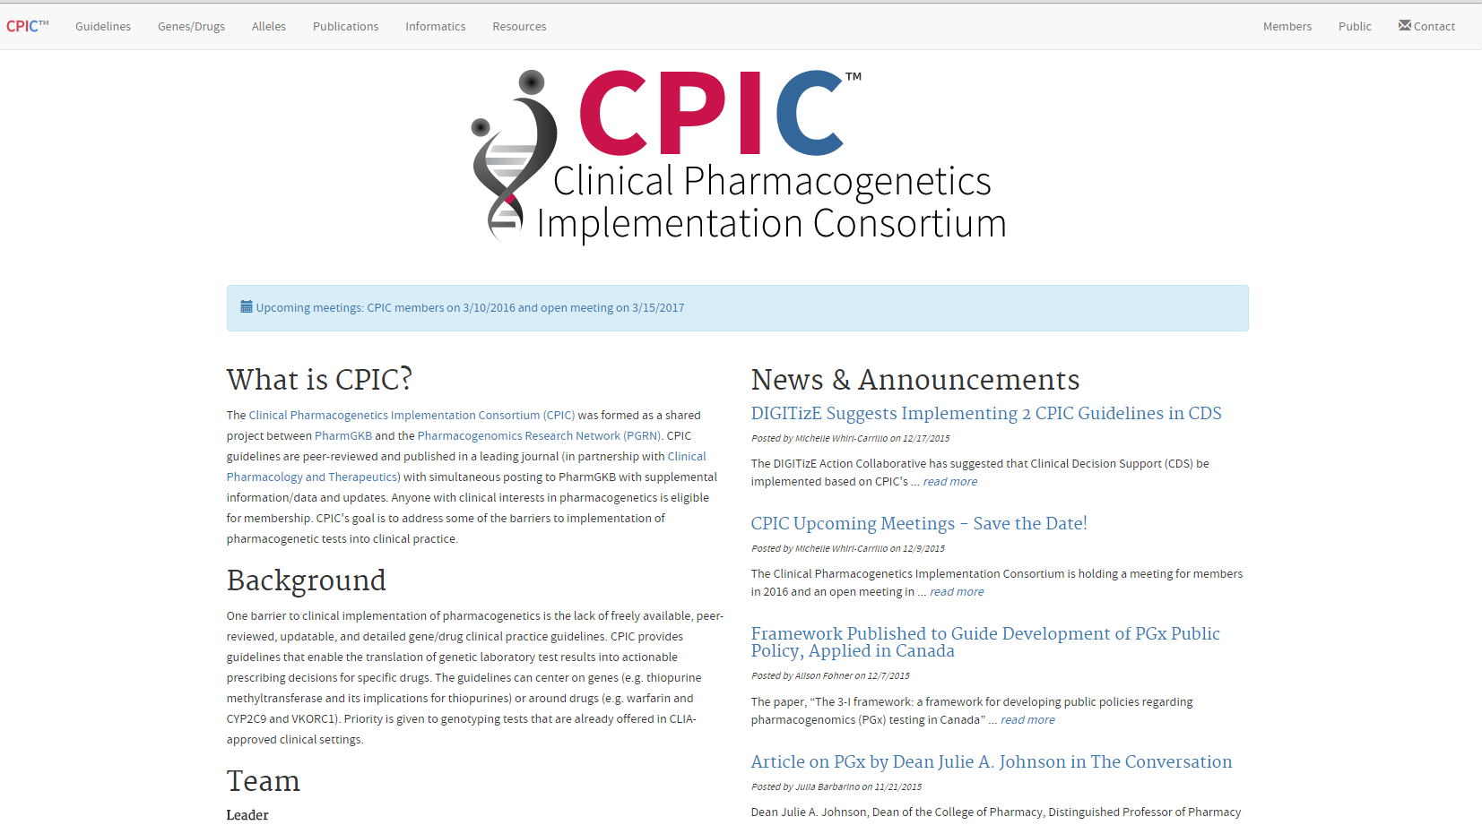
CPIC website: www.cpicpgx.org
CPIC guidelines and list of CPIC genes/drugs
CPIC announcements
CPIC information
Coming soon: List of implementers

Slide 26
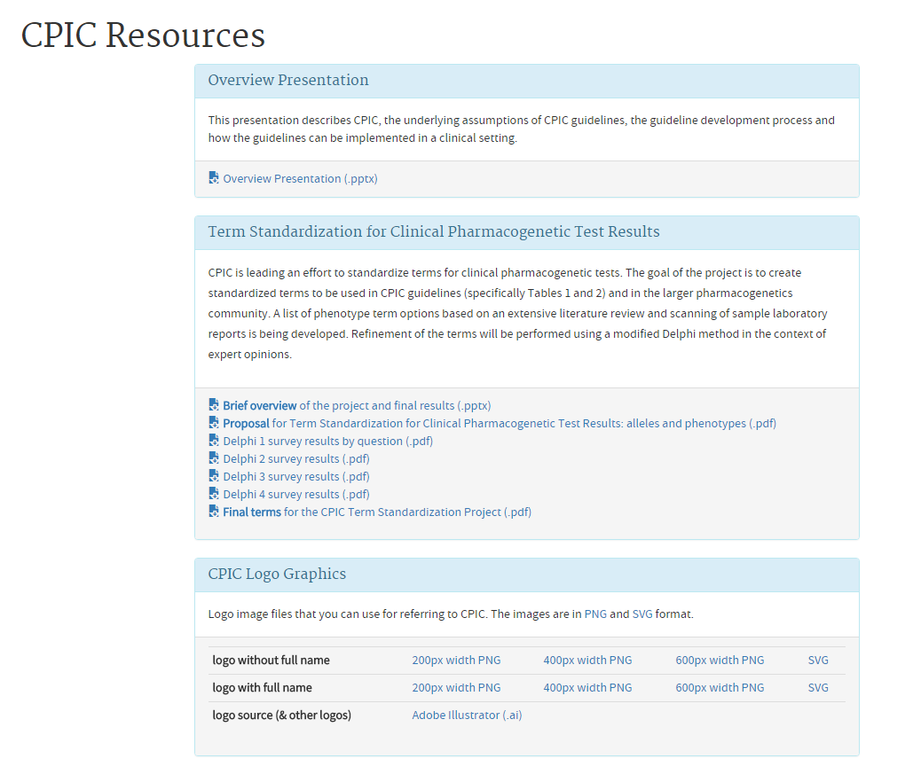
CPIC information available at cpicpgx.org
CPIC slides
CPIC projects
CPIC logo

Slide 27
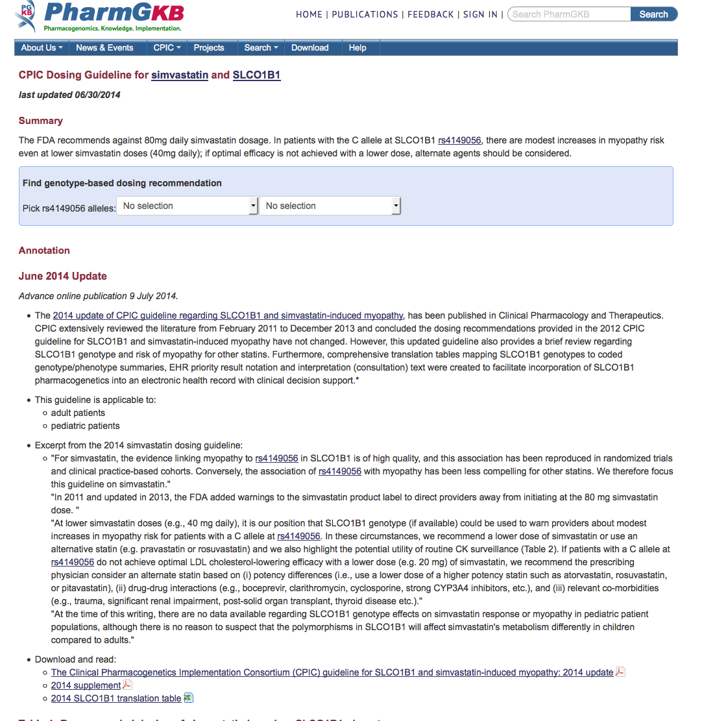
CPIC guidelines are posted on PharmGKB (www.pharmgkb.org)

Slide 28
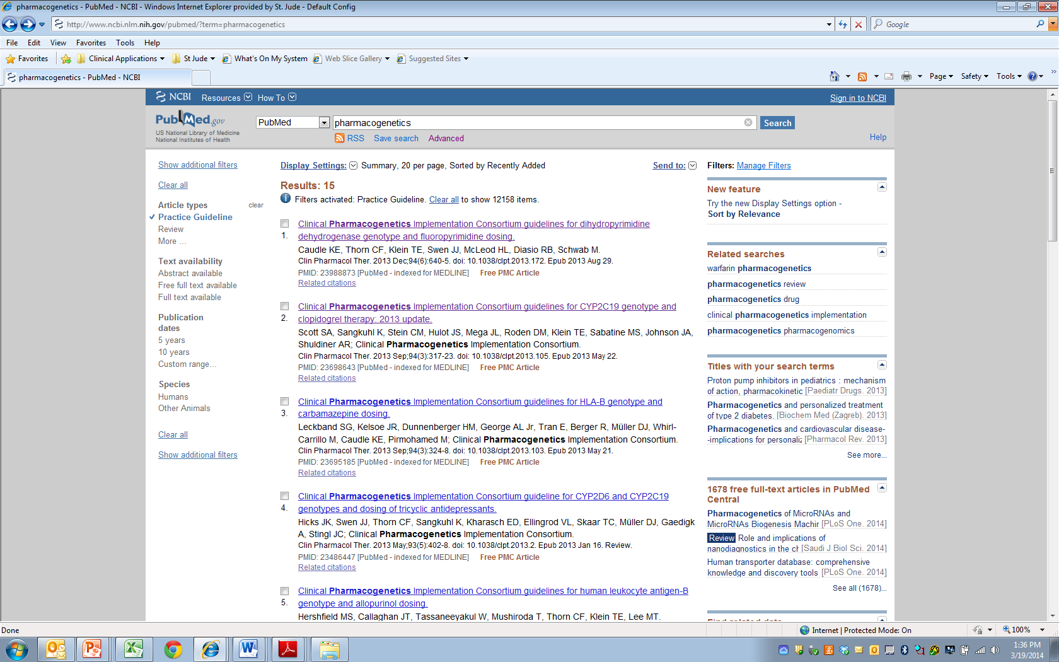
CPIC guidelines linked to “Practice Guideline” filter on PubMed

Slide 29
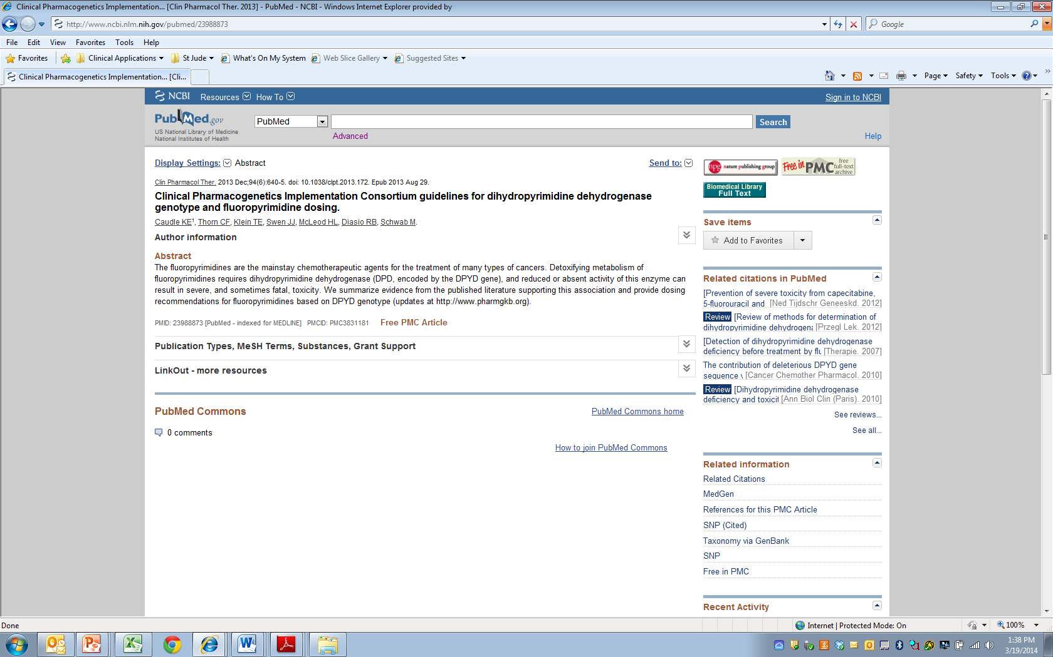

Slide 30
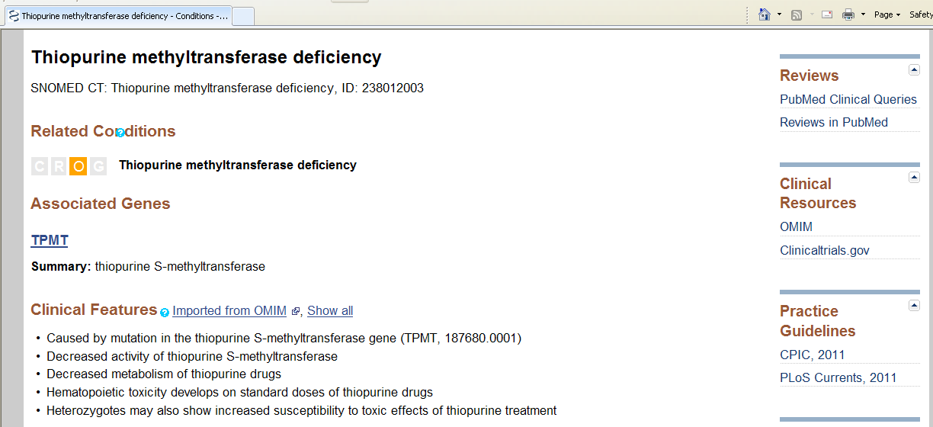
CPIC is cited in NIH’s Genetic Test Registry (GTR) for clinical pharmacogenetic tests

