Slide 1
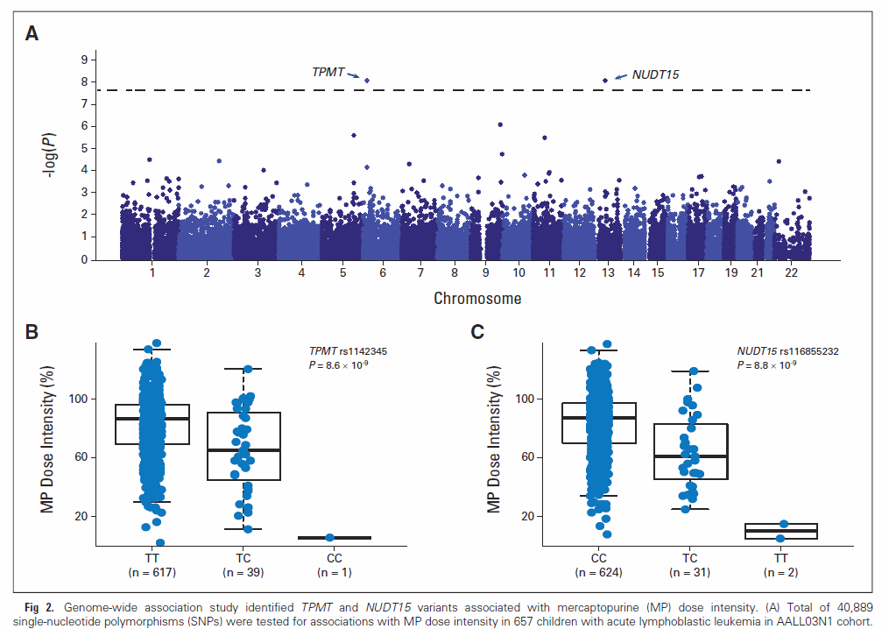
GWAS of Mercaptopurine Tolerable Dosage in ALL patients
Yang et al., J Clin Oncol 2015, Moriyama et al, Nat. Genet. 2016

Slide 2
Adjusting first dose of 6MP on Day 22
Based on TPMT and NUDT15 Genotypes

