Slide 1
Pharmacogenetic Testing in a Community Cancer Center
Jennifer Eichmeyer, MS, LCGC
Jessie Modlin, PharmD

Slide 2
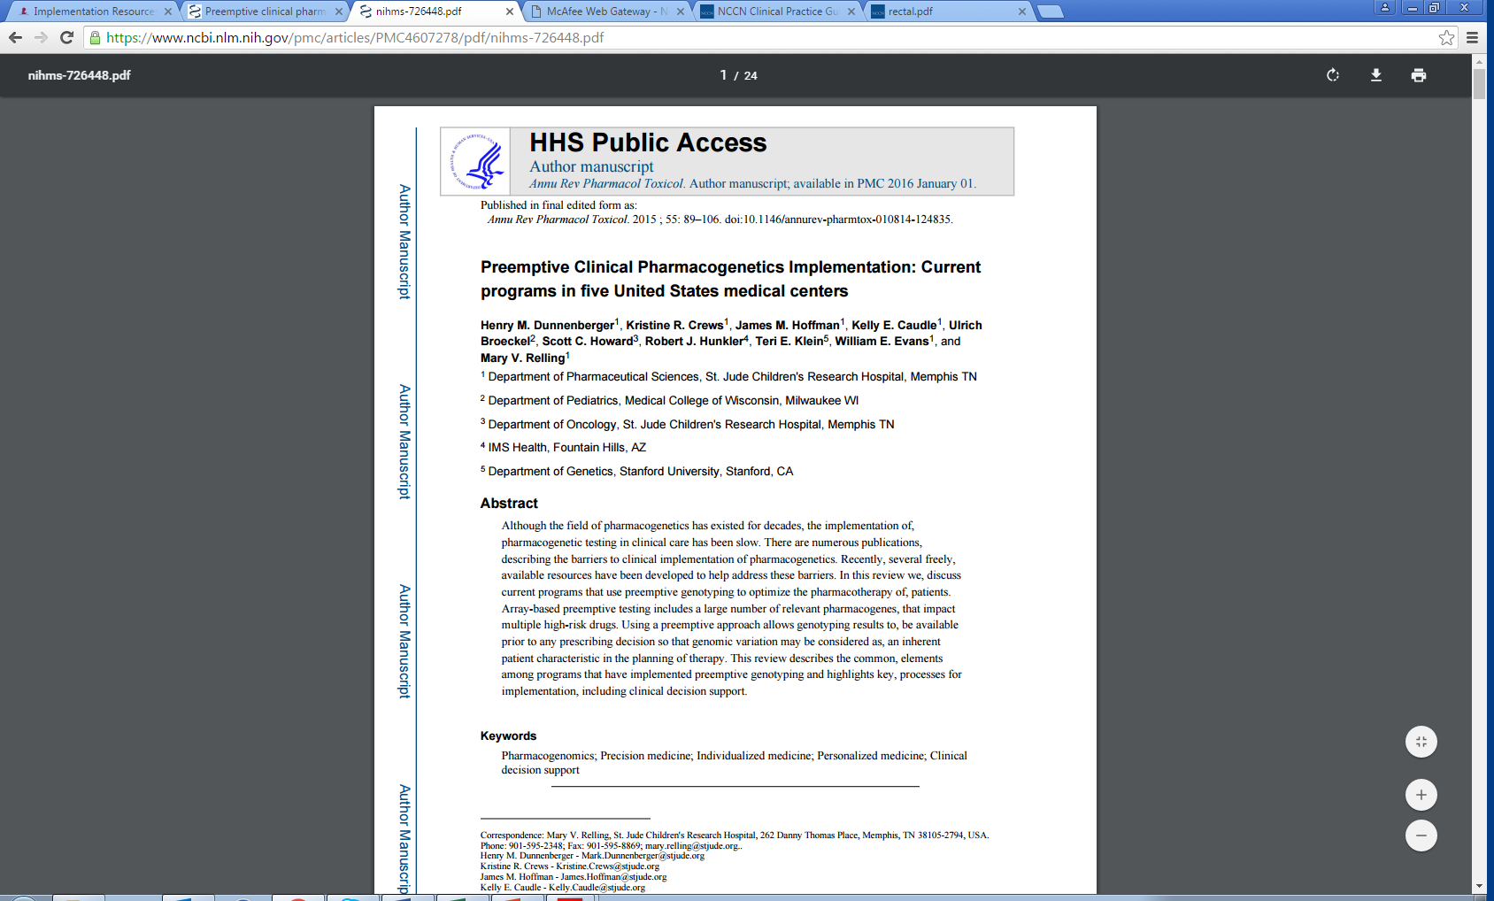
https://www.ncbi.nlm.nih.gov/pmc/articles/PMC4607278/pdf/nihms-726448.pdf Accessed 6 Sep 2016.

Slide 3
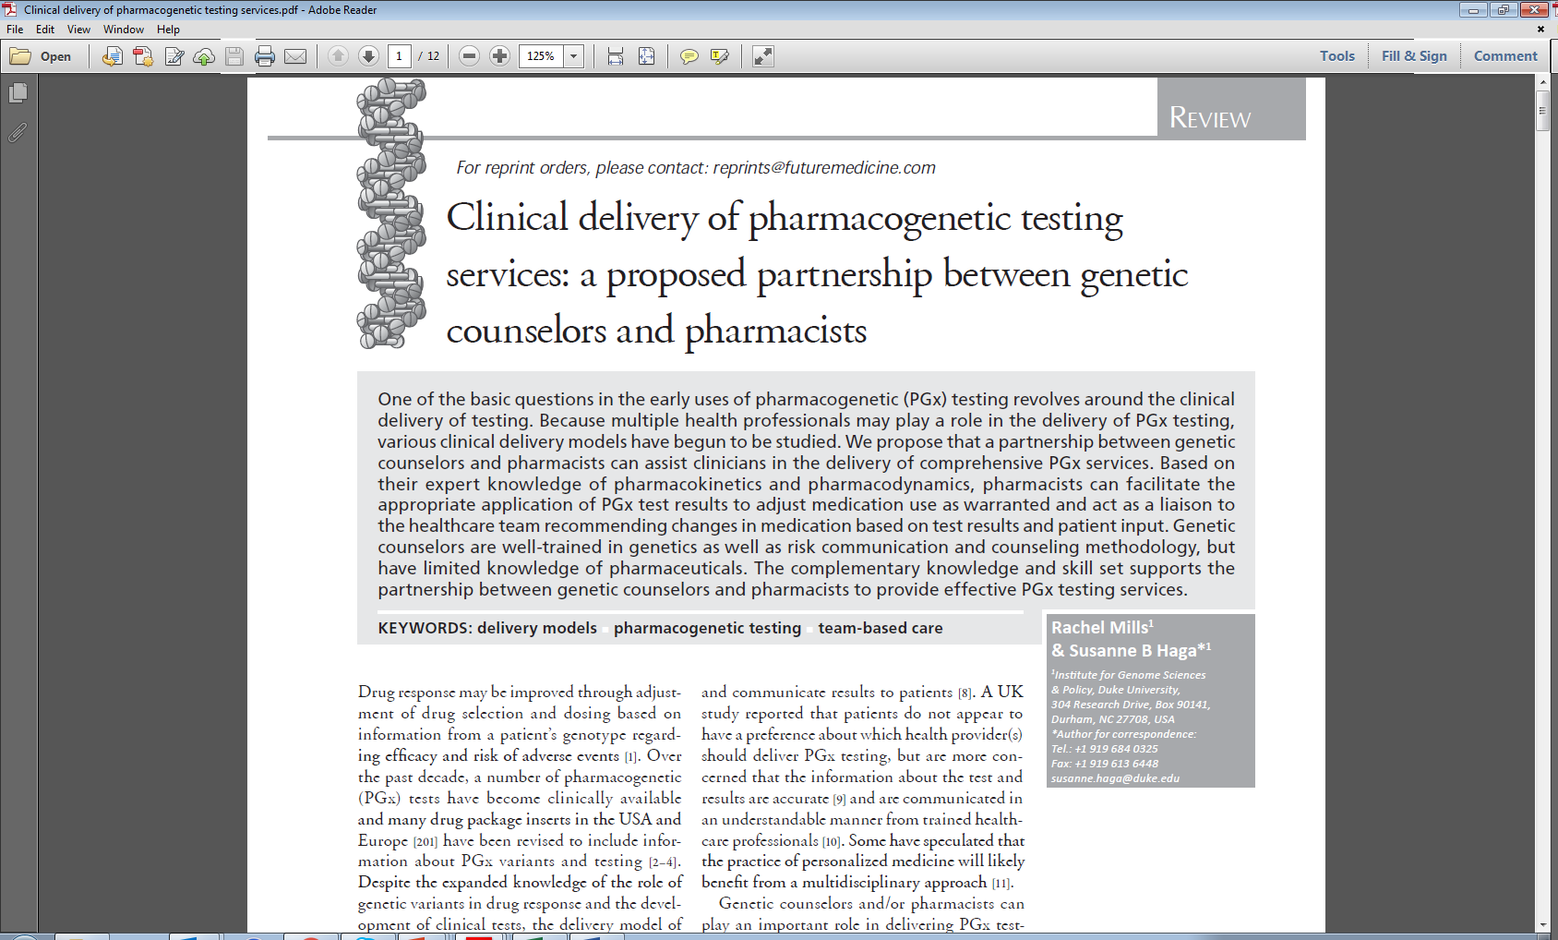
https://www.ncbi.nlm.nih.gov/pmc/articles/PMC3731754/ Accessed 29 Aug 2016.

Slide 4
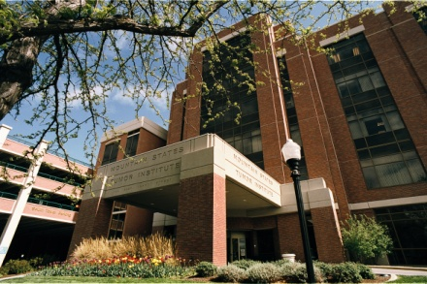
St. Luke’s Health System Mountain States Tumor Institute
Established in 1972
Regional Community Cancer Center
5 sites
Boise
Meridian, Nampa, Fruitland and Twin Falls
Serves southern Idaho, eastern Oregon and northern Nevada

Slide 5


Mark Wagner Post-Graduate Year 2 Oncology Resident

Slide 6
Pharmacogenetic Testing Process
1. Physician orders pharmacogenetic test
2. Insurance inquiry
5. Pharmacist completes dosing recommendation
3. Lab draw scheduled
4. Results to genetic counselor

Slide 7
The Real World
Physician orders pharmacogenetic test
Scheduler alerts financial advocate
Financial advocate performs insurance inquiry
Financial advocate (if approved by insurance) notifies scheduler and genetic counselor
Lab draws test and sends to appropriate lab
Pharmacist completes dosing recommendation sheet
Pharmacist sends electronic task to physician’s primary RN to alert physician of results
Pharmacist directly alerts physician if there is a mutation present
Scheduler schedules lab to be drawn at next patient visit
Send out lab reports results to genetic counselor
Genetic counselor alerts pharmacy of results
Physician uses information to ensure appropriate dosing for patient

Slide 8
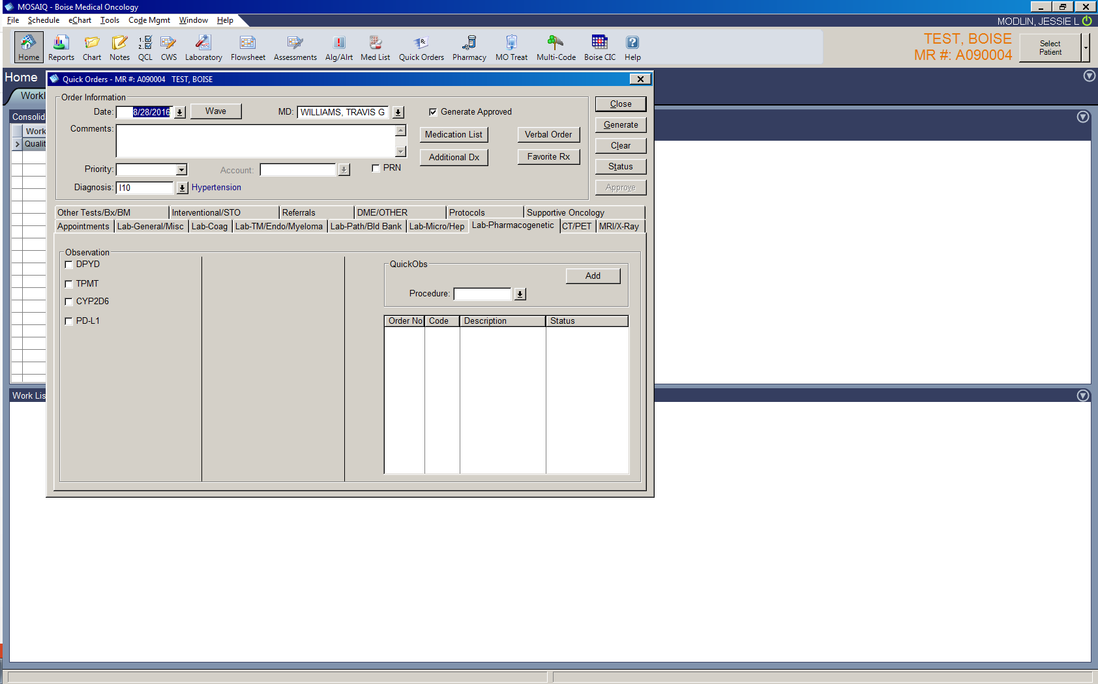
Selection of Pharmacogenetic Tests
Dosing recommendations available in the CPIC guidelines
Frequency of prescribing
Significance/incidence of genetic mutations
Cost and test availability
capecitabine, fluorouracil
thioguanine, mercaptopurine

Slide 9
Result Dissemination
Genetic Counselor
Receives results from contract lab
Communicates results with pharmacist
Pharmacist
Fills out dosing recommendation sheet
Sends electronic message to physician’s primary nurse
Alerts physician of results if necessary

Slide 10


Slide 11
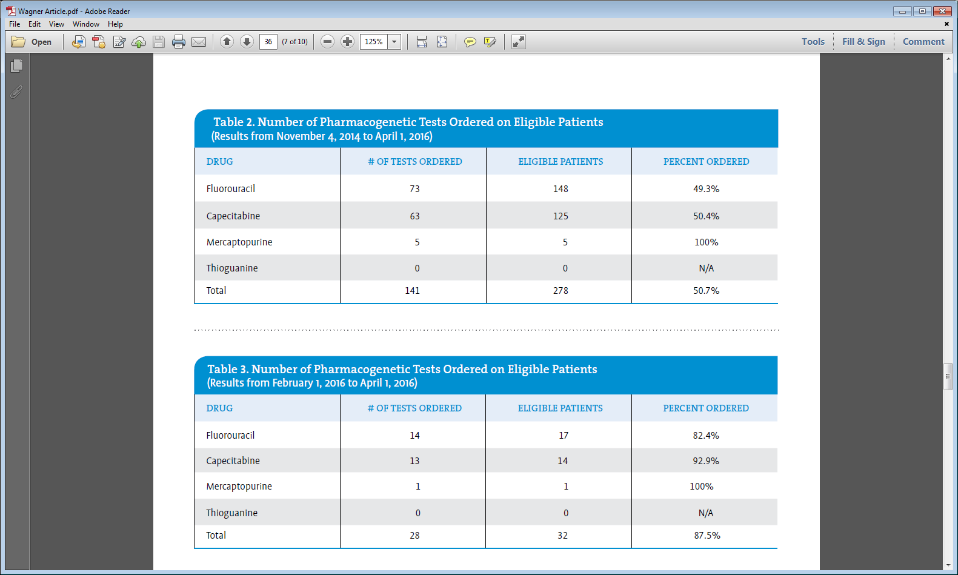

Slide 12
Results
Test | Homozygous Wild Type | Heterozygous Variant | Homozygous Variant
DPYD | 186 | 3 | 0
TPMT | 5 | 0 | 0
DPYD variants - *2A, *13, rs67376798A

Slide 13
Cost of Testing & Contract Labs
Individual genes vs alleles (~$200)
DPYD
TPMT
Variants of unknown significance
Test turn around time
Send out
Insurance requirement
Batched labs – twice weekly
13 days for DPYD; 9 days for TPMT
Multiple genes and cost effectiveness

Slide 14
Insurance Coverage
Insurance Company | # of Tests Ordered | # Approved | # Denied
Medicare | 36 | 35 | 1
Blue Cross | 22 | 8 (6 out of state) | 14 (3 out of state)
Regence | 7 | 2 | 3 (2 pending)
AARP Medicare CMPLT HMO | 7 | 7 | 0
United Healthcare | 6 | 6 | 0
Medicaid | 6 | 5 | 1
True Blue | 6 | 1 | 5
Select Health | 6 | 3 | 3
Tricare | 5 | 1 | 4
Pacific Source | 5 | 3 | 2
20 other companies (<4 tests ordered) | 28 | 14 | 14
Self Pay | 5 | 3 payed | 2 opted out

Slide 15
EMR Challenges
Epic Go-Live Oct 1, 2016
Admin support not available to establish new workflow
Reports
Pharmacy recommendations
Patient identification

Slide 16

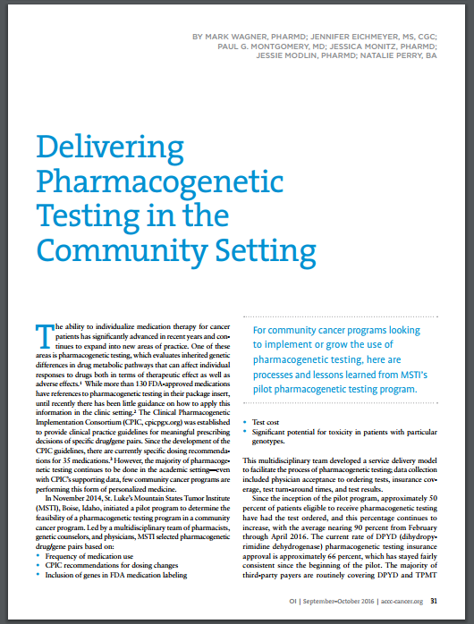
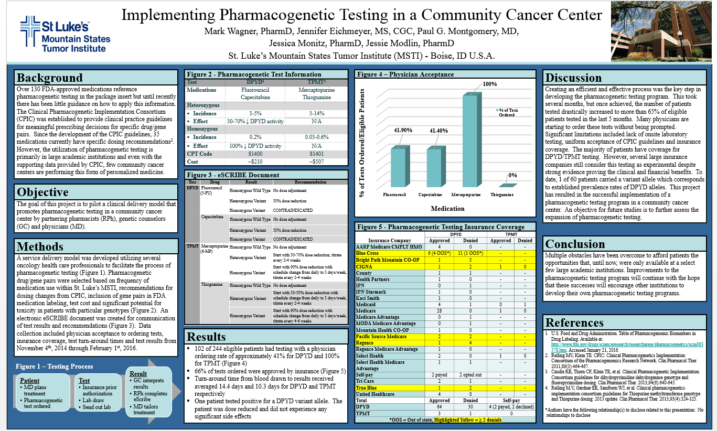

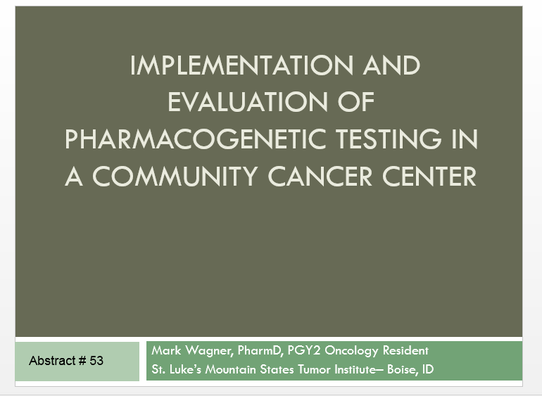
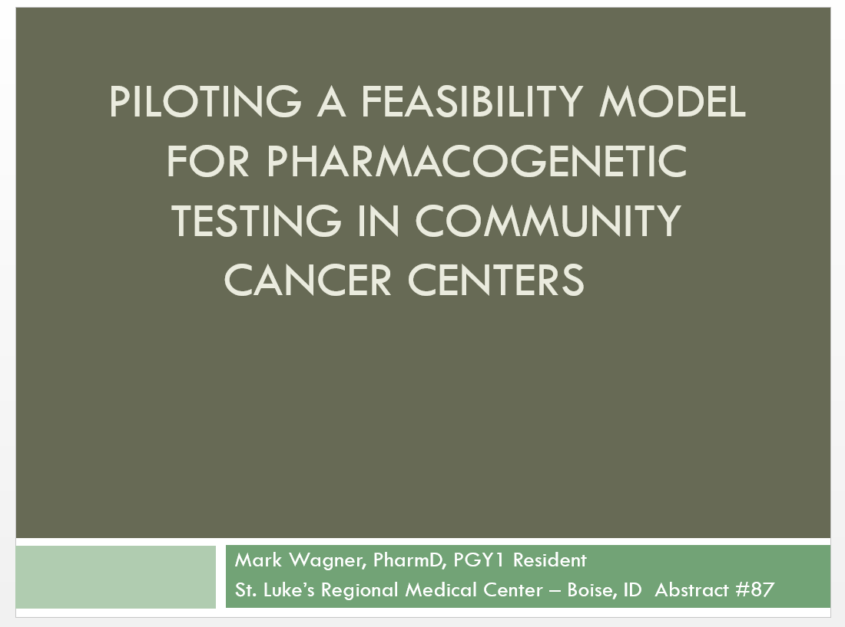
Oncology Issues Sep/Oct 2016
Idaho Society of Clinical Oncology
2016
National Society of Genetic Counseling Education Conference Sept 2017
Hematology/Oncology Pharmacy Association 2016
Mountain States Conference 2015 and 2016

Slide 17
Pharmacogenetic Testing in Community Cancer Centers
Lab does not perform this test
We don’t know if insurance will pay
Pharmacy does not know how to interpret the results
EMR is not set up to order this testing pre-emptively before treatment starts
Lack of staffing of genetic counselors
Genetic counselors have limited training (non-traditional role)

Slide 18
Thank you

