Slide 1
Please mute your phone or computer

Slide 2
CYP2D6 Genotype to Phenotype Standardization Project
Survey 1 Results

Slide 3
Project Objectives
Determine a strategy for defining CYP2D6 phenotype based on genotype using a modified Delphi method.
Standardize phenotype definitions across CPIC and DPWG guideline and external groups.

Slide 4
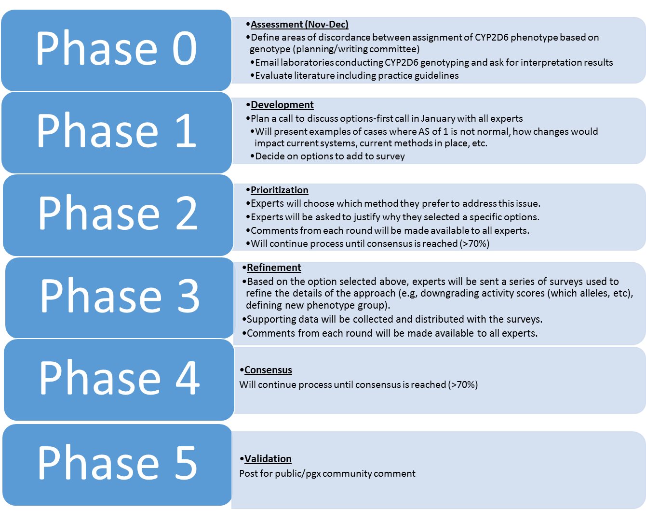

Slide 5
Demographics: Workplace setting
11.1%
7.4%
48.2%
18.5%
14.8%
n = 27

Slide 6
Demographics: % of work involving CYP2D6
3.7%
7.4%
22.2%
48.2%
18.5%
n = 27

Slide 7
Q1: Clinically significant difference between AS 1 and 2?
YES
92.6% (n = 25)
NO
7.4% (n = 2)
n = 27
Select comments:
Substrate-specific
Protein expression as well as functional activity is significantly reduced in AS 1 vs. AS 2
Definitely PK differences
PK differences may or may not equate to clinical differences (drug-specific – depends on therapeutic index)
Strongest difference between *10/*10 and *1/*1 (difference may not exist if *10 is not included in analysis)
Appears to be difference when *10 included in analysis, but not in studies that do not include *10
AS 1 may be more prone to interactions with CYP2D6 inhibitor vs. AS 2
If difference wasn’t found, it was due to small sample size

Slide 8
Q2: Clinically significant difference between AS 0.5 and 1?
YES
77.8% (n = 21)
NO
22.2% (n = 6)
n = 27
Select comments:
Substrate-specific
Difficult to determine from available data – need more research
Studies that show a difference have a larger sample size than studies that don’t
Less data to support difference
May be statistical difference but likely no clinical difference
Best to distinguish between the two to account for the cases where the difference may be relevant
Recommend keeping phenotypes as detailed as possible to avoid discrepancies between studies that can complicate interpretation when various genotype combinations are pooled in same phenotype

Slide 9
Q3: Downgrade certain alleles from AS 0.5 to AS 0.25?
NO
48.2% (n = 13)
YES
51.8% (n = 14)
n = 27
Participants who believe certain alleles should be downgraded were prompted to answer the following question about which alleles should be classified as AS 0.25

Slide 10
Q4: Which alleles should be downgraded to AS 0.25?
n = 14

Slide 11
Q5: Which method to convert genotype to phenotype?

Slide 12
Last call
Allele Activity score vs Percentage Activity

Slide 13
Next steps
Survey 2: Will focus on options where more than 40% agreed:
Working with DPWG to come up with recommendations to bring to the group.

