Slide 1
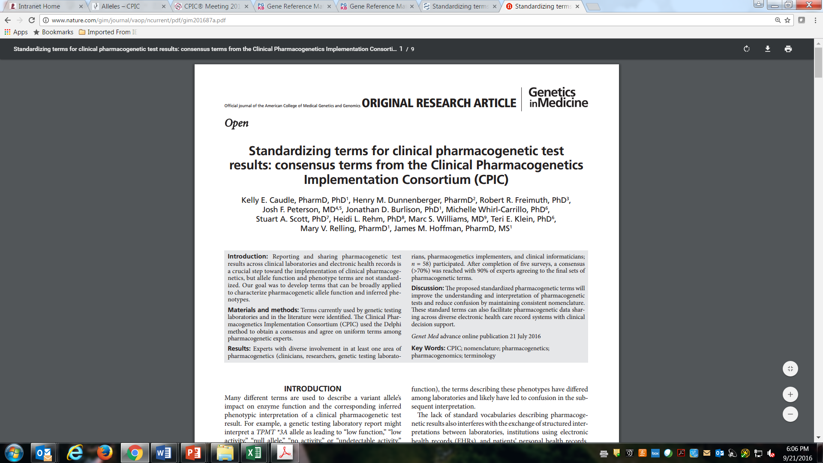

Slide 2
Request SNOMED codes be standardized to CPIC phenotype terms
TPMT – SNOMED CT Code
Thiopurine methyltransferase deficiency
vs
TPMT- standardized Terms
TPMT - Normal Metabolizer (normal dose)
TPMT - Intermediate Metabolizer (60% dose)
TPMT - Poor Metabolizer (5% dose)

Slide 3
SNOMED Submission: Work Completed by CPIC Informatics
Defined scope of submission to include these genes:
CYP2B6, CYP2C9, CYP2C19, CYP2D6, CYP3A5, DPYD, TPMT, UGT1A1, HLA-B (15:02, 57:01, 58:01), HLA-A (31:01)
Reviewed existing SNOMED pharmacogenetic terms
Found substantial variability in both terms and location in tree structure

Slide 4
SNOMED Submission: Work Completed by CPIC Informatics
Proposed tree structure position for new phenotype terms
Submission process
Reviewed submission procedures
Determined we must make a unique submission for each gene
Started drafting submission

Slide 5
Proposed SNOMED Tree Structure
SNOMED CT Concept → Clinical finding → Evaluation finding → Genetic finding → Pharmacogenetic phenotype → PHENOTYPE TERM (e.g., CYP2D6 intermediate metabolizer)
Contrast to existing terms and tree structure
Actionable phenotypes often listed as diseases or disorders
Others as enzyme or laboratory test
Range of location in tree structure; some very deep (e.g. CYP2D6)

Slide 6
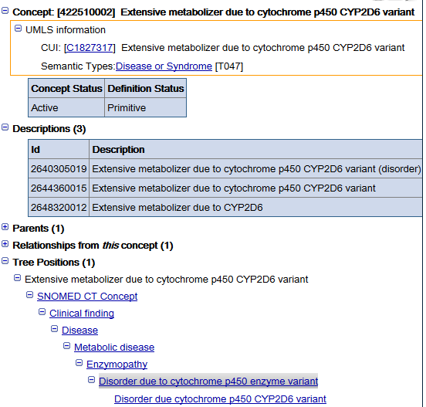

Slide 7
Next Steps for SNOMED Submission
Conduct BRIEF survey to confirm CPIC Informatics Plan
About 5 questions plus a few demographic questions
Send to CPIC members with the minutes from this call (next week)
Post to PharmGKB to reach beyond CPIC membership
Interested in responses from around the world since SNOMED is an international terminology
If survey shows consensus, expect to submit by June 1

Slide 8
Questions and Discussion

Slide 9
Final Standardized Terms: Allele function
Term/Gene Category | Final Term | Functional Definition | Example diplotypes/alleles
Allele Functional Status-all genes | Increased Function | Function greater than normal function | CYP2C19*17
 | Normal Function | Fully functional/wild-type | CYP2C19*1
 | Decreased Function | Function less than normal function | CYP2C19*9
 | No Function | Non-functional | CYP2C19*2
 | Unknown Function | No literature describing function or the allele is novel | CYP2C19*29
 | Uncertain Function | Literature supporting function is conflicting or weak | CYP2C19*12
Caudle KE, et al. Genet Med. 2016;Jul 21 [Epub ahead of print]
Notes:
Will update citation if available before meeting

Slide 10
Final Standardized Terms: Phenotype for Drug Metabolizing Enzymes
For example: CYP2C19, CYP2D6, CYP3A5, CYP2C9, TPMT, DPYD, UGT1A1
Final Term | Functional Definition | Example diplotypes/alleles | Term/Gene Category
Ultra-rapid Metabolizer | Increased enzyme activity compared to rapid metabolizers | Two increased function alleles, or more than 2 normal function alleles | CYP2C19*17/*17 CYP2D6*1/*1XN
Rapid Metabolizer | Increased enzyme activity compared to normal metabolizers but less than ultra-rapid metabolizers | Combinations of normal function and increased function alleles | CYP2C19*1/*17
Normal Metabolizer | Fully functional enzyme activity | Combinations of normal function and decreased function alleles | CYP2C19*1/*1
Intermediate Metabolizer | Decreased enzyme activity (activity between normal and poor metabolizer) | Combinations of normal function, decreased function, and/or no function alleles | CYP2C19*1/*2
Poor Metabolizer | Little to no enzyme activity | Combination of no function alleles and/or decreased function alleles | CYP2C19*2/*2
Caudle KE, et al. Genet Med. 2016;Jul 21 [Epub ahead of print]
Notes:
Will update citation if available before meeting

Slide 11
Final Standardized Terms: Phenotype for Drug Transporters
For example: SLCO1B1
Final Term | Functional Definition | Example diplotypes/alleles | Term/Gene Category
Increased Function | Increased transporter function compared to normal function | One or more increased function alleles | SLCO1B1*1/*14
Normal Function | Fully functional transporter function | Combinations of normal function and/or decreased function alleles | SLCO1B1*1/*1
Decreased Function | Decreased transporter function (function between normal and poor function) | Combinations of normal function, decreased function, and/or no function alleles | SLCO1B1*1/*5
Poor Function | Little to no transporter function | Combination of no function alleles and/or decreased function alleles | SLCO1B1*5/*5
Caudle KE, et al. Genet Med. 2016;Jul 21 [Epub ahead of print]
Notes:
Will update citation if available before meeting

Slide 12
Final Standardized Terms: (HLA-genes) Phenotype for High-Risk Genotype Status
For example: HLA-B*57:01
Final Term | Functional Definition | Example diplotypes/alleles | Term/Gene Category
Positive | Detection of high-risk allele | Homozygous or heterozygous for high-risk allele | HLA-B*15:02
Negative | High risk-allele not detected | No copies of high-risk allele
Caudle KE, et al. Genet Med. 2016;Jul 21 [Epub ahead of print]
Notes:
Will update citation if available before meeting

Slide 13
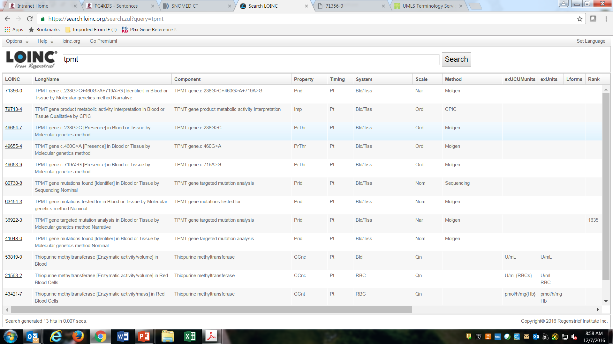
CPIC Informatics: working to standardize and clean up LOINC codes for all CPIC genes

