Slide 1
DPYD Nomenclature

Slide 2
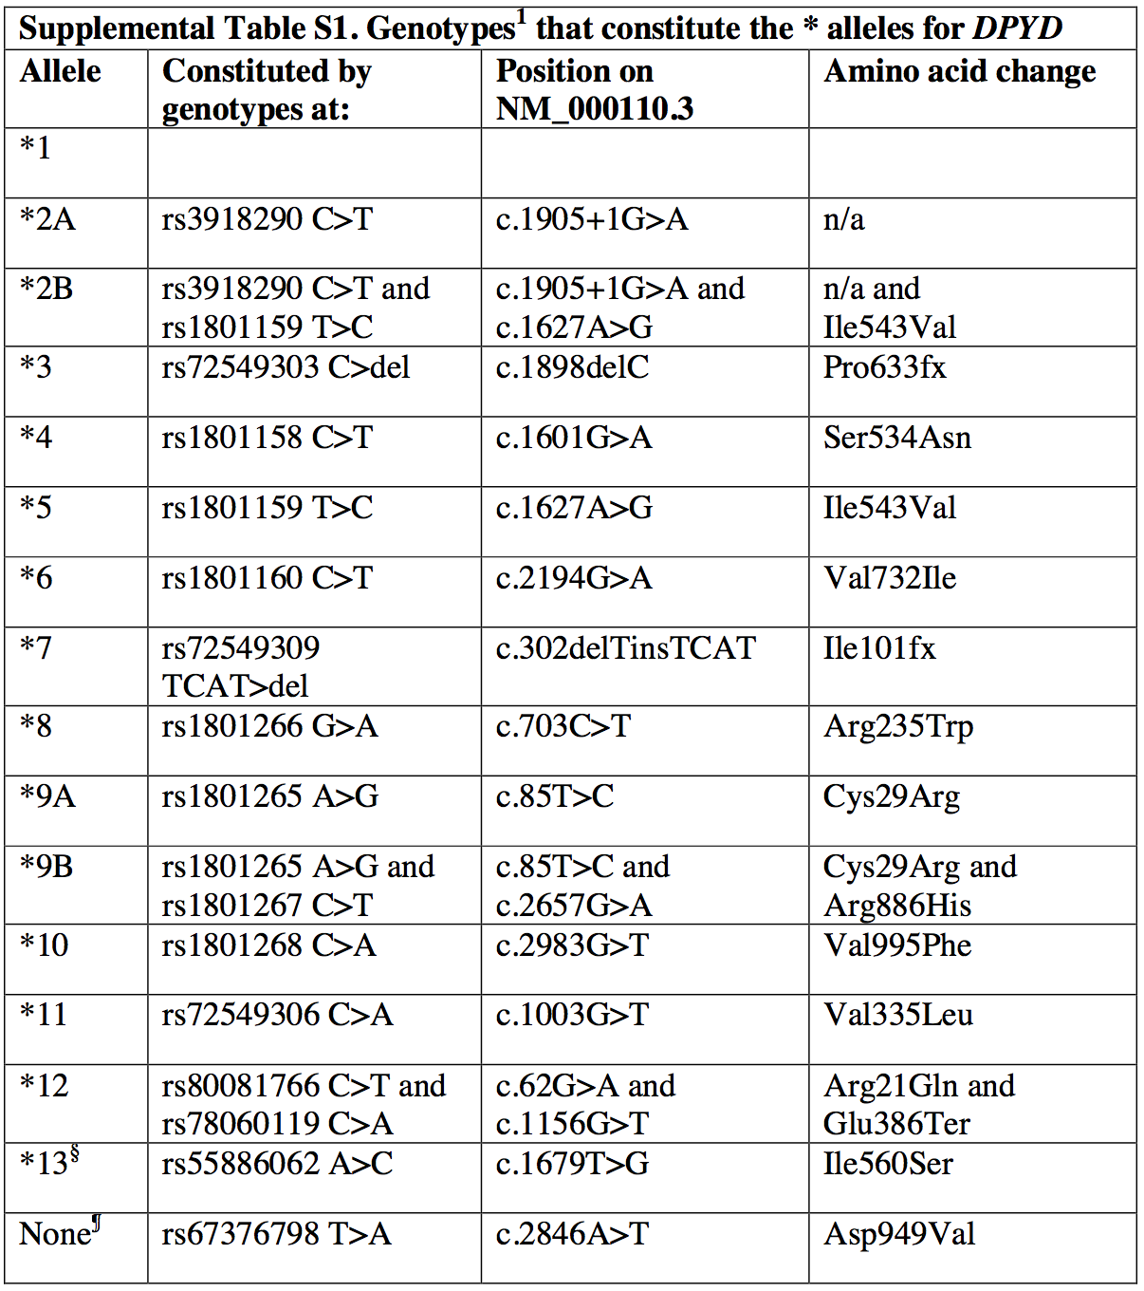
A small set of DPYD variants have designated * alleles, which came from nomenclature published by several groups.
These * allele designations were used in the previous DPYD CPIC guideline
Notes:
McLeod, H.L. et al. Nomenclature for human DPYD alleles. Pharmacogenetics 8, 455-9 (1998)
Mattison, L.K., Johnson, M.R. & Diasio, R.B. A comparative analysis of translated dihydropyrimidine dehydrogenase cDNA; conservation of functional domains and relevance to genetic polymorphisms. Pharmacogenetics 12, 133-44 (2002)
Johnson, M.R., Wang, K. & Diasio, R.B. Profound dihydropyrimidine dehydrogenase deficiency resulting from a novel compound heterozygote genotype. Clin Cancer Res 8, 768-74 (2002).

Slide 3
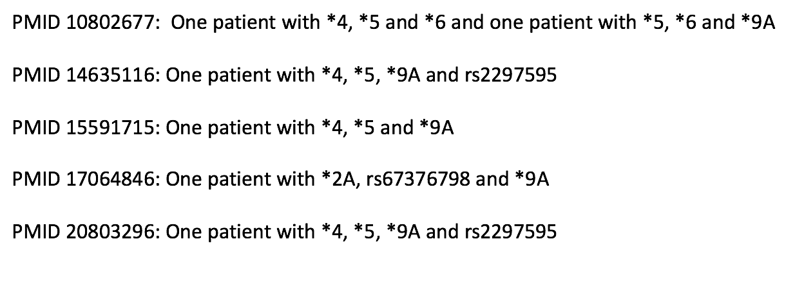
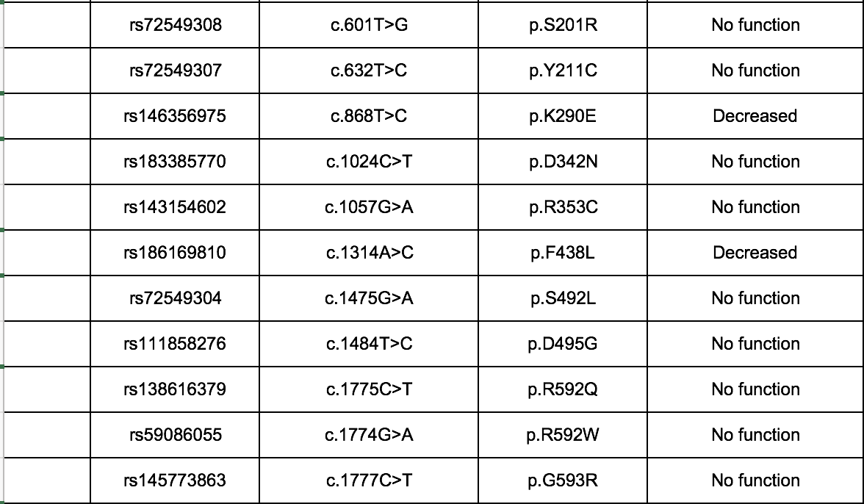
Issues with using * nomenclature for DPYD
Can have multiple * alleles on the same chromosome
* allele nomenclature hasn’t been updated to capture new variants that have been discovered (>100)
Notes:
~110 new variants added, with 11 decreased and 20 no function. Will mention that rs67376798 isn’t covered either.

Slide 4
Two options: rsIDs and alleles vs. HGVS nomenclature
rsID and allele
HGVS
rs3918290 C>T
c.1905+1C>T
rs1801265 A>G
c.85A>G
Previous guidelines have used rsIDs
rsIDs are mapped to multiple reference sequences in dbSNP so you can cross different genome builds, as well as gene, cDNA and protein reference sequences.
HGVS nomenclature may be more commonly used

