Slide 1
CPIC Informatics
Feb 6, 2019

Slide 2
Agenda
Introductions and announcements
Membership reminders – new members welcome to apply and join
CPIC open meeting in June – registration now open
Guideline updates (Kelly)
Discuss database/API efforts
Recap key findings from Nov/Dec listening sessions
Review organizations interested in being involved as early testing partners
Discuss progress on further standardizing implementation resources to enable database

Slide 3
Guidelines
This group does careful review of the resources with each guideline
Review Recent Guidelines
Review Upcoming Guidelines

Slide 4

2011
TPMT – thiopurines
CYP2C19– clopidogrel
CYP2C9, VKORC1 – warfarin
2012
CYP2D6 – codeine
HLA-B – abacavir
SLCO1B1 – simvastatin
2013
HLA-B – allopurinol
CYP2D6, CYP2C19 – TCAs
HLA-B – carbamazepine
DPYD -- 5FU / capecitabine
TPMT – thiopurines—UPDATE
CYP2C19 – clopidogrel--UPDATE
2014
IL28B -- PEG interferon α
CFTR -- Ivacaftor
G6PD -- Rasburicase
CYP2C9, HLA-B -- Phenytoin
CYP2D6 – codeine--UPDATE
HLA-B – abacavir--UPDATE
SLCO1B1 – simvastatin—UPDATE
2015
CYP3A5 – tacrolimus
CYP2D6, CYP2C19– SSRIs
UGT1A1 – atazanavir
HLA-B – allopurinol—UPDATE
2016
CYP2C19 – voriconazole
CYP2D6 – ondansetron
CYP2C9, VKORC1 – warfarin--UPDATE
CYP2D6, CYP2C19 – TCAs--UPDATE
2017
CYP2D6 – tamoxifen
HLA-B – carbamazepine—UPDATE
DPYD -- 5FU / capecitabine—UPDATE-in review
2018
RYR1/CACNA1S– inhaled anesthetics
TPMT/NUDT15 – thiopurines—UPDATE
2019 (in progress)
CYP2B6—efavirenz-in review
CYP2D6—atomoxetine-in review
CYP2C19/PPI
CYP2C9/HLA-phenytoin—UPDATE
CYP2C9/NSAIDS
CYP2D6/codeine-UPDATE (to include other opioids)
https://cpicpgx.org/guidelines/
Notes:
Kelly to update this slide closer to the meeting

Slide 5
Discuss Database/API Efforts
Recap key findings from Nov/Dec listening sessions
Review organizations interested in being involved as early testing partners
Discuss progress on further standardizing implementation resources to enable database

Slide 6
Some key findings from listening session
Great interest from a variety of users
Scope questions – initial focus is outside the EHR but eventually could go deeper in time
Features and requests
Robust versioning mentioned several times
Could be scenarios where would want to look at what recommendations were over time
Default to most recent version
Batch processing scenario discussed – use entire database
Defining what is actionable is important

Slide 7
Some key findings from listening session
Discussion brought up other resources
Examples
PharmVar
PharmCat
We will not duplicate efforts and this will provide something others do not currently offer

Slide 8
Discuss Database/API Efforts
Review organizations interested in being involved as early testing partners

Slide 9
Discuss Database/API Efforts
Discuss progress on further standardizing implementation resources to enable database

Slide 10
For Reference
Slides from Listening Sessions

Slide 11
Planning for CPIC Database content, functionality, API
Listening Sessions
CPIC Informatics Call 11/27/18
CPIC Call 12/6/18

Slide 12
Developing new tools to expand and customize use of CPIC guidelines
Make guidelines more computable
Implementation resources available on www.cpicpgx.org
Database for implementation resources
Application Programming Interface (API)
Will enable use of CPIC knowledge in new ways across a broad potential user community
Notes:
Hospitals
Laboratories
EHR vendors
Drug information providers

Slide 13

The established CPIC implementation resources provide a foundation for these new tools
CPIC Informatics work group lead the development of resources that accompany each guideline
First set of resources published in 2014 (abacavir/HLA guideline update)
Comprehensive translation tables from genotype to phenotype to clinical recommendation is one unique resource
Genotype
Phenotype
Recommendation

Slide 14
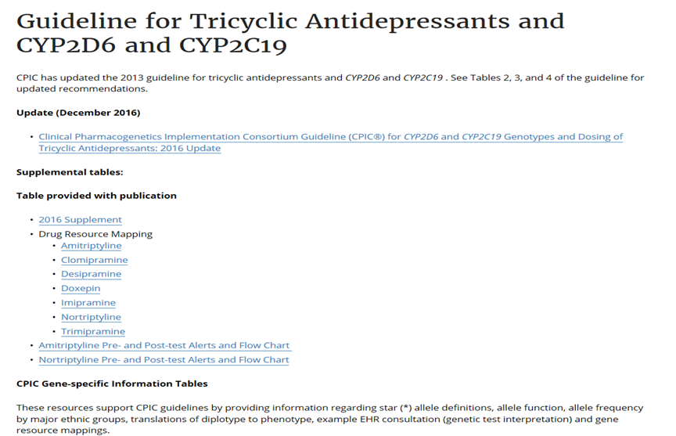
Hoffman JM et al. J Am Med Inform Assoc. 2016 https://cpicpgx.org/guidelines/

Slide 15
Examples of potential use cases
Retrieve a summary of the drugs and genes that are associated with a CPIC guideline Uses the standard nomenclatures already in CPIC guidelines (e.g. RxNorm for medications and HGNC for genes)

Slide 16
Examples of potential use cases
Retrieve a summary of the drugs and genes that are associated with a CPIC guideline Uses the standard nomenclatures already in CPIC guidelines (e.g. RxNorm for medications and HGNC for genes)
Filter available drug/gene information to specific local needs CPIC guideline may include information on 7 tricyclic antidepressants, but users may only want to download applicable information (e.g. CDS language) for the drugs on the hospital’s formulary Further, show recommendations based on one gene (e.g. CYP2D6) for an antidepressant – not the second gene (e.g. CYP2C19) for which testing is not yet available at the site
Retrieve all drugs with CPIC guidelines and return a summary of all actionable diplotype/phenotype data with the corresponding CDS alert language These data would be used on an ongoing basis This data may be sent to different applications and/or users

Slide 17
Examples of potential use cases
Retrieve a summary of the drugs and genes that are associated with a CPIC guideline Uses the standard nomenclatures already in CPIC guidelines (e.g. RxNorm for medications and HGNC for genes)
Filter available drug/gene information to specific local needs CPIC guideline may include information on 7 tricyclic antidepressants, but users may only want to download applicable information (e.g. CDS language) for the drugs on the hospital’s formulary Further, show recommendations based on one gene (e.g. CYP2D6) for an antidepressant – not the second gene (e.g. CYP2C19) for which testing is not yet available at the site
Retrieve all drugs with CPIC guidelines and return a summary of all actionable diplotype/phenotype data with the corresponding CDS alert language These data would be used on an ongoing basis This data may be sent to different applications and/or users

Slide 18
Query Examples

Slide 19
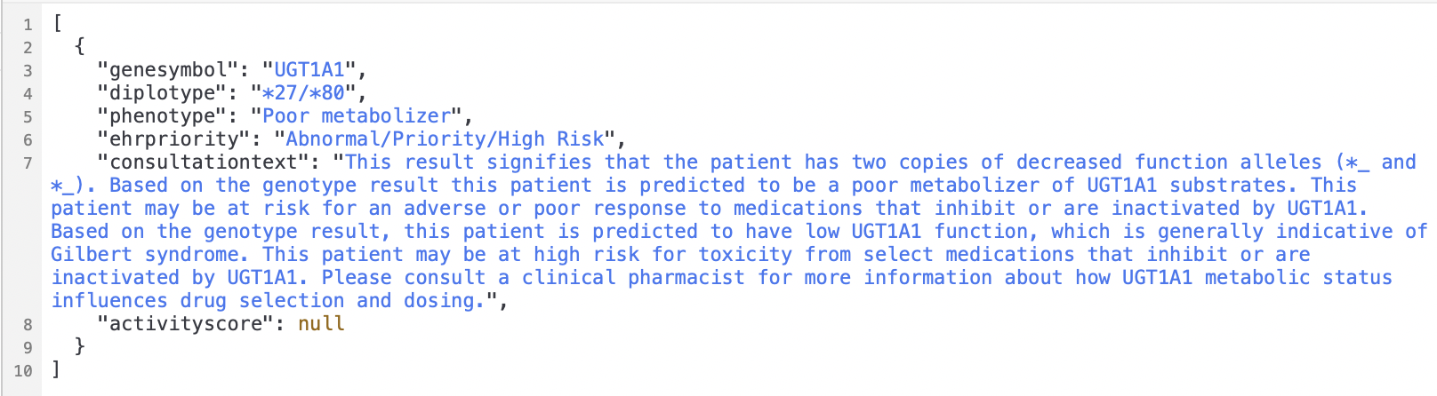
/diplotype_view?genesymbol=eq.UGT1A1&diplotype=eq.*27/*80

Slide 20
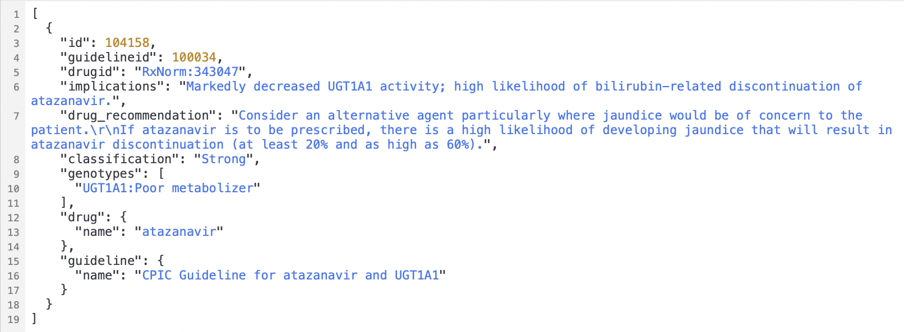
/recommendation?genotypes=cs.”UGT1A1:Poor metabolizer”

Slide 21
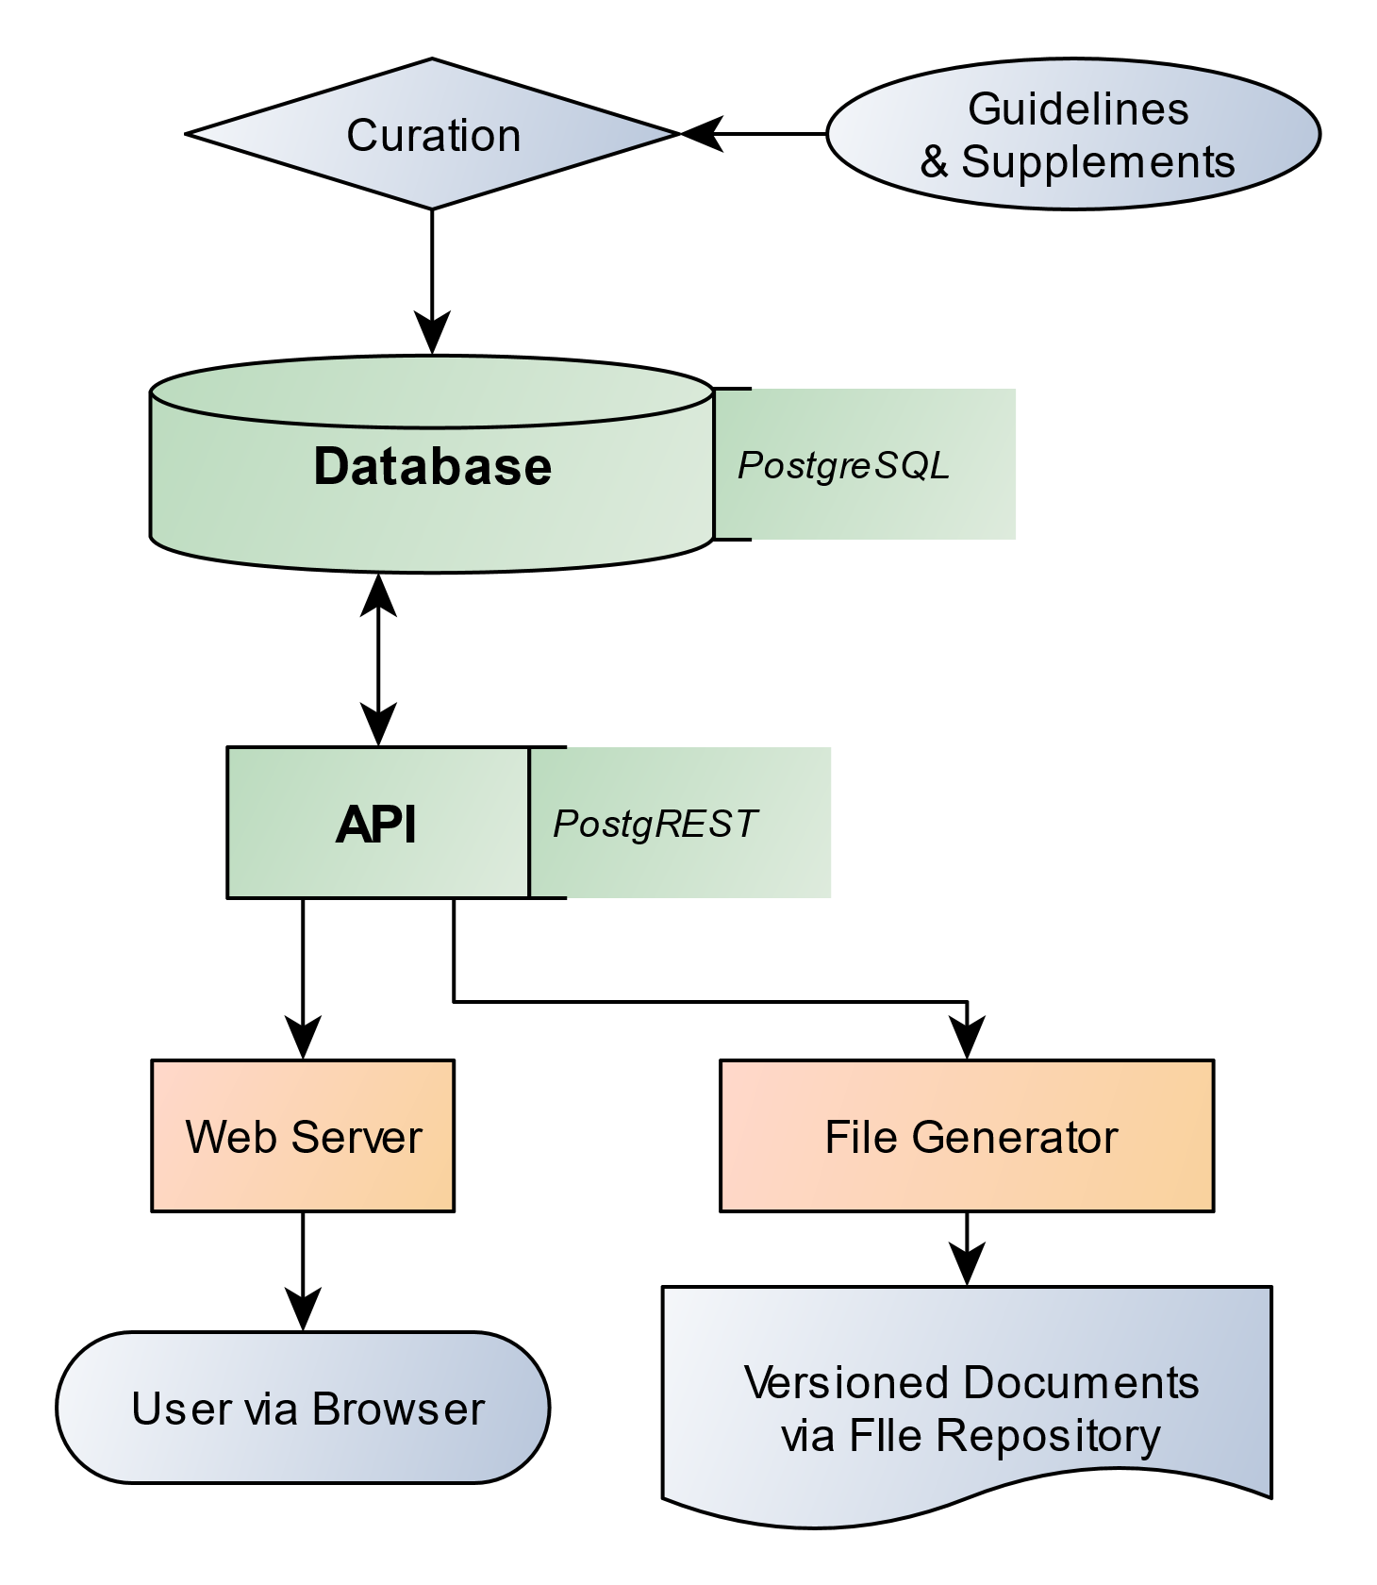

Slide 22
Feedback: Questions to guide discussion
How do you anticipate you would use the CPIC database/API?
Of the existing CPIC implementation resources, what is the top priority to build in the database?
What support or guidance would you need to use the CPIC database/API?
How should the CPIC guideline development process change to support these new resources?

Slide 23
Next steps
Evaluate feedback from both listening sessions and determine where additional information may be needed
Additional review with CPIC leadership and steering committee
Ongoing progress reports on CPIC Informatics calls with routine updates to all of CPIC

