Slide 1

The Clinical Pharmacogenetics Implementation Consortium: Incorporating Pharmacogenetics into Clinical Practice and the EHR

Slide 2
Learning Objectives
After completing this activity, the learner should be able to…
Describe barriers to clinical implementation of pharmacogenetics.
Describe CPIC and the underlying assumptions of CPIC guidelines.
Explain the CPIC guideline development process.
Illustrate how CPIC guidelines can be used by clinicians to make specific prescribing decisions for patient care when genetic information is available.
Illustrate how CPIC guidelines can be used to aid the clinical implementation of pharmacogenomics into the electronic health record with clinical decision support.

Slide 3
Survey: Challenges to implementing pharmacogenetics in the clinic
What do you think is the most challenging aspect of the implementation of pharmacogenetics into the clinic?
Translation of genetic information into clinical action
Test cost, test reimbursement or other economic issues
Availability of high quality genotyping test (CLIA approved)
Electronic medical record use, such as the application of CDS
Clinician and patient resistance and/or ethical concerns
Clin Pharmacol Ther. 2011 Mar;89(3):464-7.

Slide 4
Survey: top 3 Challenges to implementing pharmacogenetics in the clinic
95% of respondents selected: “process required to translate genetic information into clinical actions”
Next 2 responses
  Genotype test interpretation (e.g. using genotype information to impute phenotype)
  Providing recommendations for selecting the drug/gene pairs to implement
Clin Pharmacol Ther. 2011 Mar;89(3):464-7.

Slide 5
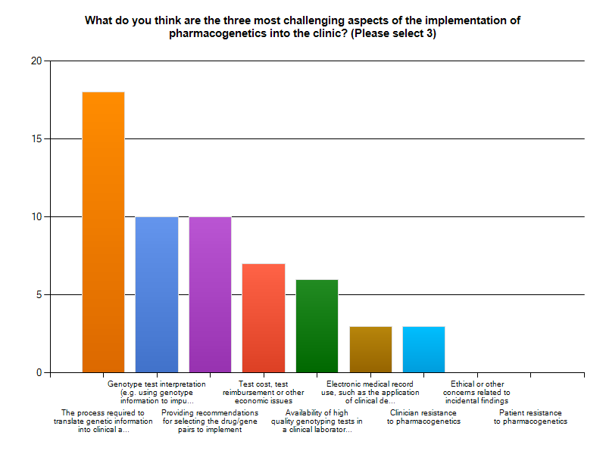
Clin Pharmacol Ther. 2011 Mar;89(3):464-7.

Slide 6
Key Points about a CPIC guideline
Based on assumption that the test results are in hand and NOT to discuss the merits of doing the test
Standardized formats
Grading of evidence and of recommendations
Peer reviewed
Freely available
Updated
Authorship with COI policy
Closely follow IOM practices

Slide 7
CPIC guidelines are designed to help clinicians understand HOW available genetic test results should be used to optimize drug therapy.
  Not WHETHER tests should be ordered.
Key Assumption:
  Clinical high-throughput and pre-emptive genotyping will become more widespread.
  Clinicians will be faced with having patients’ genotypes available even if they did not order test with drug in mind.

Slide 8

2011
TPMT – thiopurines
CYP2C19– clopidogrel
CYP2C9, VKORC1 – warfarin
2012
CYP2D6 – codeine
HLA-B – abacavir
SLCO1B1 – simvastatin
2013
HLA-B – allopurinol
CYP2D6, CYP2C19 – TCAs
HLA-B – carbamazepine
DPYD -- 5FU / capecitabine
TPMT – thiopurines—UPDATE
CYP2C19 – clopidogrel--UPDATE
2014
IL28B -- PEG interferon α
CFTR -- Ivacaftor
G6PD -- Rasburicase
CYP2C9, HLA-B -- Phenytoin
CYP2D6 – codeine--UPDATE
HLA-B – abacavir--UPDATE
SLCO1B1 – simvastatin—UPDATE
2015
CYP3A5 – tacrolimus
CYP2D6, CYP2C19– SSRIs
UGT1A1 – atazanavir
HLA-B – allopurinol—UPDATE
2016
CYP2C19 – voriconazole
CYP2D6 – ondansetron
CYP2C9, VKORC1 – warfarin--UPDATE
CYP2D6, CYP2C19 – TCAs--UPDATE
2017
CYP2D6 – tamoxifen
HLA-B – carbamazepine—UPDATE
DPYD -- 5FU / capecitabine—UPDATE
2018
RYR1/CACNA1S– inhaled anesthetics
TPMT/NUDT15 – thiopurines—UPDATE
2019 (in progress included)
CYP2B6—efavirenz-published
CYP2D6—atomoxetine-published
CYP2C19/PPI
CYP2C9/HLA-phenytoin—UPDATE
CYP2C9/NSAIDS
CYP2D6/codeine-UPDATE (to include other opioids)
CYP2C19/clopidogrel-UPDATE
mtRNR1/aminoglycosides
https://cpicpgx.org/guidelines/
Notes:
Kelly to update this slide closer to the meeting

Slide 9
23 guidelines; 20 genes and 46 drugs
TPMT, NUDT15
  MP, TG, azathioprine
CYP2D6
  Codeine, tramadol, hydrocodone, oxycodone, TCAs, tamoxifen, SSRIs, ondansetron, tropisetron, atomoxetine
CYP2C19
  TCAs, clopidogrel, voriconazole, SSRIs, PPIs (in progress)
VKORC1
  Warfarin
CYP2C9
  Warfarin, phenytoin, NSAIDs (in progress)
CYP4F2
  Warfarin
HLA-B
  --Allopurinol, CBZ, Oxcarbazepine, abacavir, phenytoin
HLA-A
  CBZ
CFTR
  -- Ivacaftor
DPYD
  5FU, capecitabine, tegafur
G6PD
  Rasburicase
UGT1A1
  Atazanavir
SLCO1B1
  Simvastatin
IFNL3 (IL28B)
  Interferon
CYP3A5
  Tacrolimus
CYP2B6
  Efavirenz
RYR1, CACNA1S
  Inhaled anesthetics
mtRNR1 (in progress)
  aminoglycosides
https://cpicpgx.org/guidelines/

Slide 10
As of October 2019:
  >385 Members
    Clinicians and scientists
    292 institutions
    35 countries
  14 Observers (NIH, FDA, professional societies)
  CPIC Informatics
    >35 members from 25 organizations
Notes:
89 in 2013
42 institutions

Slide 11
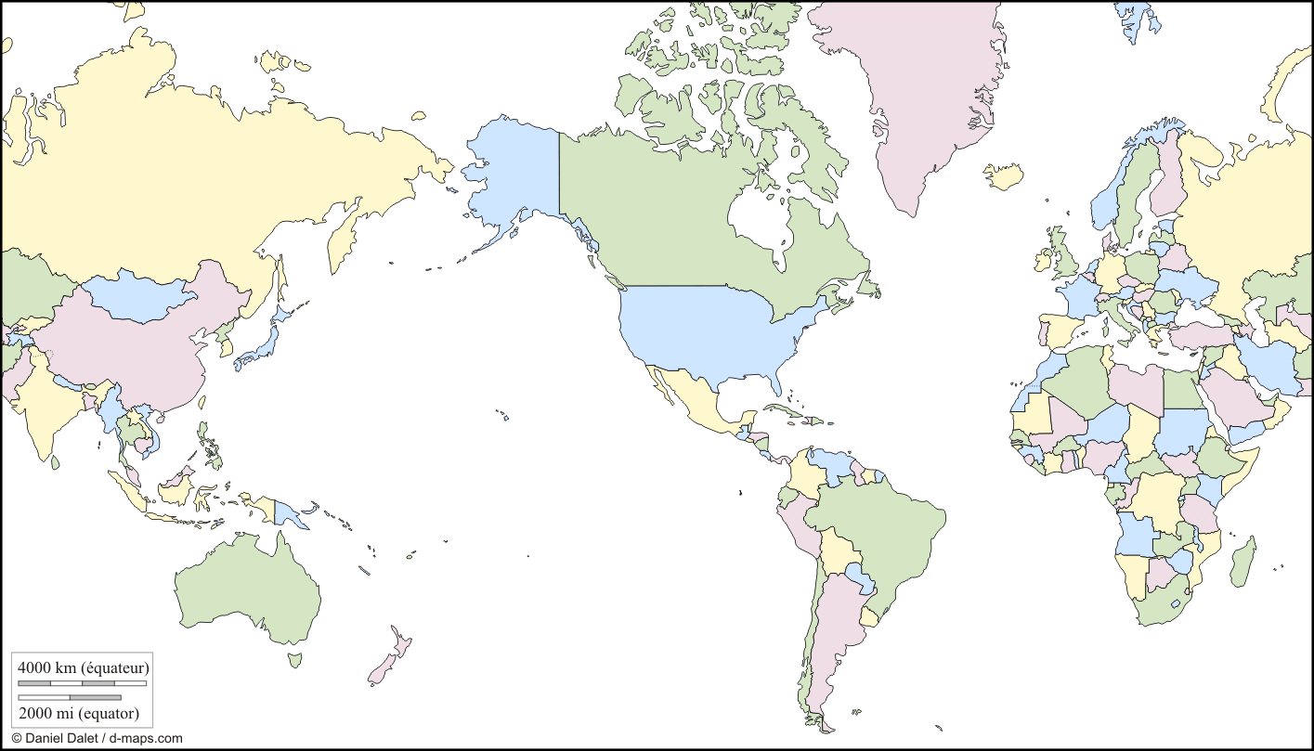
>385 members
Academic, Hospital,
Health Care Systems
Industry

Slide 12
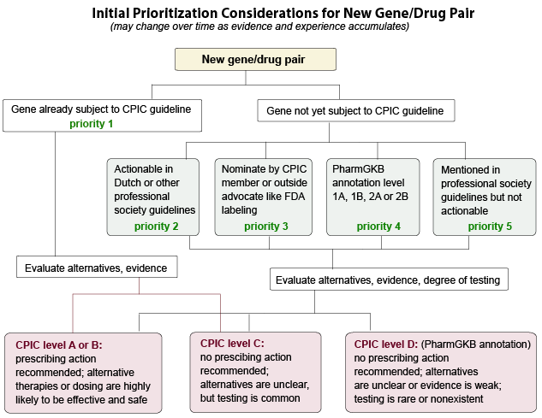
Initial Prioritization Considerations for New Gene/Drug Groups
New genes/drugs

Slide 13
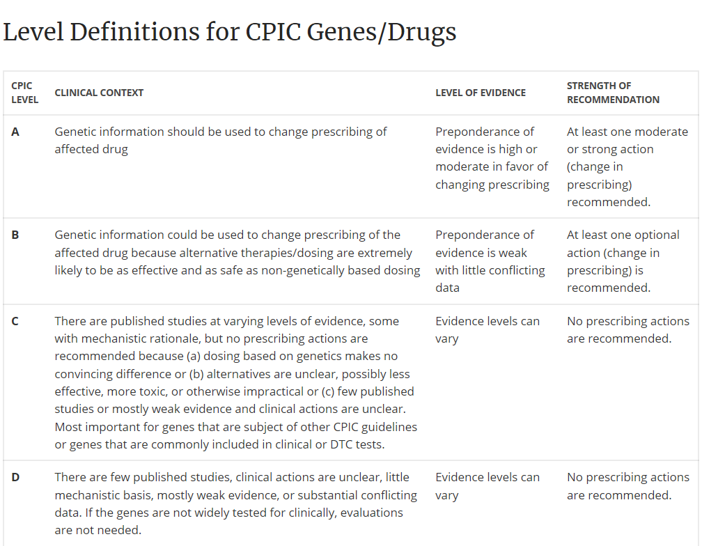

Slide 14
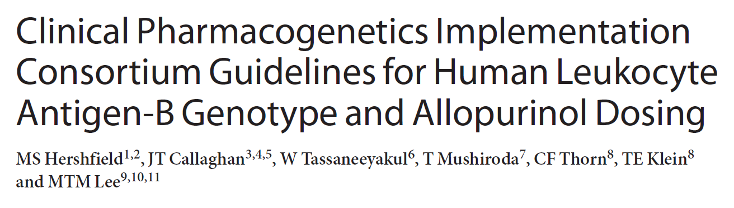
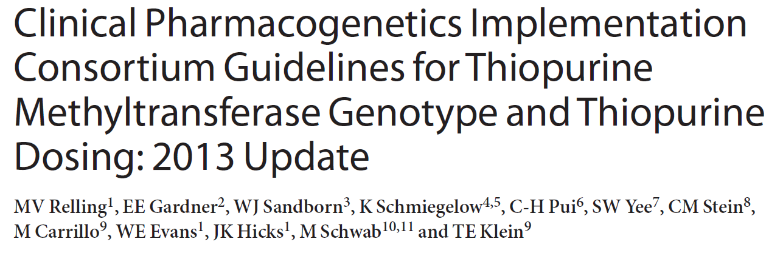
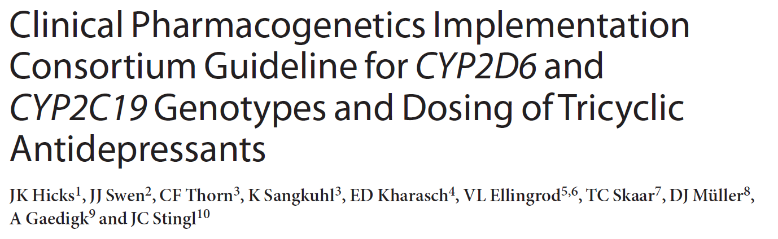
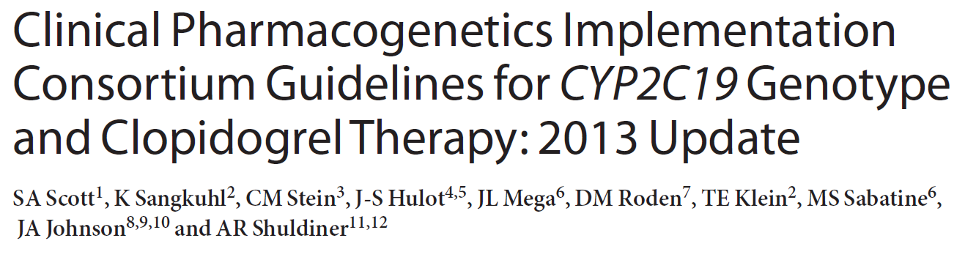
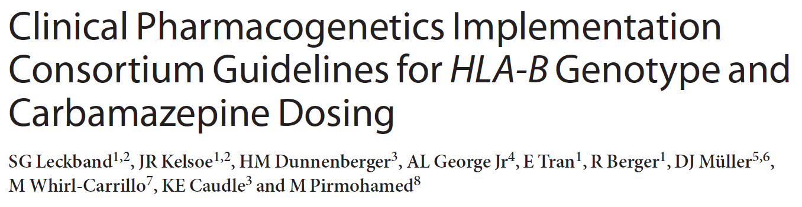
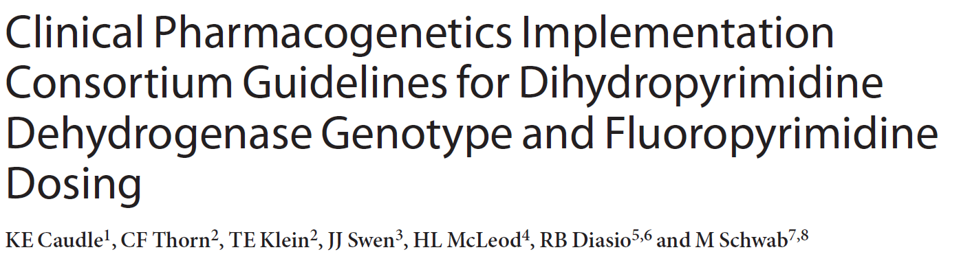
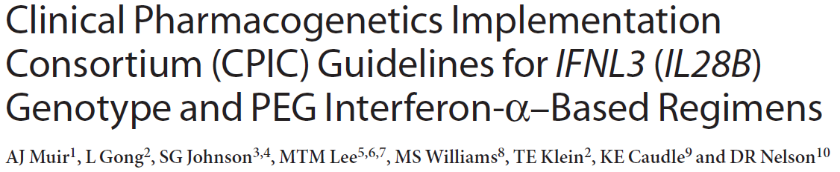
Clin Pharmacol Ther. 2013 Feb;93(2):153-8
Clin Pharmacol Ther. 2013 Apr;93(4):324-5.
Clin Pharmacol Ther. 2013 May;93(5):402-8.
Clin Pharmacol Ther. 2013 Sep;94(3):317-23
Clin Pharmacol Ther. 2013 Sep;94(3):324-8.
Clin Pharmacol Ther. 2013 Aug 29. Epub
Clin Pharmacol Ther. 2014 Feb;95(2):141-6.

Slide 15
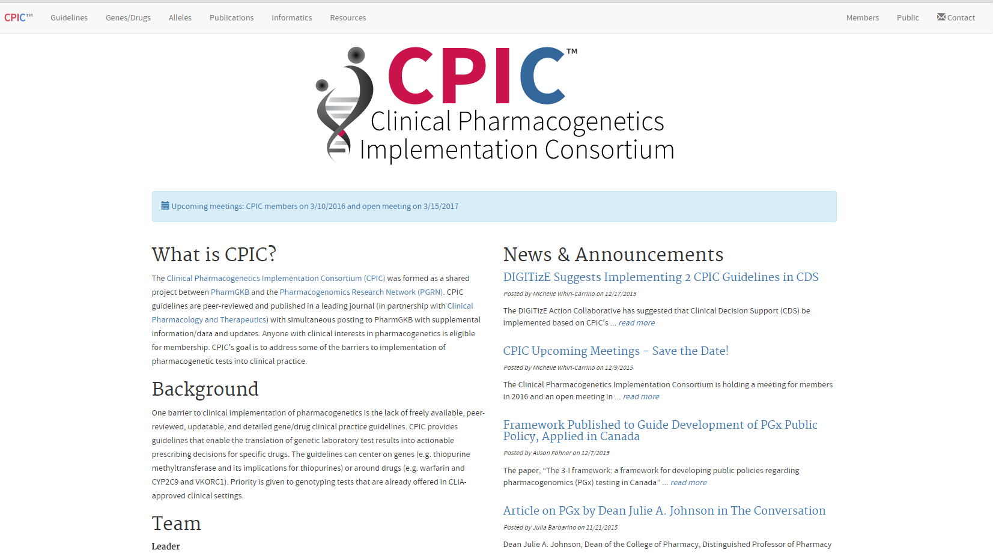
CPIC website: www.cpicpgx.org
CPIC guidelines and list of CPIC genes/drugs
CPIC announcements
CPIC information

Slide 16
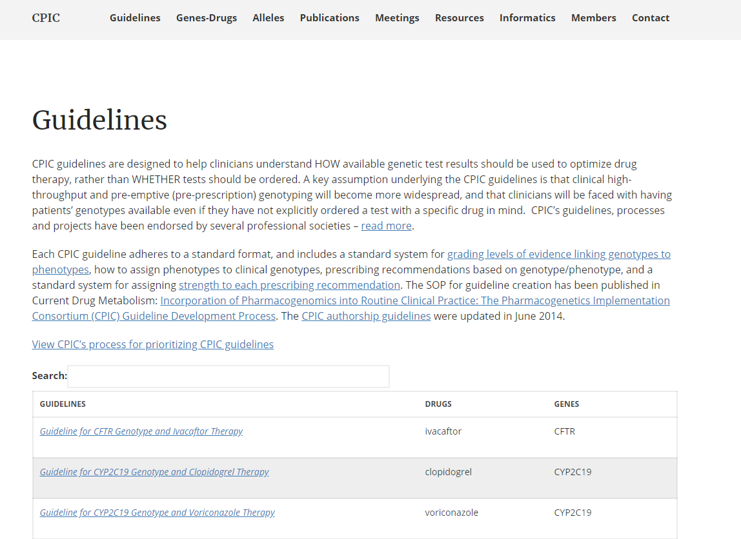
https://cpicpgx.org/guidelines/
Links to guideline pages

Slide 17
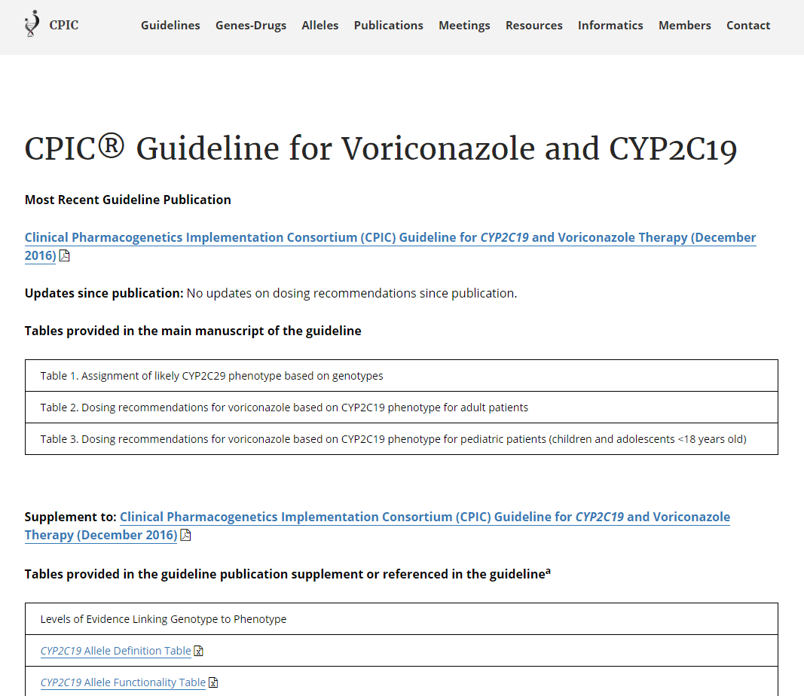

Slide 18
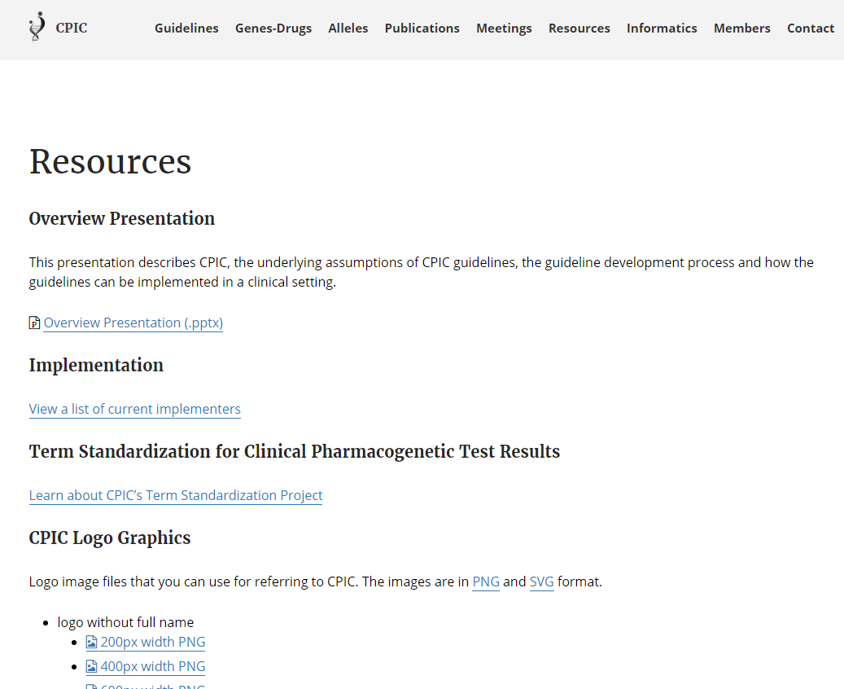
CPIC slides
CPIC projects
CPIC logo

Slide 19
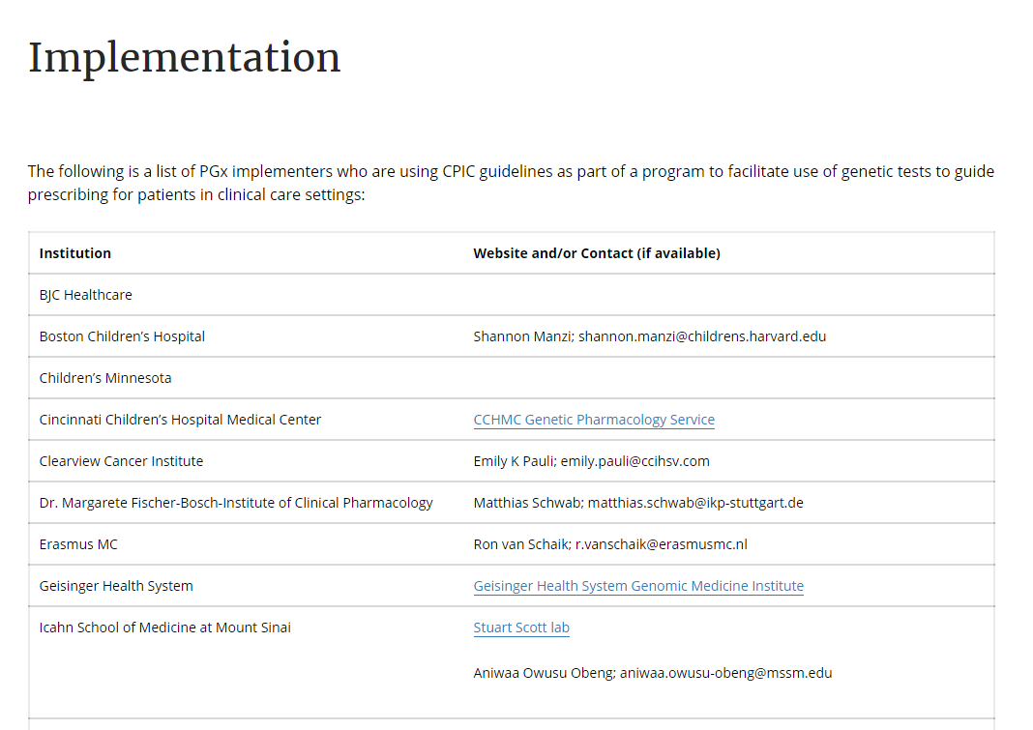
https://cpicpgx.org/implementation/

Slide 20
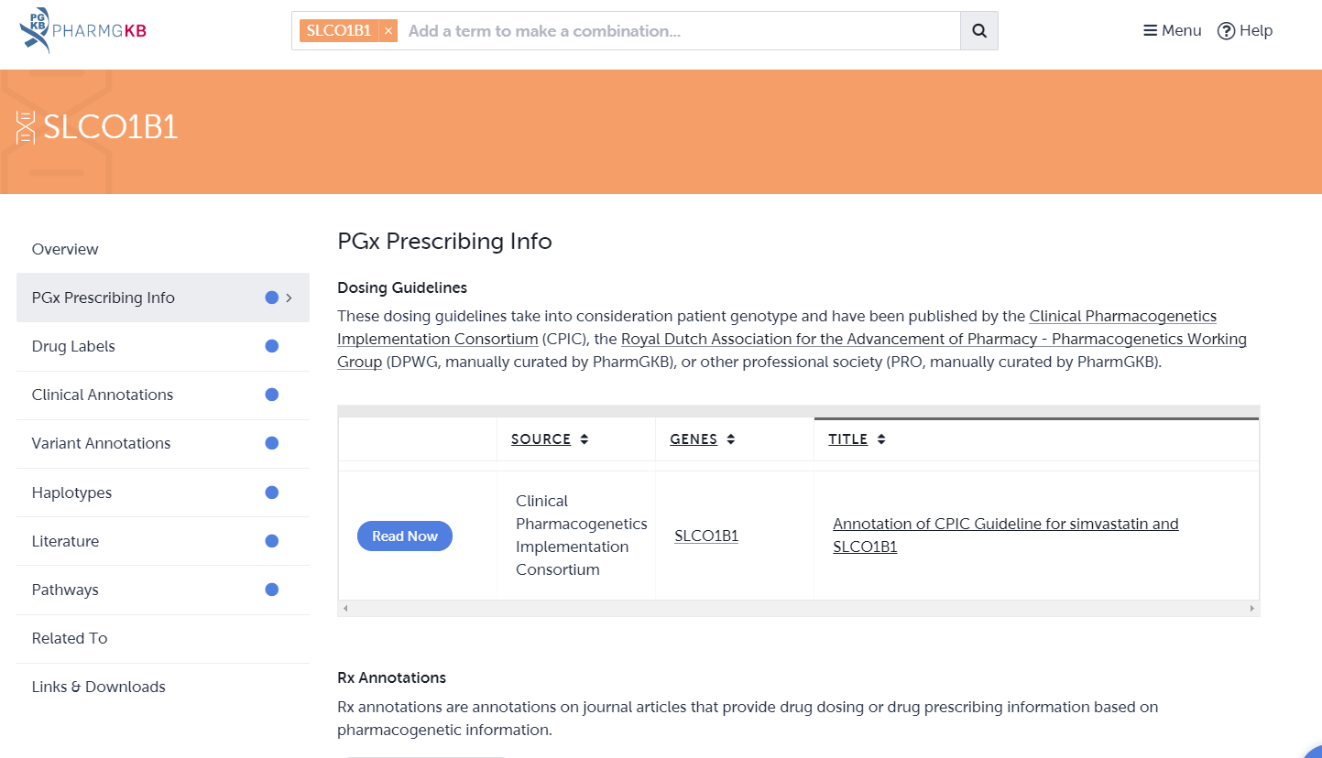
https://www.pharmgkb.org/
CPIC guidelines are posted on PharmGKB (www.pharmgkb.org)

Slide 21
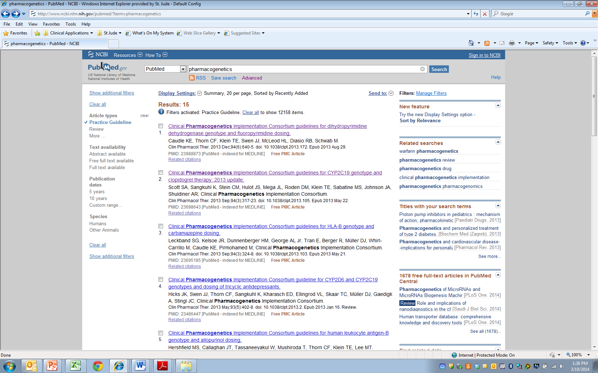
CPIC guidelines linked to “Practice Guideline” filter on PubMed

Slide 22
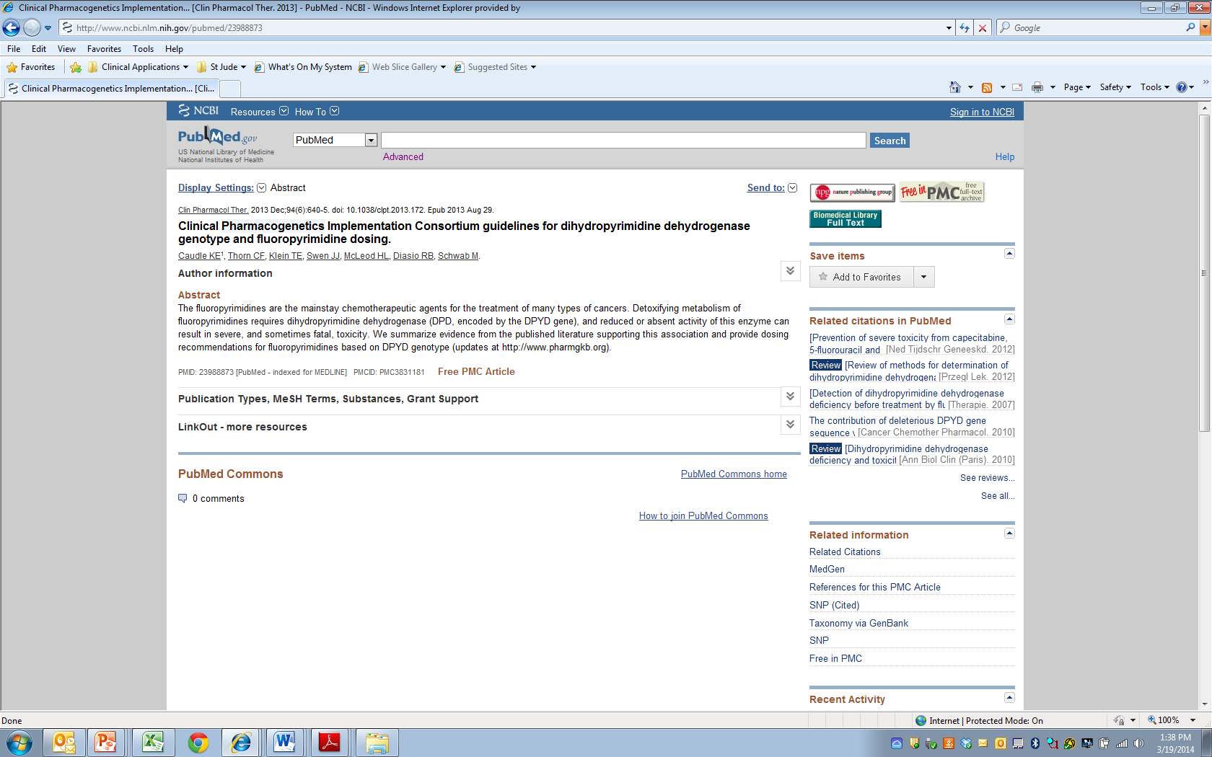

Slide 23
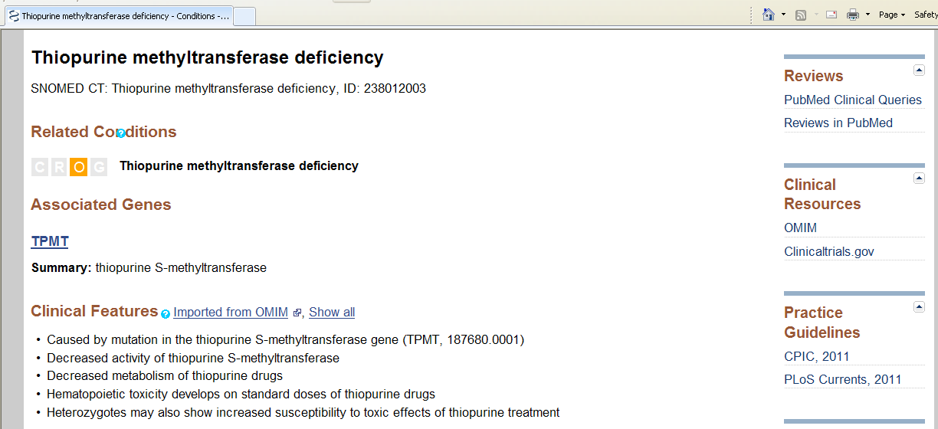
CPIC is cited in NIH’s Genetic Test Registry (GTR) for clinical pharmacogenetic tests

Slide 24
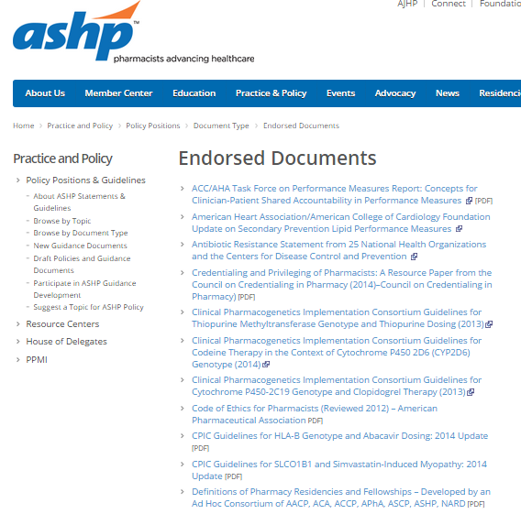
ASHP is endorsing CPIC guidelines

Slide 25
External interactions with other groups
Endorsement by professional societies
  ASCPT, ASHP
Continue interactions with NIH’s GTR, PubMed, FDA, NHGRI’s Genomic Medicine Working Group, IOM’s Genomic Medicine Roundtable, DIGITiZE, PGRN, AMIA, and eMERGE
Grow interactions with ClinGen/ClinVar

Slide 26
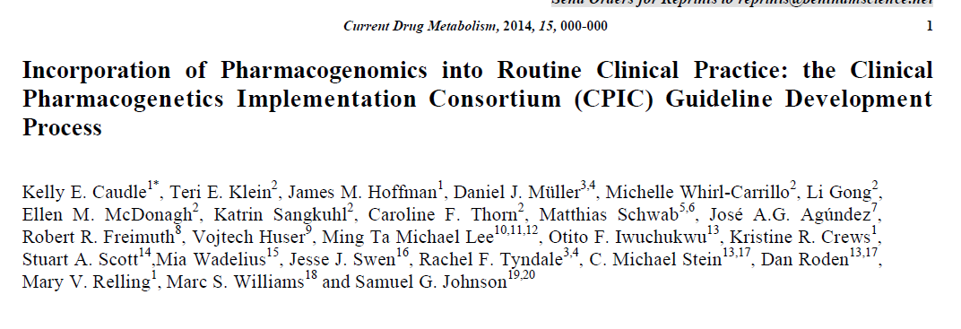
Purpose:
  To describe the development process of the CPIC guidelines
  To compare our process to the Institute of Medicine’s Standards for Developing Trustworthy Clinical Practice Guidelines

Slide 27


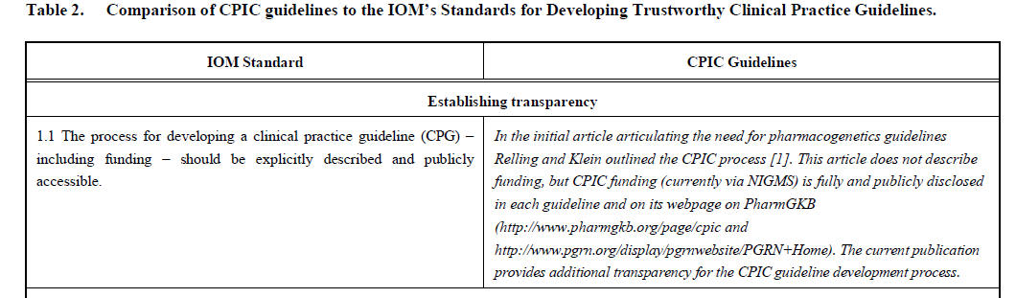
Caudle et al, Current Drug Metab 2014

Slide 28
Uniform Elements of CPIC Guidelines (Main)
Introduction
Focused Literature Review
Gene:
  Background
  Genetic Test Interpretation
    Table 1. Assignment of likely _____ [gene] phenotypes based on genotypes
  Available Genetic Test Options
  Incidental findings
  Other considerations

Slide 29
Uniform Elements of CPIC Guidelines (Main)
Drug (s):
  Background
  linking genetic variability to variability in drug-related phenotypes
  Dosage Recommendations
    Table 2. Recommended Dosing of ____ [drug/s] by ____ [gene] phenotype
    Strength of recommendations grading system
  Recommendations for Incidental Findings
  Other considerations
Potential Benefits and Risks for the Patient
Caveats: Appropriate Use and/or Potential Misuse of Genetic Tests

Slide 30
Uniform Elements of CPIC Guidelines (Supplement and online resources)
Literature Review details
Genetic Test Interpretation
Available Genetic Test Options
Supplemental Table . Evidence linking genotype with phenotype
  Levels of Evidence grading system
Allele Definition Table
Allele Functionality Table
Frequency Table
Resources to facilitate incorporation of pharmacogenetics into an electronic health record with clinical decision support (CDS) (workflow diagrams and example CDS alerts and consults)

Slide 31
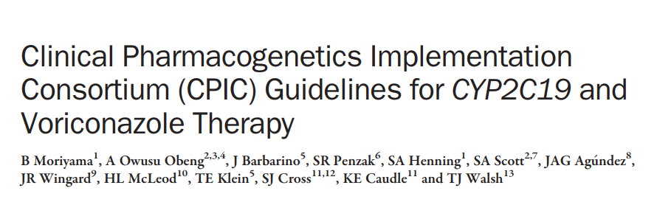
Clin Pharmacol Ther. 2017 Jul;102(1):45-51.

Slide 32
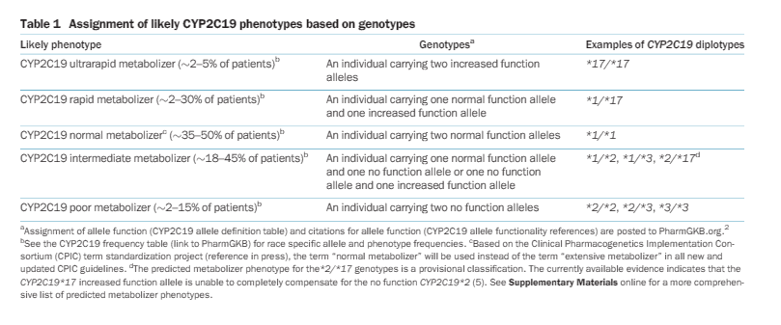

Slide 33
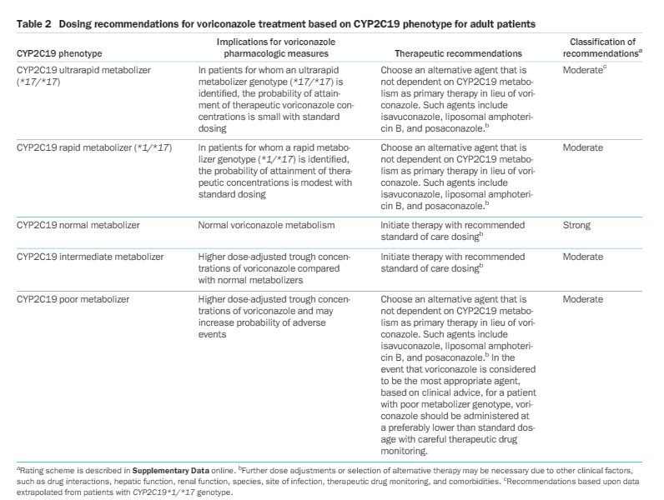

Slide 34
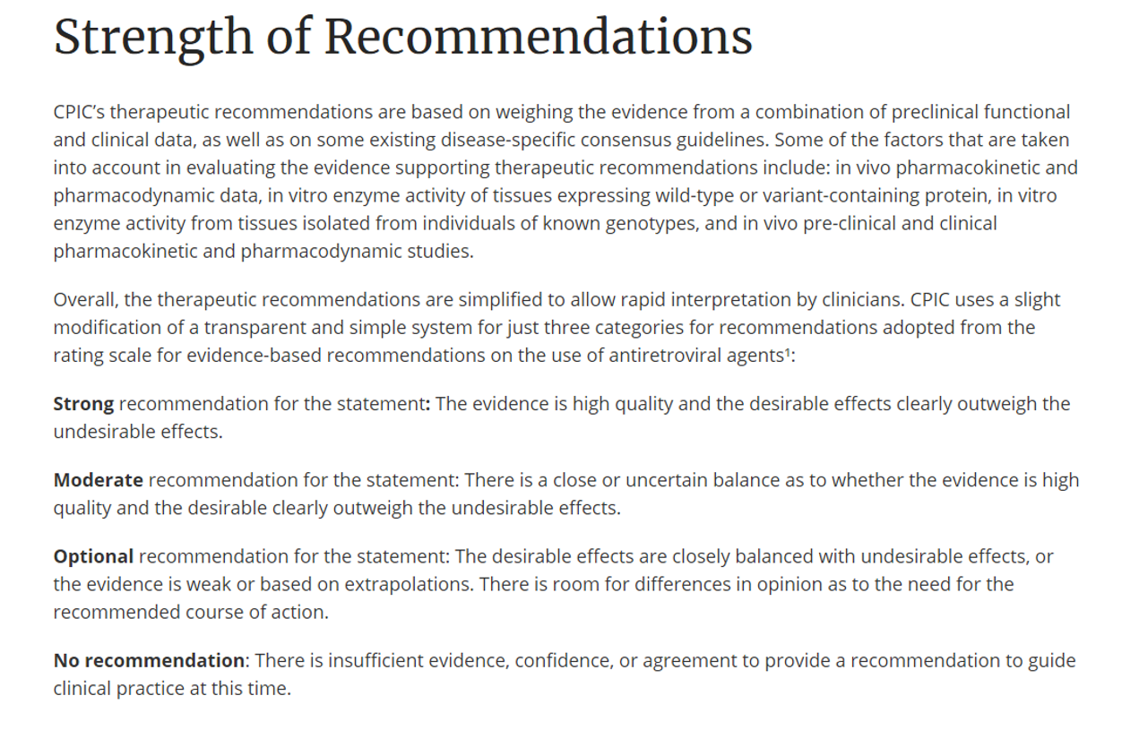

Slide 35
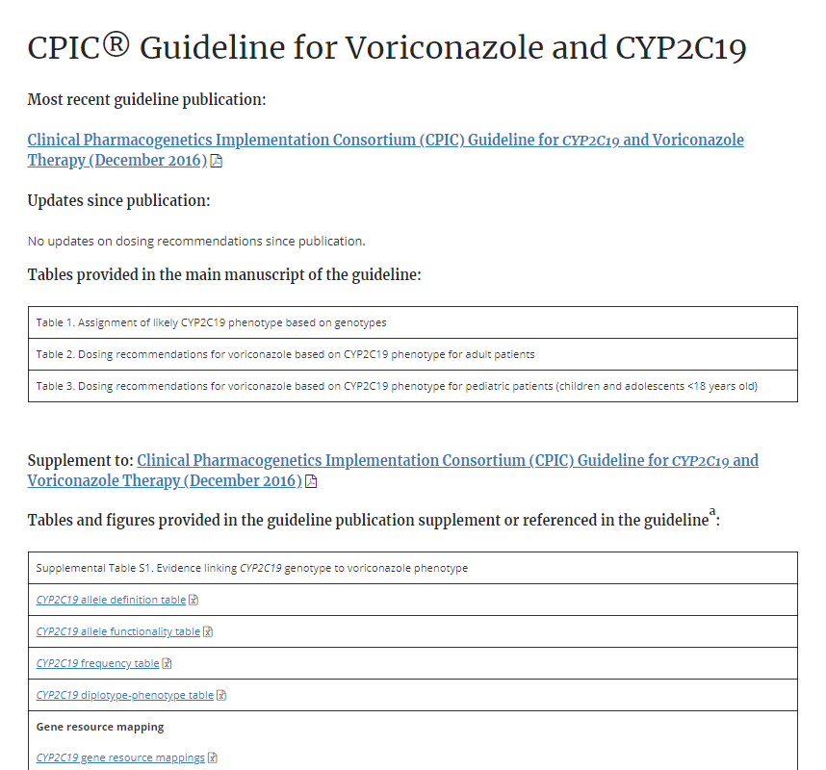
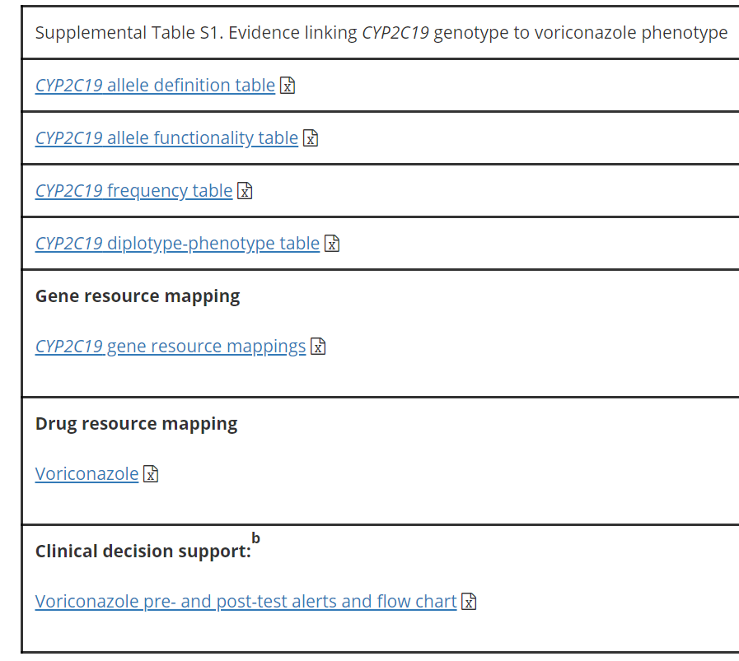

Slide 36
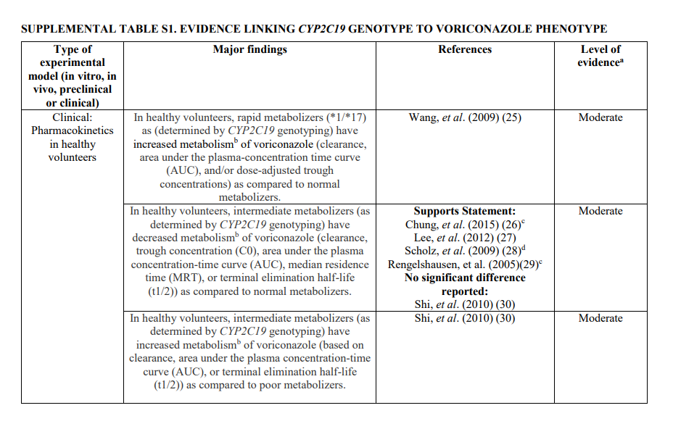
High: Evidence includes consistent results from well-designed, well-conducted studies.
Moderate: Evidence is sufficient to determine effects, but the strength of the evidence is limited by the number, quality, or consistency of the individual studies; generalizability to routine practice; or indirect nature of the evidence.
Weak: Evidence is insufficient to assess the effects on health outcomes because of limited number or power of studies, important flaws in their design or conduct, gaps in the chain of evidence, or lack of information

Slide 37
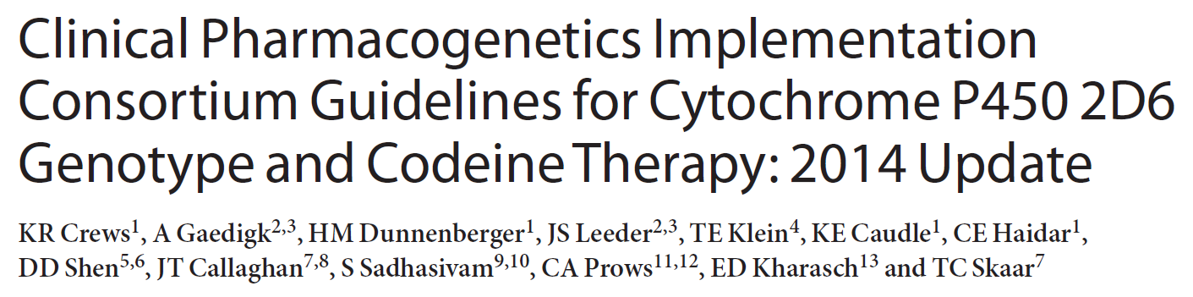
Clin Pharmacol Ther. 2014 Apr;95(4):376-82

Slide 38
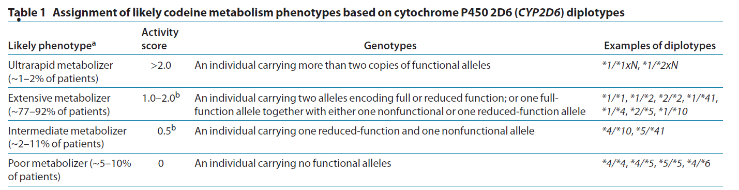
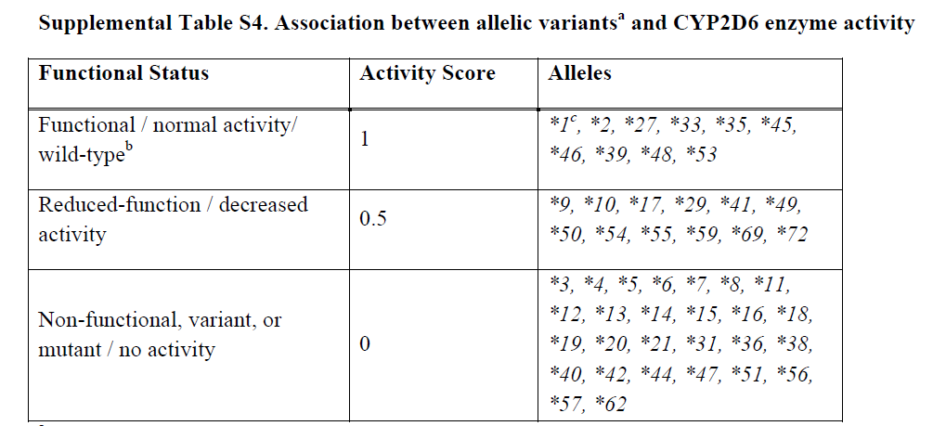
Normal
Clin Pharmacol Ther. 2014 Apr;95(4):376-82

Slide 39
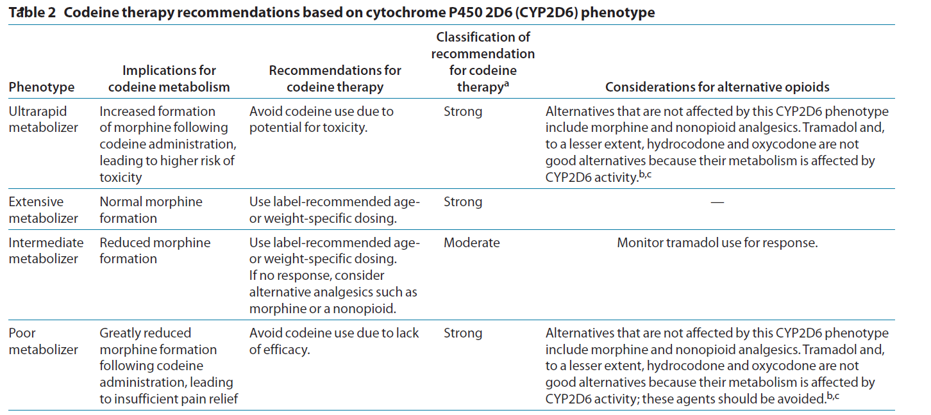
Normal

Slide 40
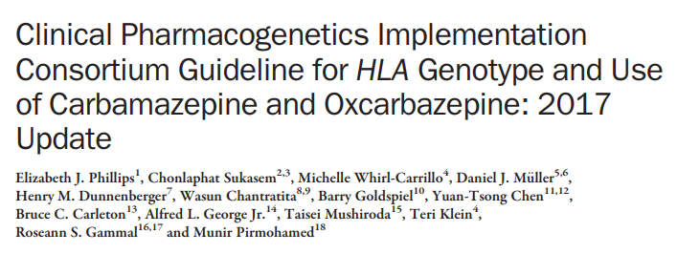
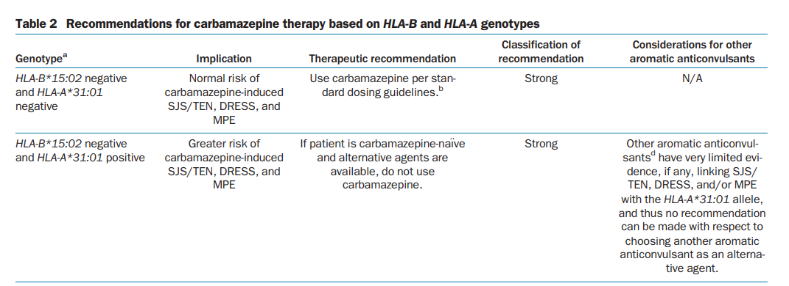
Clin Pharmacol Ther. 2012 Apr;91(4):734-8.

Slide 41
CPIC Guidelines Updates
CPIC guidelines are evaluated on an ongoing basis and updated regularly
Update to publications:
  New publication with re-publishing main dosing tables
  Changes as needed to supplemental material and website.
Update to cpicpgx.org: as needed, without waiting for updated publication

Slide 42

How can CPIC accelerate the clinical implementation of pharmacogenetics into EHRs with CDS?
Publish and maintain authoritative translation tables
Genotype/Diplotype
Phenotype
Recommendation

Slide 43
CPIC Informatics Working Group
Growing interest in informatics aspects of CPIC guidelines and clinical implementation of pharmacogenetics
Working group is a forum for discussion and collaboration focused on informatics issues
Goal
  To support the adoption of the CPIC guidelines by identifying, and resolving where possible, potential technical barriers to the implementation of the guidelines within a clinical electronic environment.

Slide 44
CPIC Informatics Working Group:
Initial Focus
Create comprehensive translation tables from genotype to phenotype to clinical recommendation for CPIC guidelines
  Define structure and process to efficiently develop and maintain in the most useful format(s)
  Publish as part of CPIC guidelines and post on PharmGKB
Genotype/Diplotype
Phenotype
Recommendation

Slide 45
CPIC tables allow translation of genetic test results to actionability
Genotypes to alleles
(e.g. g.94761900C>T + g.94762706A>G = CYP2C19*4B)
Alleles to diplotypes
(e.g. g.94761900CT + g.94762706AG = CYP2C19*1/*4B)
Diplotypes to phenotypes
(e.g. CYP2C19*1/*4B = intermediate metabolizer)
Phenotypes to actionability
(e.g. intermediate metabolizer + Rx for amitriptyline = interruptive alert)
Functions to alleles
(e.g. CYP2C19*4B = no function)
Interpretation of phenotypes
(e.g. CYP2C19 intermediate metabolizer = altered dosing recommendations for TCAs but not clopidogrel)
https://cpicpgx.org/guidelines/
https://www.pharmgkb.org/page/cyp2c19RefMaterials

Slide 46
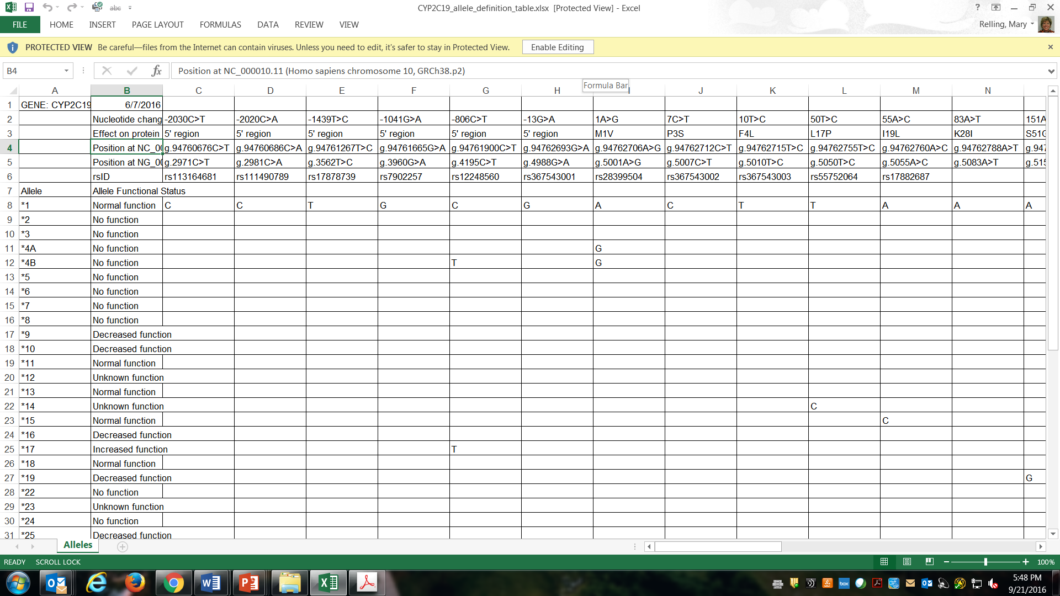

Allele definition table: genotypes to alleles
https://www.pharmgkb.org/page/pgxGeneRef
https://cpicpgx.org/guidelines/guideline-for-voriconazole-and-cyp2c19/

Slide 47
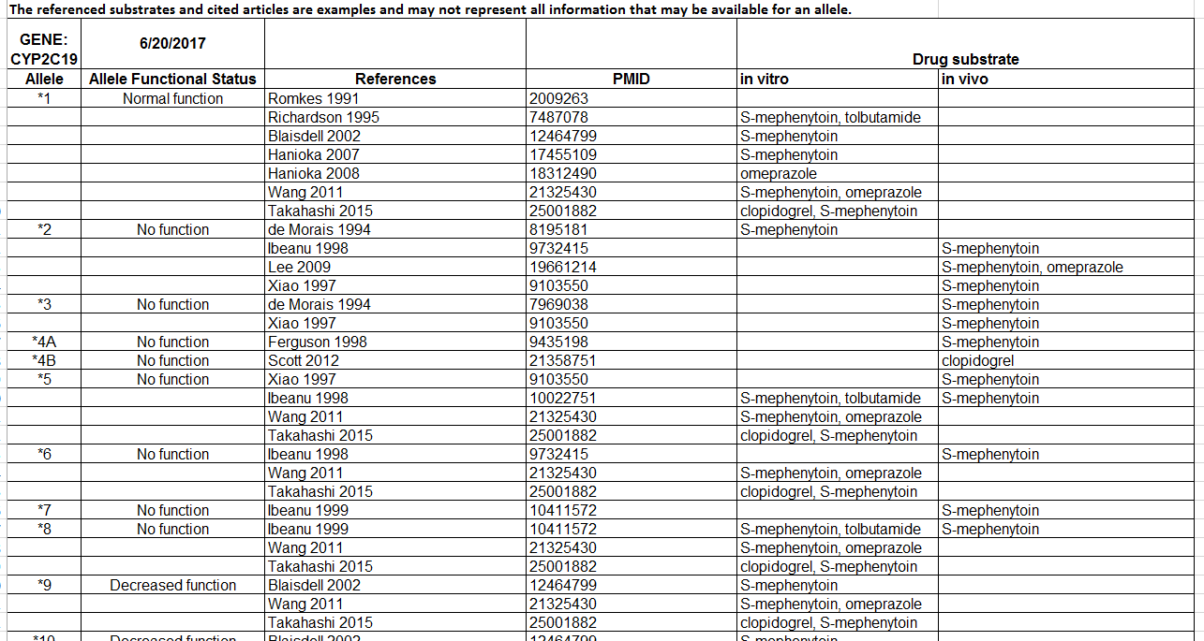
Allele functionality table: alleles to function
https://cpicpgx.org/guidelines/guideline-for-voriconazole-and-cyp2c19/

Slide 48
CPIC tables allow translation of genetic test results to actionability
Genotypes to alleles
(e.g. g.94761900C>T + g.94762706A>G = CYP2C19*4B)
Alleles to diplotypes
(e.g. g.94761900CT + g.94762706AG = CYP2C19*1/*4B)
Diplotypes to phenotypes
(e.g. CYP2C19*1/*4B = intermediate metabolizer)
Phenotypes to actionability
(e.g. intermediate metabolizer + Rx for amitriptyline = interruptive alert)
Functions to alleles
(e.g. CYP2C19*4B = no function)
Interpretation of phenotypes
(e.g. CYP2C19 intermediate metabolizer = altered dosing recommendations for TCAs but not clopidogrel)
https://cpicpgx.org/guidelines/
https://www.pharmgkb.org/page/cyp2c19RefMaterials

Slide 49
Variants must be phased to assign diplotypes for pharmacogenes
CPIC Gene | Var/var different than var/wt?
TPMT | Yes
CYP2C19 | Yes
CYP2D6 | Yes
DPYD | Yes
CYP2C9 | Yes
SLCO1B1 | Yes
HLA-B | No
VKORC1 | Yes
IL28-B | Yes
CFTR | No
G6PD | Yes
UGT1A1 | Yes
CYP3A5 | Yes

Slide 50
CPIC tables allow translation of genetic test results to actionability
Genotypes to alleles
(e.g. g.94761900C>T + g.94762706A>G = CYP2C19*4B)
Alleles to diplotypes
(e.g. g.94761900CT + g.94762706AG = CYP2C19*1/*4B)
Diplotypes to phenotypes
(e.g. CYP2C19*1/*4B = intermediate metabolizer)
Phenotypes to actionability
(e.g. intermediate metabolizer + Rx for amitriptyline = interruptive alert)
Functions to alleles
(e.g. CYP2C19*4B = no function)
Interpretation of phenotypes
(e.g. CYP2C19 intermediate metabolizer = altered dosing recommendations for TCAs but not clopidogrel)
https://cpicpgx.org/guidelines/
https://www.pharmgkb.org/page/cyp2c19RefMaterials

Slide 51
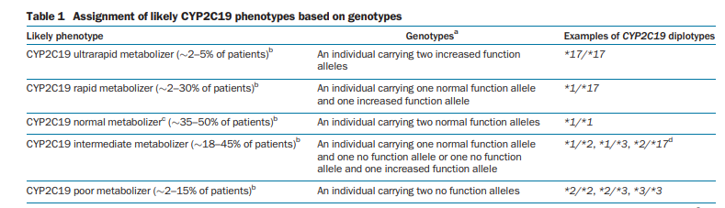
Genotype to phenotype assignment based on allele function
Clin Pharmacol Ther. 2017 Jul: 102 (1):45-51.
https://cpicpgx.org/guidelines/guideline-for-voriconazole-and-cyp2c19/

Slide 52
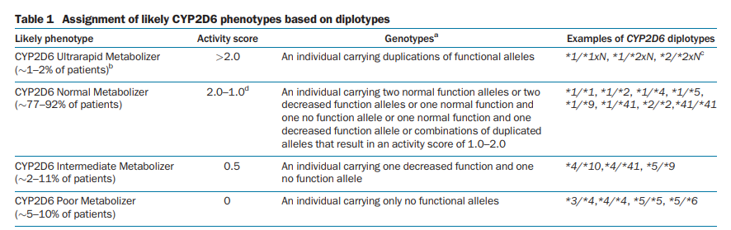
Genotype to phenotype assignment based on allele function
There are differences in genotype to phenotype assignment between the CPIC and the DPWG guidelines. We are in the process of working together to resolve these discordances.

Slide 53

https://www.pharmgkb.org/page/cyp2c19RefMaterials
https://cpicpgx.org/guidelines/guideline-for-voriconazole-and-cyp2c19/

Slide 54
CPIC tables allow translation of genetic test results to actionability
Genotypes to alleles
(e.g. g.94761900C>T + g.94762706A>G = CYP2C19*4B)
Alleles to diplotypes
(e.g. g.94761900CT + g.94762706AG = CYP2C19*1/*4B)
Diplotypes to phenotypes
(e.g. CYP2C19*1/*4B = intermediate metabolizer)
Phenotypes to actionability
(e.g. intermediate metabolizer + Rx for amitriptyline = interruptive alert)
Functions to alleles
(e.g. CYP2C19*4B = no function)
Interpretation of phenotypes
(e.g. CYP2C19 intermediate metabolizer = altered dosing recommendations for TCAs but not clopidogrel)
https://cpicpgx.org/guidelines/
https://www.pharmgkb.org/page/cyp2c19RefMaterials

Slide 55
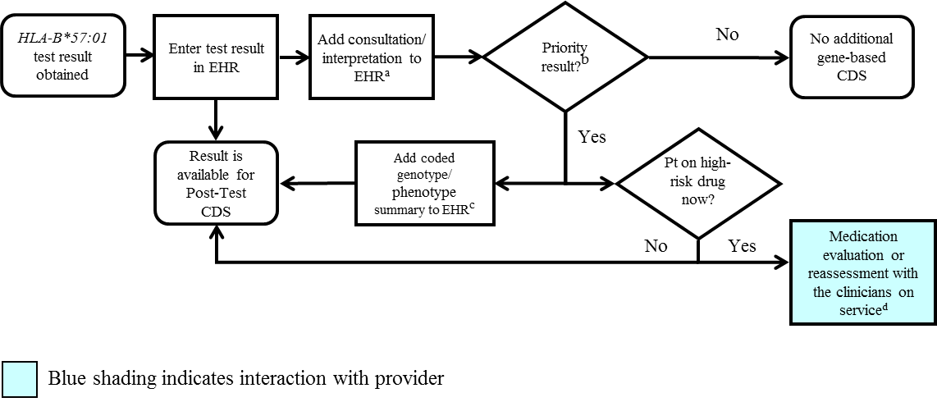
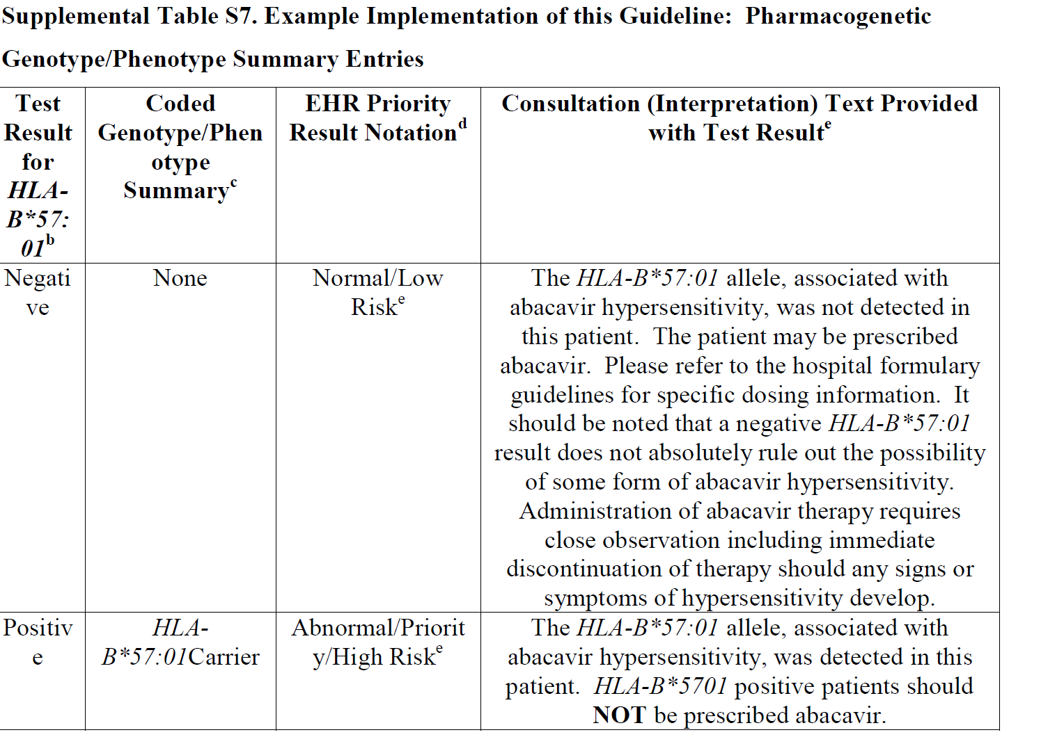
HLA-B*57:01 Pharmacogenetic Test Result: Clinical Implementation Workflow for EHR
Notes:
Supplemental Figure S3. HLA-B*57:01 Pharmacogenetic Test Result: Clinical Implementation Workflow for EHR
ªSee Supplementary Table S7 for diplotype/phenotype specific example
^{b}"Priority result" is defined as a genetic test result that necessitates a change in drug, drug dose, or drug monitoring now or potentially in the future.
^{c}Documentation in the EHR is institution specific. Optimally, the phenotype and/or genotype are available in the EHR to permanently inform prescribing decisions. See Supplementary Table S7 for genotype/phenotype-specific summaries.
^{d}See supplement section “Other Considerations” for discussion regarding use of abacavir in HLA-B*57:01 positive patient.

Slide 56
HLA-B*57:01 Pharmacogenetic Test Result: Clinical Implementation Workflow for EHR
Notes:
Supplemental Figure S3. HLA-B*57:01 Pharmacogenetic Test Result: Clinical Implementation Workflow for EHR
ªSee Supplementary Table S7 for diplotype/phenotype specific example
^{b}"Priority result" is defined as a genetic test result that necessitates a change in drug, drug dose, or drug monitoring now or potentially in the future.
^{c}Documentation in the EHR is institution specific. Optimally, the phenotype and/or genotype are available in the EHR to permanently inform prescribing decisions. See Supplementary Table S7 for genotype/phenotype-specific summaries.
^{d}See supplement section “Other Considerations” for discussion regarding use of abacavir in HLA-B*57:01 positive patient.

Slide 57
SLCO1B1 Genotype and Simvastatin: Point of Care
Clinical Decision Support
Simvastatin order initiated
SLCO1B1 genetic test results on file?
Yes
Priority result?^{c}
No
No post-test alert required; continue with drug order
No
Yes
1
2
CDS Pre-test Alert Messageª
(additional action may be considered)^{b}
CDS Post-test alert^{d} or notify prescriber with recommendation
Note: Circled numerals refer to Supplementary Table 12
Supplemental Figure S3. SLCO1B1 Genotype and Simvastatin: Point of Care Clinical Decision Support
ªSee Supplementary Table S12 for diplotype/phenotype specific pre-test alert example.
^{b}Additional actions may include ordering a pharmacogenetic test, preventing the clinician from ordering the medication or allowing the clinician to cancel out of the alert.
^{c}Priority result defined as a genetic test result that results in a change in drug, drug dose, or drug monitoring.
^{d}See Supplementary Table S12 for diplotype/phenotype specific post-test alert example.

Slide 58
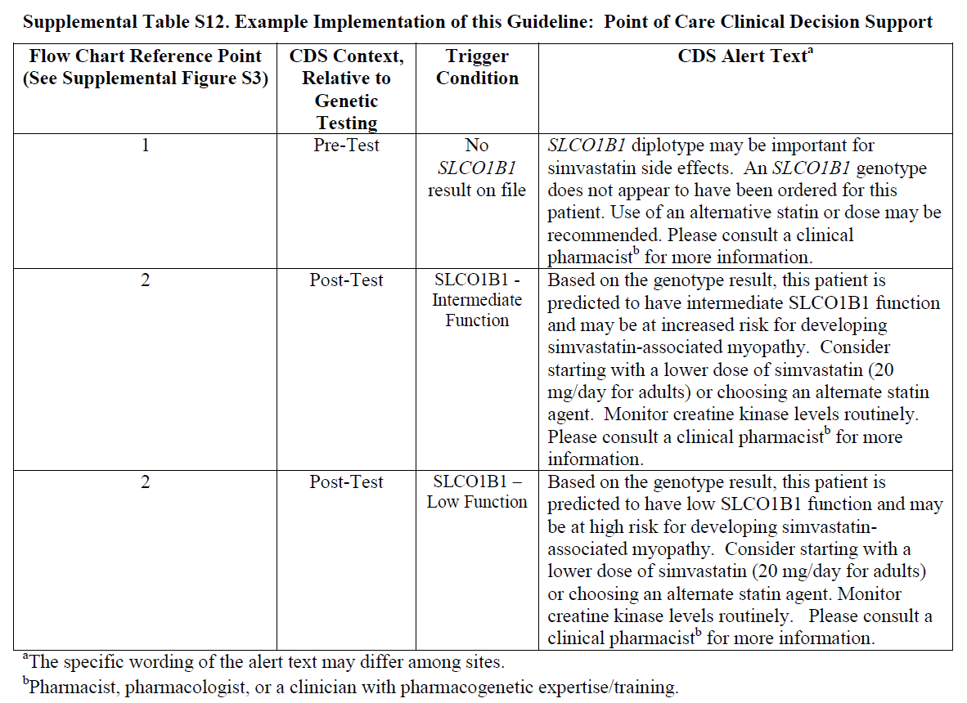

Slide 59

Summary
CPIC guidelines help clinicians understand HOW available genetic test results should be used to optimize drug therapy.
  Not WHETHER tests should be ordered.
21 guidelines produced in a standard format
  Published in Clinical Pharmacology and Therapeutics
  Freely available on cpicpgx.org and
CPIC resources available to support the adoption of pharmacogenetics into the EHR with CDS

Slide 60
Acknowledgements
CPIC Steering Committee
  Mary Relling
  Julie Johnson
  Teri Klein
  Dan Roden
  Rachel Tyndale
Kelly Caudle, CPIC Director
Rose Gammal
PGRN
Stanford
  Teri Klein
  Russ Altman
  Michelle Whirl-Carrillo
  PharmGKB curators
CPIC members/observers
CPIC informatics working group
  James Hoffman
  Michelle Whirl-Carrillo
  Bob Freimuth
This work was funded by the National Institutes of Health (NIH) (R24GM115264 and U24HG010135)

