Slide 1
CPIC guideline in progress
MT-RNR1/aminoglycosides-in review (just resubmitted revisions)
CYP2C19/clopidogrel
drafting guideline
Statin guideline
Draft recommendations for SLCO1B1 and ABCG2
Finalizing evidence review for HMGCR, CYP2C9, CYP3A
SSRI/SNRI
Evidence review ongoing for CYP2D6, CYP2C19, HTR2A, ABCB1, SLC6A4, and CYP2B6
CYP2D6/Beta-blockers
Authorship plan approved by steering committee
CYP2D6/antipsychotics
Will begin this guideline when SSRI evidence review is complete

Slide 2
G6PD/rasburicase update
Is the drug listed in Supplemental Table S6?
YES
NO
Is the drug deemed “safe” in G6PD deficiency by all the references in Table S6?
Is there a warning regarding G6PD deficiency on the drug label by FDA or another regulatory agency?
YES
NO
YES
NO
Include
Exclude
Is the drug used in clinical practice today?
Exclude
YES
NO
Include
Exclude

Slide 3
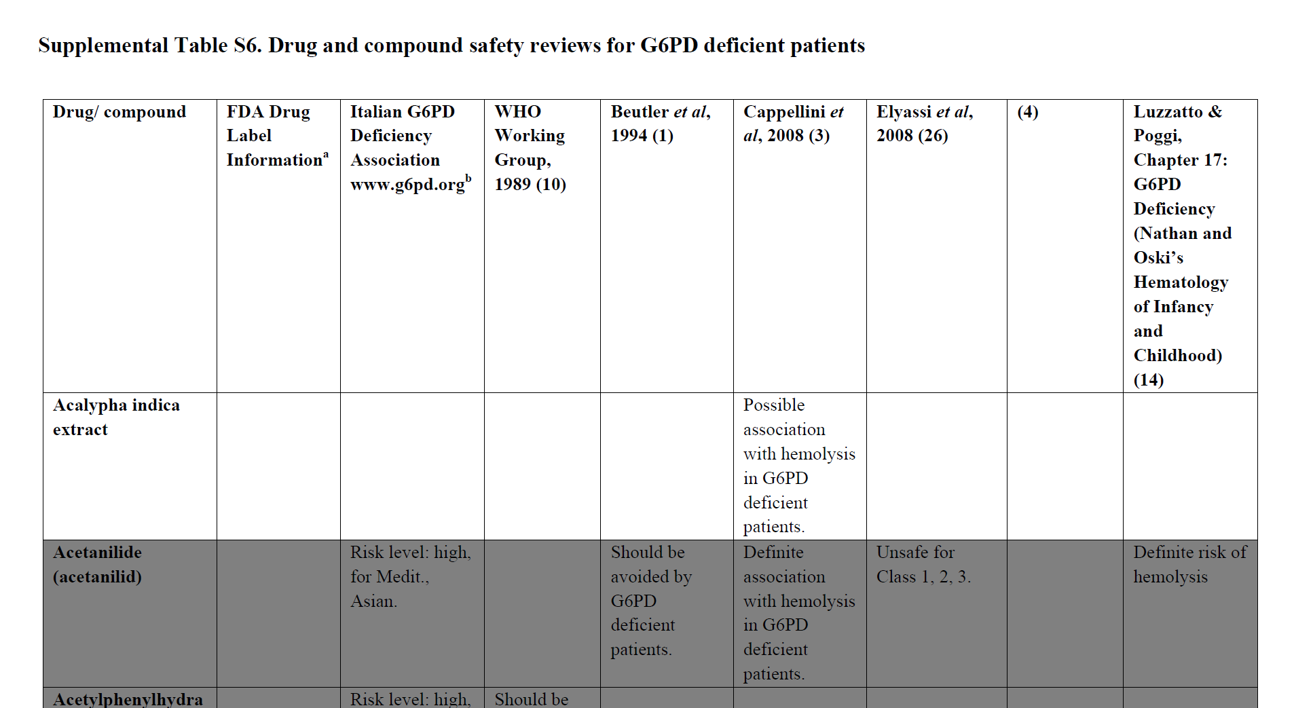

Slide 4
G6PD/rasburicase update
Is the drug listed in Supplemental Table S6?
YES
NO
Is the drug deemed “safe” in G6PD deficiency by all the references in Table S6?
Is there a warning regarding G6PD deficiency on the drug label by FDA or another regulatory agency?
YES
NO
YES
NO
Include
Exclude
Is the drug used in clinical practice today?
Exclude
YES
NO
Include
Exclude

Slide 5
Excel file

Slide 6
Assigning putative G6PD drugs to a risk category
High-risk: avoid in G6PD deficiency
High-level evidence, rarely used
Medium-risk: use caution
Weak evidence AND rarely used drug
Low-to-no risk: no need for increased caution on basis of G6PD
Weak evidence AND commonly used drug
OR Weak evidence AND subject of strong regulatory warnings (that may have hindered drug’s use in G6PD deficient pts)
OR moderate level evidence, rarely used with regulatory warnings
OR moderate level evidence with strong mechanism
OR Weak evidence AND mild or inconsistent regulatory warnings

Slide 7
Term Standardization Part 2
5/6/2021

Slide 8
Term standardization Part 1
Drug Metabolizing Enzymes (CYP enzymes, DPYD, TPMT)
Drug Transporters (SLCO1B1)
High risk alleles (HLA)

Slide 9
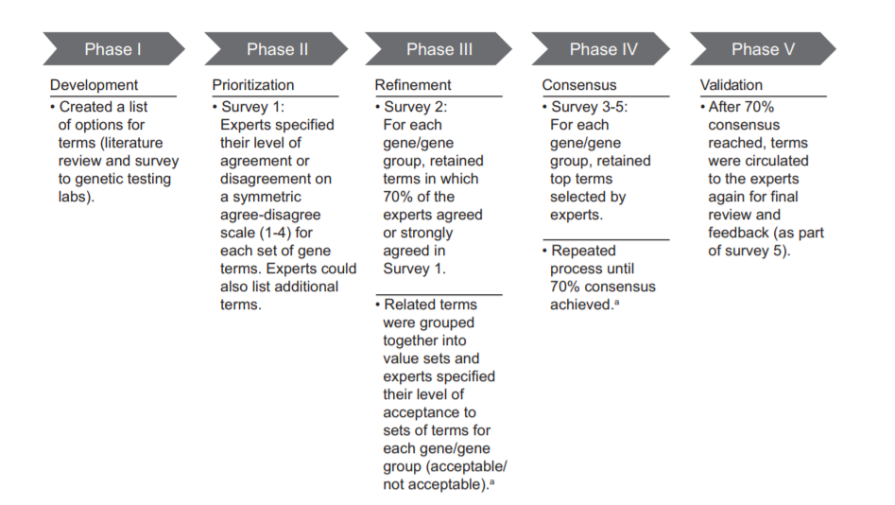

Slide 10
Gene/Disease expert panel will review current terminologies* as part of the CPIC guideline development process and recommend terms for allele clinical function status and phenotype
PGx expert panel will review and provide feedback to gene/disease expert panel for recommended terms
Process will continue until 70% of experts agree to terms
Terms will be posted for public comment
Terms will be used in CPIC guideline
CPIC informatics working group will work to submit to LOINC, SNOMED, others

Slide 11
Expert panels
Gene/Guideline expert panel
CPIC guideline authors
Representation from other expert panels, if applicable (i.e. working group regarding the guideline topic)
ClinGen Variant Curation Expert Panel
ClinVar
FDA
ACMG
Other gene/disease specific resources (e.g., G6PD WHO working group, European Malignant Hyperthermia Group, etc)
Others as determined by guideline authors
PGx expert panel
Clinician with a working knowledge of pharmacogenetics (pharmacists, physicians, nurses, genetic counselors, etc).
Researcher with at least 2 years of PGx research experience
Clinical laboratory scientist or staff with at least 2 years of PGx experience
EHR standards expert/medical informatic (PGx experience not required but involvement in HL7 or similar experience preferred)

Slide 12
Evaluation of current terminologies
Gene/Disease expert panel will review all current terminology in the following resources:
ClinGen
ClinVar
FDA
ACMG
LOINC
SNOMED
Other gene/disease specific resources
Laboratory reports
Guideline authors will utilize current terminology if/where appropriate. In some cases, disease terminology will not be appropriate if disease phenotype not 1:1 with drug phenotype (i.e. variants that are associated with disease risk are not all associated with drug phenotype and vice versa).

Slide 13
Experts-primary involvement in PGx
Clinician with a working knowledge of pharmacogenetics (pharmacists, physicians, nurses, genetic counselors, etc). | 59%
Researcher with at least 2 years of PGx research experience | 47%
Clinical laboratory scientist or staff with at least 2 years of PGx experience | 24%
EHR standards expert/medical informatics | 6%
Gene specific experts and/or CPIC or DPWG guideline author for genes included in this project | 18%

Slide 14
Likely phenotype | Genotypes | Example genotypes
MT-RNR1 aminoglycoside-induced hearing loss increased risk | Individuals with a MT-RNR1 variant associated with an increased risk of aminoglycoside-induced hearing loss | 1095T>C 1494C>T 1555A>G
MT-RNR1 aminoglycoside-induced hearing loss normal risk | Individuals with no detectable MT-RNR1 variant or a variant associated with normal risk of aminoglycoside-induced hearing loss | 827A>G
MT-RNR1 aminoglycoside-induced hearing loss indeterminate risk | Individuals with a MT-RNR1 variant associated with an uncertain risk of aminoglycoside-induced hearing loss | 663A>G 669T>C 747A>G 786G>A 807A>G 807A>C 839A>G 896A>G 930A>G 951G>A 960C>del 961T>G 961T>del 961T>del+Cn 988G>A 1189T>C 1243T>C 1438A>G 1520T>C 1537C>T 1556C>T

Slide 15
Clinical function assignment term
increased risk of aminoglycoside-induced hearing loss
normal risk of aminoglycoside-induced hearing loss
uncertain risk of aminoglycoside-induced hearing loss

Slide 16
We have consensus!
n=39

Slide 17
Phenotype terms
MT-RNR1 aminoglycoside-induced hearing loss increased risk
MT-RNR1 aminoglycoside-induced hearing loss normal risk
MT-RNR1 aminoglycoside-induced hearing loss indeterminate risk
[gene] [drug phenotype] [increased, normal, uncertain] risk
OR
[gene] [increased, normal, uncertain] risk of [drug phenotype]

Slide 18
Term standardization Part 1

Slide 19
n=34

Slide 20
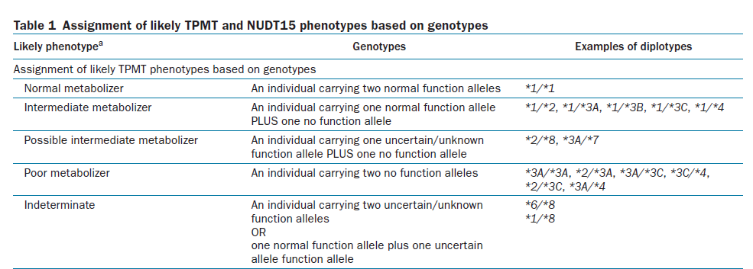
Possible and likely phenotypes
“possible”
Known function allele (decrease, no function) plus an uncertain/unknown function variant

Slide 21
Feedback
Prefer “likely”
"Possible" is misleading as this is really saying that this phenotype is "likely." There are other phenotypes that are "possible.“
In practice, I have found "possible" modifiers to lead to significant confusion. Would recommend we avoid or go to the ACMG type term of "likely"
Possible" provides very little helpful information--it opens up questions on what are the other possibilities. "Likely" provides a bit more certainty, when available and appropriate.
Range of phenotypes
I don't like the "possible" modifier much because it doesn't rule anything in or out. In this context, there are no increased function alleles, so we know that an individual with one no function allele is not a normal metabolizer. For this reason, I might suggest the term "poor or intermediate metabolizer" for a *2/*8, etc.
Suggestion: "Possible intermediate-poor metabolizer“
Unless the uncertain variant has the possibility of having increased function, then I think that it would be clearer to use "poor-to-intermediate" or a similar term. I'm concerned that the use of "possible" will lead uninformed clinicians to think more along the lines of "normal-to-intermediate" rather than "intermediate-to-poor" function levels.

Slide 22
Feedback
Other
I think it could be useful to add a grade of certainty to your nomenclature. For example, in cardiology guidelines, we use I, IIa, IIb, III. If we translate this to genetic variants functionality or clinical validity, I and III would be clear cut variants with I being definite association; III definitely no association, while IIa would be uncertain, but likely has an impact; and IIb, uncertain, but lower likelihood.
I don't like the modifier "possible" in this case. To me it indicates intermediate or higher activity when it should better indicate "no higher than intermediate activity". I know this is awkward but we can consider "at most intermediate metabolizer". I don't like "intermediate or poor metabolizer".
hard to implement "possible IM" into decision support

Slide 23
Feedback
Rationale to use “possible”
I like the term “possible” for these scenarios. BPAs will fire for these patients and give guidance if it’s clinically relevant so I’m not worried of clinicians being confused about this terms meaning.
I can see the benefits of it as it could make prescribing recommendations applicable to more patients. However, I would prefer for it to be used sparingly and only after a lot of consideration from the authors about the benefits v risk to patients with genotypes falling into this category

Slide 24
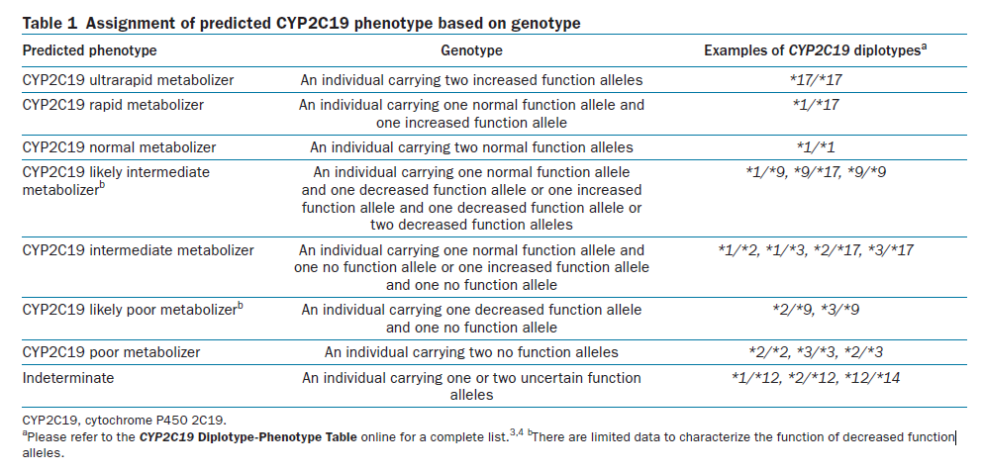
Possible and likely phenotypes
“likely”
Uncertainty of phenotype grouping (but know the phenotype is not normal).

Slide 25
Feedback
Likely: 6 not sure, 7 do not like, 22 like
Range of phenotypes suggested again here.
I do not like this. It conveys a difference in probability from the other scenario that I don't think is real.
OK with me but "probable" is another option if people don't like likely. It conveys a little more certainty than "likely" in my opinion.
Expected
I don’t like the use of “likely” for this. I think that people would reasonably expect that if they had 2 patients, and one was a possible IM and the other was a likely IM, that the later would have a higher chance of being an IM than the former. In reality, we don’t know that. I think that we should use words like “possible” when we are making our best guess at a phenotype (for whatever reason) and then use comments (multiple words) to explain why we are not sure. Otherwise we are adding to the already very high burden of pharmacogenomic-specific language that gets in the way of widespread implementation.
Likely provides more confidence than "possible"--but should only be used when appropriate and accurate.
It's not my favorite but I don't have a better way to put it.

Slide 26
Do we need separate terms?
Not sure-7; NO-18, YES-12
YES should be separate terms
I think they are represented correctly. Possible to me has less certainly than likely. Possible includes one variant with unknown function, thus fits well. Therefore, the functional level has not been determined yet at all. Likely, both variant's functions are known, but the exact functional level has not been determined yet.
I think separate term make more sense to me as "potential for" (possible) is distinct from "probable" relative to likely.
There should be separate terms then users have an idea where the uncertainty is coming from (either at the allele level or at the phenotype grouping level) and don't need to dig around themselves.

Slide 27
Do we need separate terms?
NO should be the same term
Good question. I dont know. This is sooo difficult. In the tables above for both 2C19 and TMPT/NUDT15, both modifiers can make sense. In essence, both modifiers really mean the same thing - it COULD be this type of phenotype. In the end, i guess its not so important which term is used; better is that the consequence (potenttal change of therapy) arising from the phenotype assignment is clear and warranted (supported by the clinical evidence).
No. Use "possible" to convey the "worst case scenario" and then explain (using more words).
If two terms truly allow specificity, then two terms are fine. However, it is not clear to me that the two separate term do provide specificity. I am a bit worried about creating all of these extra terms and then the authors (or the users of the guidelines) not understanding what they really mean
I would prefer using "likely" in both situations, or not using modifiers at all. In the TPMT example, it is known that the patient has at least one no-function allele, so it is almost certain that they are not a normal metabolizer (I don't know if increased function vars have ever been reported for TPMT). The use of "possible intermediate", if I were reading this as a patient, would suggest to me that I'm normal and possibly intermediate, when I think it's supposed to be conveying that I'm at least intermediate, possibly poor metabolizer. I would favor just reporting this type of result as "intermediate metabolizer", without any modifiers, but maybe add a footnote that an unknown variant was also present?
For a guideline table it may be reasonable to combine them if the wording is the same (noting that it is poor or likely poor for example). For the CDS resources they need to be separate b/c systems may need to align categories with genotypes.
There should be separate terms then users have an idea where the uncertainty is coming from (either at the allele level or at the phenotype grouping level) and don't need to dig around themselves.

Slide 28
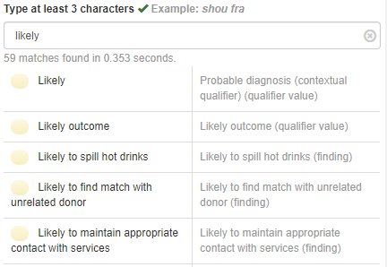
Likely
Term is used by ACMG
Because there is no quantitative definition of the term 'likely', the ACMG/AMP committee proposed “that the terms 'likely pathogenic' and 'likely benign' be used to mean greater than 90% certainty of a variant either being disease causing or benign to provide laboratories with a common, albeit arbitrary, definition
SNOMED

Slide 29
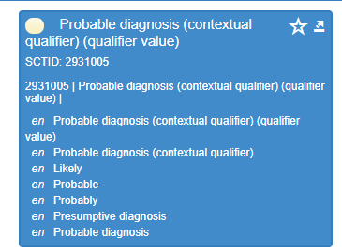

Slide 31
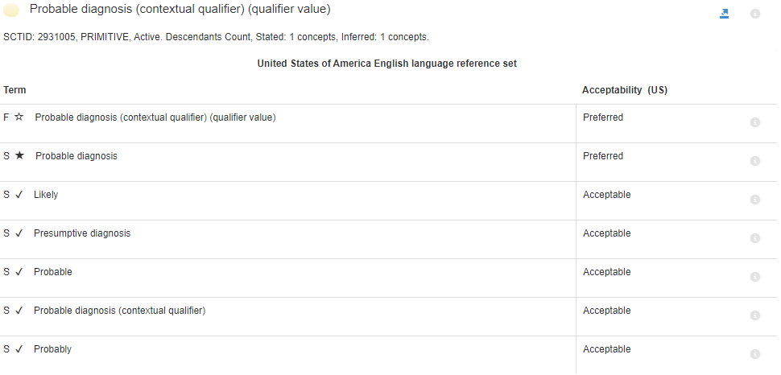

Slide 32
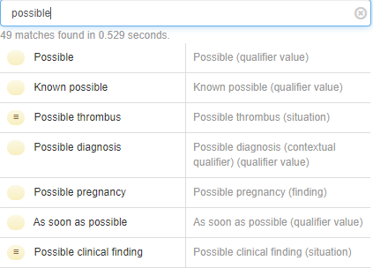
Possible
SNOMED modifier term

Slide 35
Discussion and next survey
We will continue to discuss the modifier terms
We will continue to engage ACMG, AMP, ClinGen, etc to establish terms acceptable to the genomics community.

